Slide 1
Phaco Machine
and Instruments
Michael Abendroth, MD, MBA

Slide 2
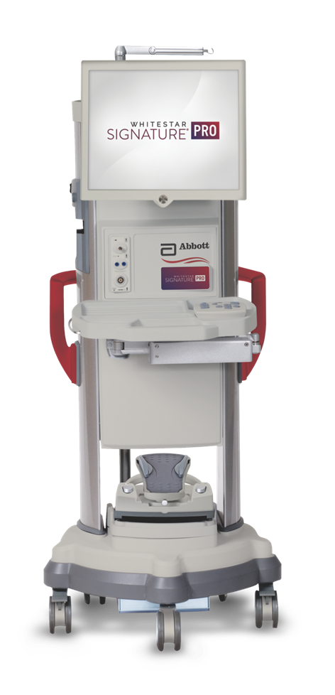
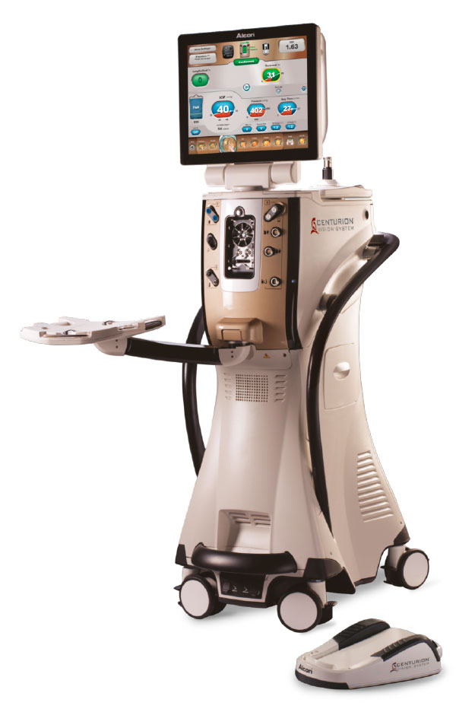
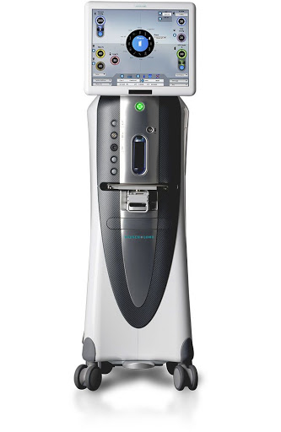
Phaco Machine
Alcon Centurion
B&L Stellaris Elite
J&J Whitestar Signature Pro

Slide 3
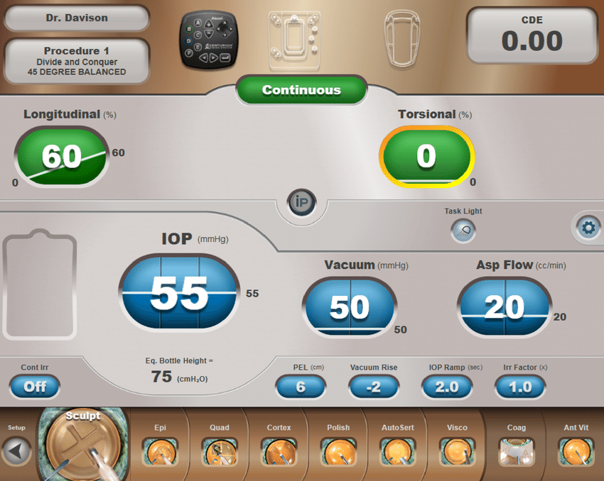
Phaco Screen
Surgeon
Cumulative Dissipated Energy
Procedure
Phaco Power
BSS Remaining
Bottle Height / IOP
Vacuum & Aspiration
Continuous Irrigation
Phaco Mode
Davison, James. 10.2147/OPTH.S90245

Slide 4
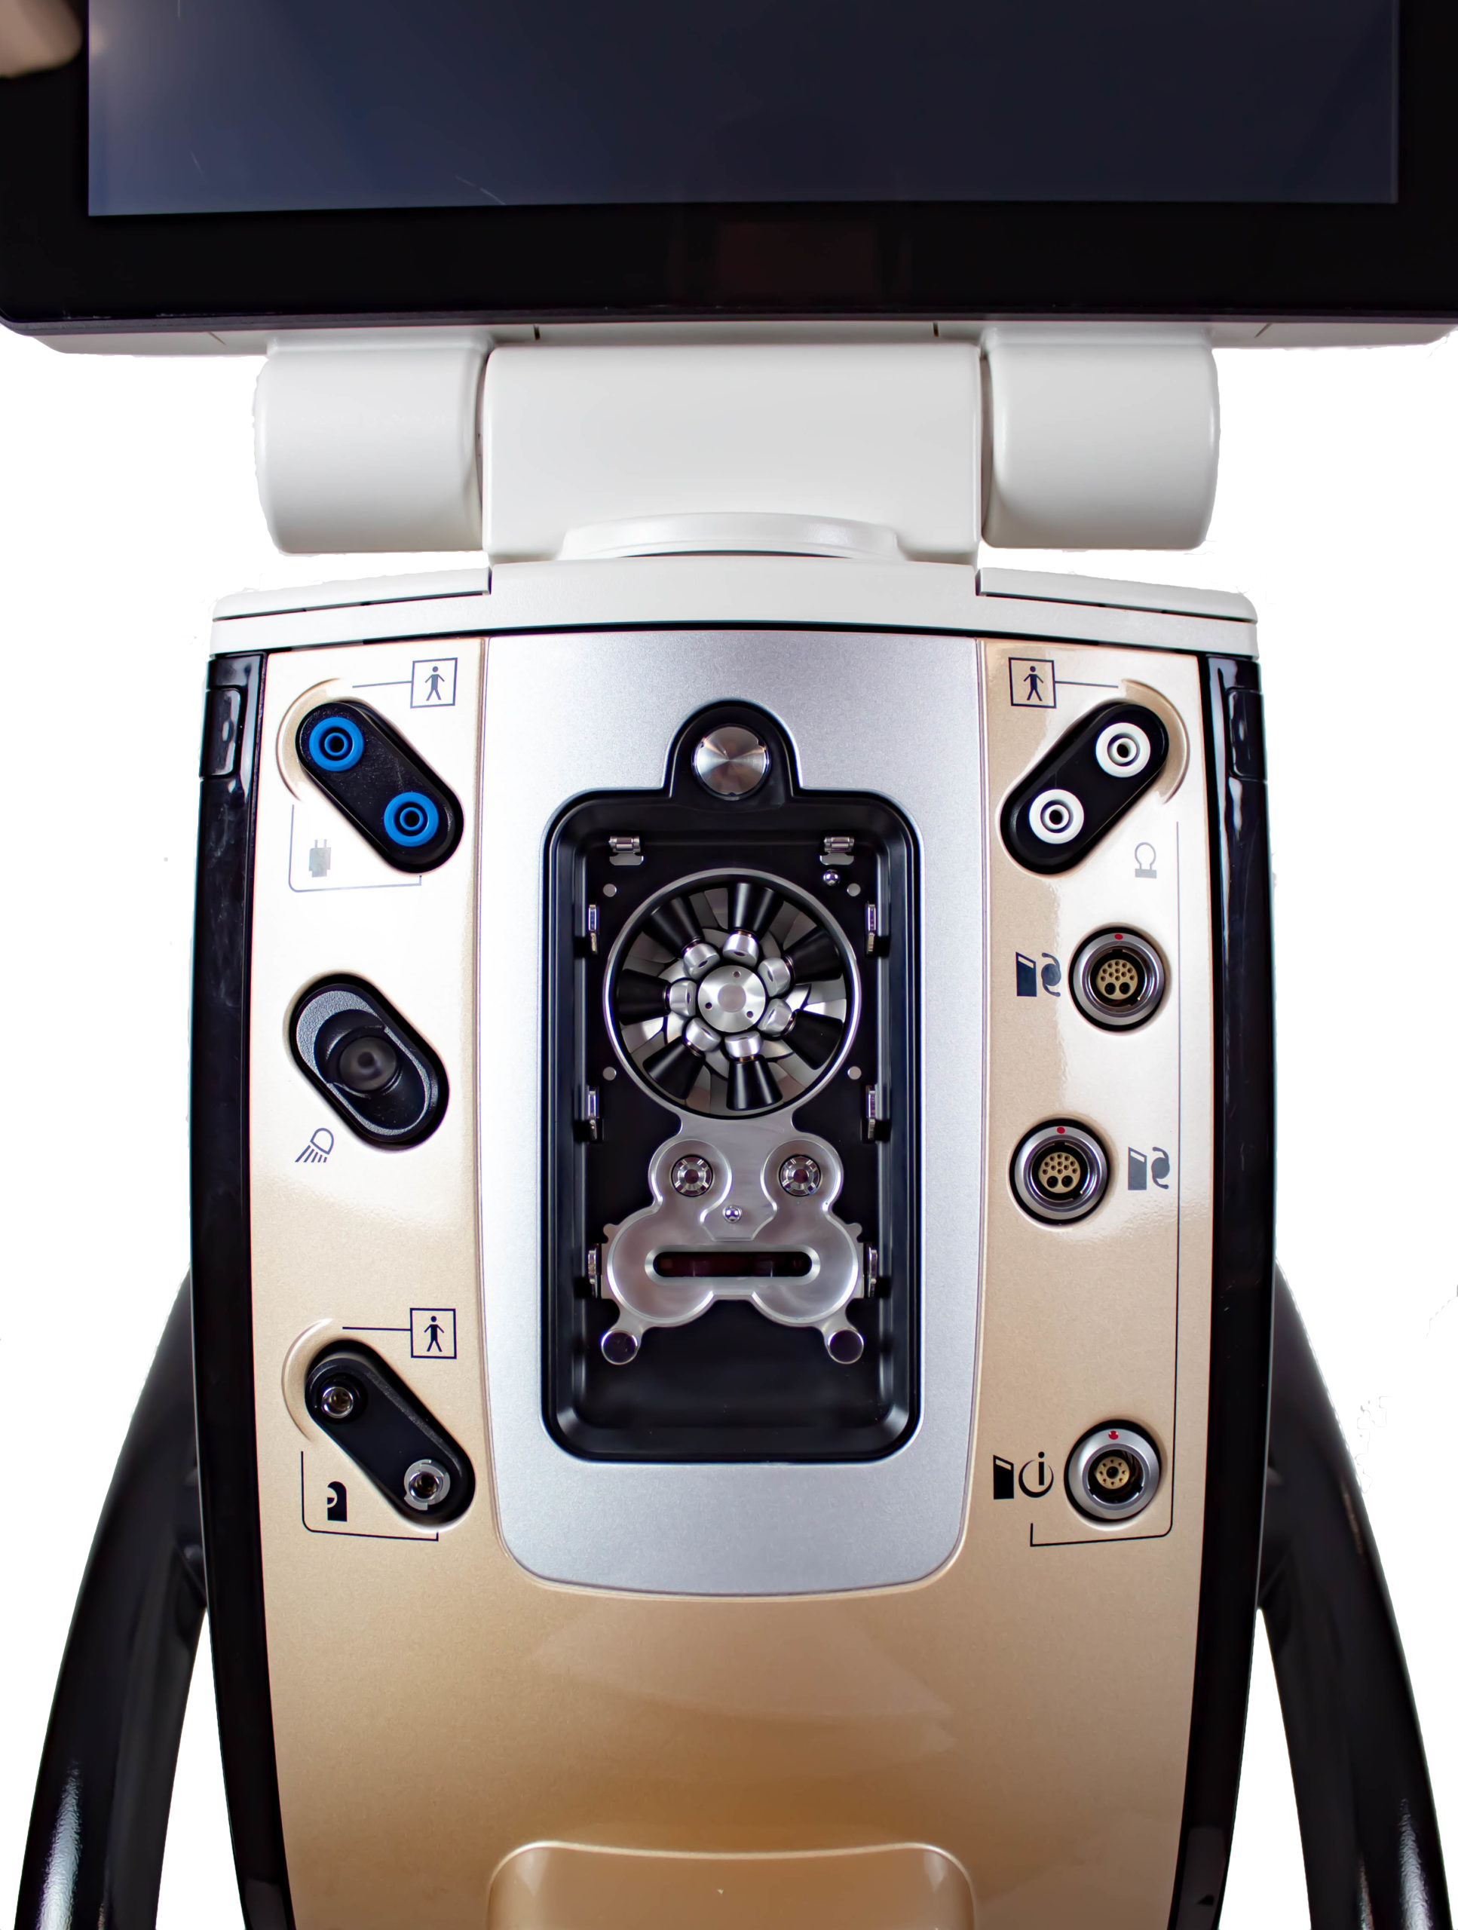
Phaco Base
Phaco Handpiece
Fluid Cassette
Vitrector
www.jodymyerseye.com

Slide 5
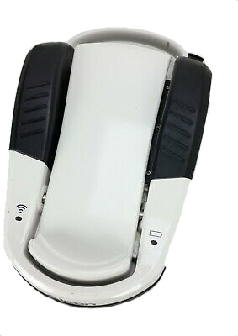
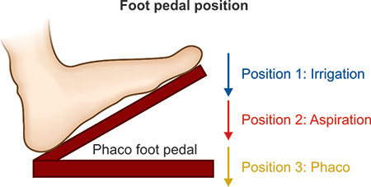
Phaco Foot Pedal
Dada, Tanuj. 9788184481792

Slide 6
Steps of Cataract Surgery
Paracentesis
Anesthetic and Viscoelastic
Main Wound
Capsulorrhexis
Hydrodissection +/- Hydrodelineation
Nuclear Disassembly
Cortex Removal
IOL Insertion
Viscoelastic Removal
Wound Hydration

Slide 7
Steps of Cataract Surgery
Paracentesis
Anesthetic and Viscoelastic
Main Wound
Capsulorrhexis
Hydrodissection +/- Hydrodelineation
Nuclear Disassembly
Cortex Removal
IOL Insertion
Viscoelastic Removal
Wound Hydration

Slide 8
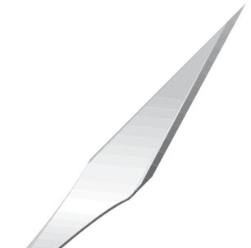
Paracentesis Blade
www.caliberophthalmics.com

Slide 9
Steps of Cataract Surgery
Paracentesis
Anesthetic and Viscoelastic
Main Wound
Capsulorrhexis
Hydrodissection +/- Hydrodelineation
Nuclear Disassembly
Cortex Removal
IOL Insertion
Viscoelastic Removal
Wound Hydration

Slide 10
Anesthetic and Viscoelastic
Lidocaine +/- Epinephrine
Dispersive Viscoelastic

Slide 11
Steps of Cataract Surgery
Paracentesis
Anesthetic and Viscoelastic
Main Wound
Capsulorrhexis
Hydrodissection +/- Hydrodelineation
Nuclear Disassembly
Cortex Removal
IOL Insertion
Viscoelastic Removal
Wound Hydration

Slide 12
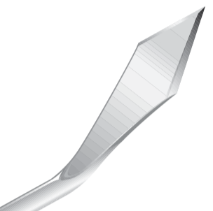
Keratome
www.caliberophthalmics.com

Slide 13
Steps of Cataract Surgery
Paracentesis
Anesthetic and Viscoelastic
Main Wound
Capsulorrhexis
Hydrodissection +/- Hydrodelineation
Nuclear Disassembly
Cortex Removal
IOL Insertion
Viscoelastic Removal
Wound Hydration

Slide 14
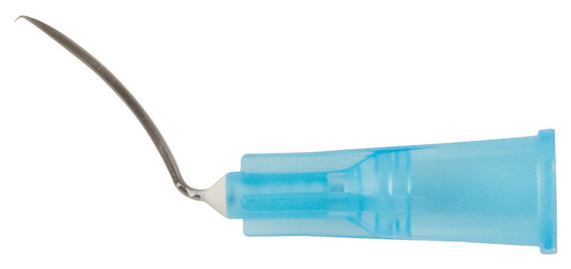
Cystotome and Utrata
www.storzeye.eu

Slide 15
Steps of Cataract Surgery
Paracentesis
Anesthetic and Viscoelastic
Main Wound
Capsulorrhexis
Hydrodissection +/- Hydrodelineation
Nuclear Disassembly
Cortex Removal
IOL Insertion
Viscoelastic Removal
Wound Hydration

Slide 16
Hydrodissection Cannula
Round Tip
Flat Tip
Chang
www.storzeye.eu

Slide 17
Steps of Cataract Surgery
Paracentesis
Anesthetic and Viscoelastic
Main Wound
Capsulorrhexis
Hydrodissection +/- Hydrodelineation
Nuclear Disassembly
Cortex Removal
IOL Insertion
Viscoelastic Removal
Wound Hydration

Slide 18
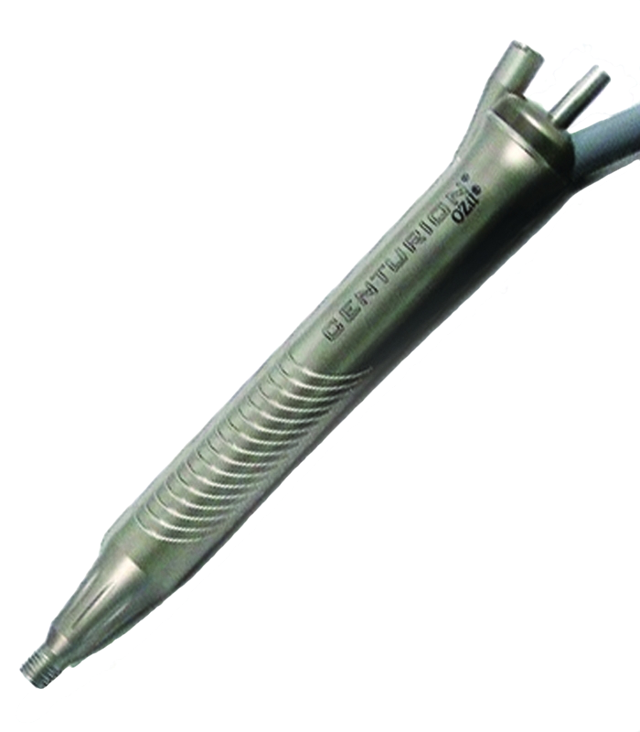
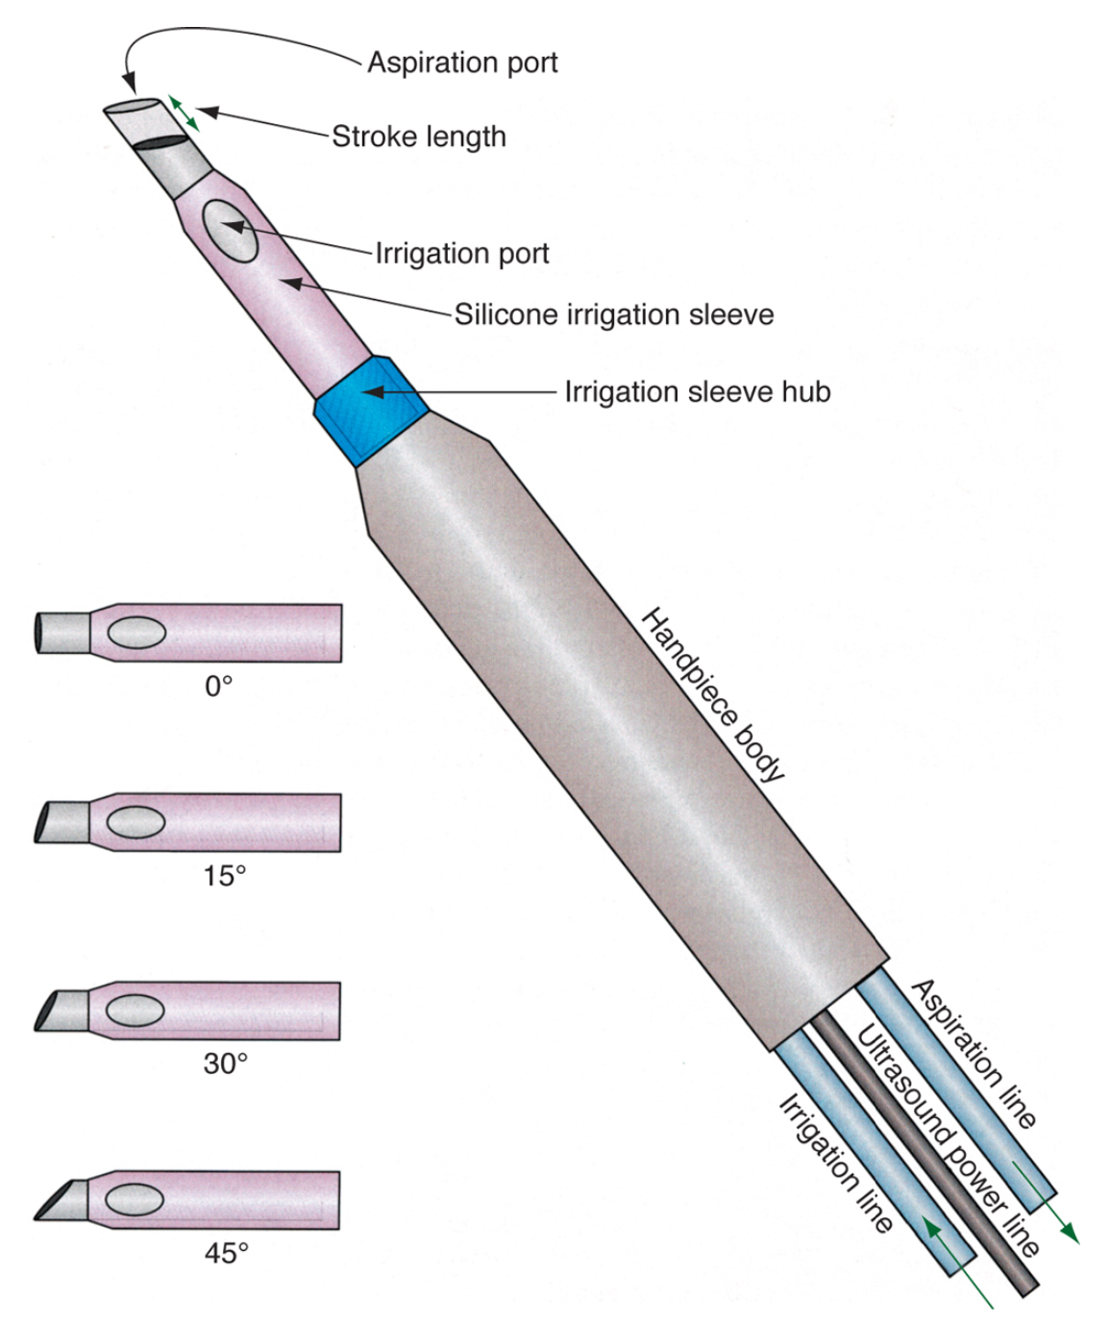
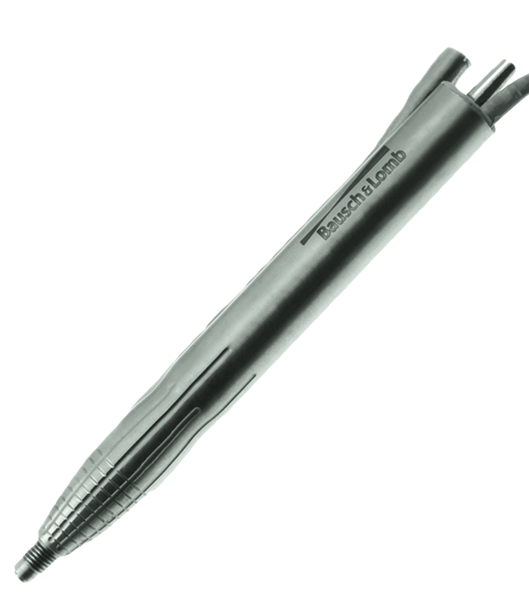
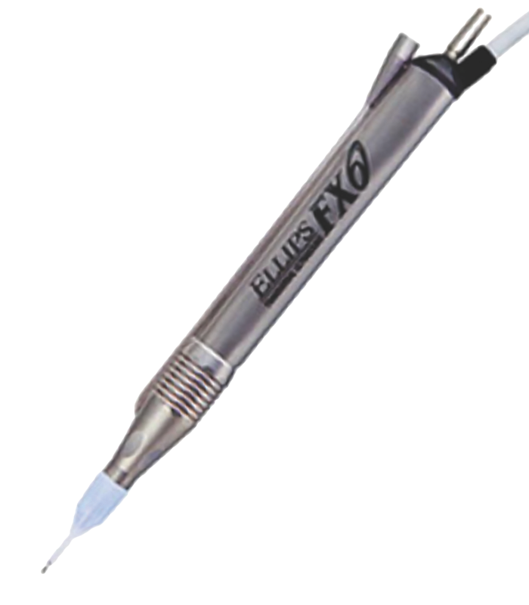
Phaco Handpiece
BCSC Volume 11: Lens and Cataract

Slide 19
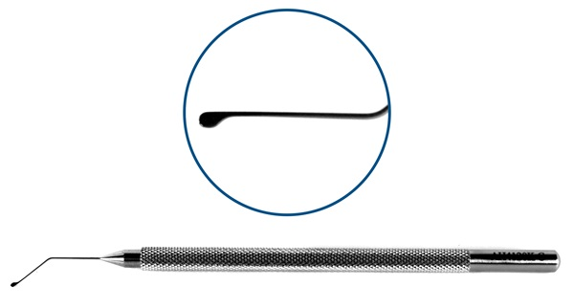
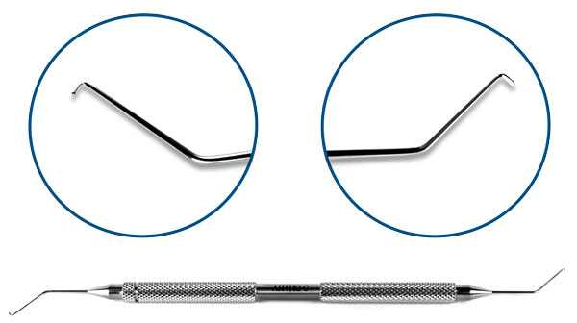
Second Instrument
www.microsurgical.com

Slide 20
Steps of Cataract Surgery
Paracentesis
Anesthetic and Viscoelastic
Main Wound
Capsulorrhexis
Hydrodissection +/- Hydrodelineation
Nuclear Disassembly
Cortex Removal
IOL Insertion
Viscoelastic Removal
Wound Hydration

Slide 21
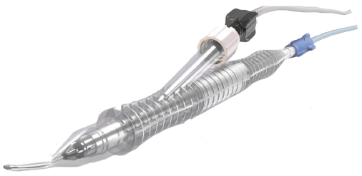
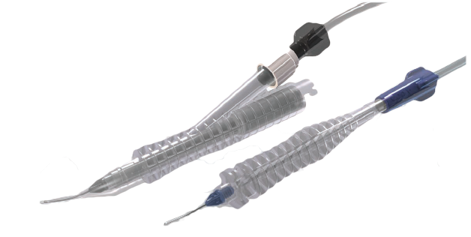
Irrigation/Aspiration Handpiece

Slide 22
Steps of Cataract Surgery
Paracentesis
Anesthetic and Viscoelastic
Main Wound
Capsulorrhexis
Hydrodissection +/- Hydrodelineation
Nuclear Disassembly
Cortex Removal
IOL Insertion
Viscoelastic Removal
Wound Hydration

Slide 23
Viscoelastic
Cohesive

Slide 24
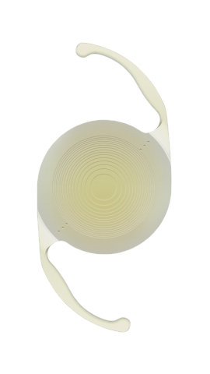
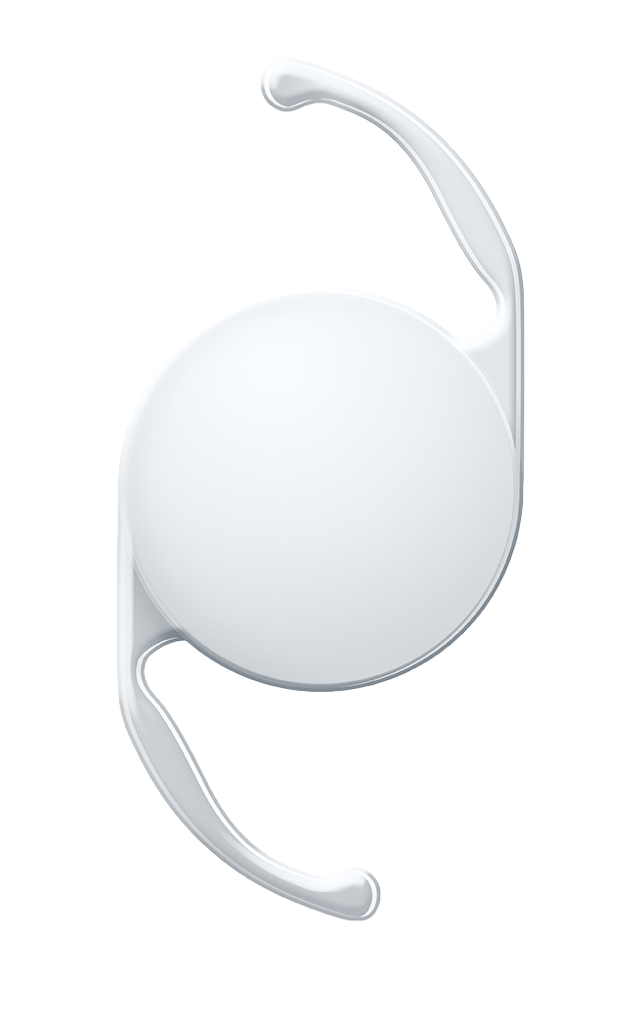
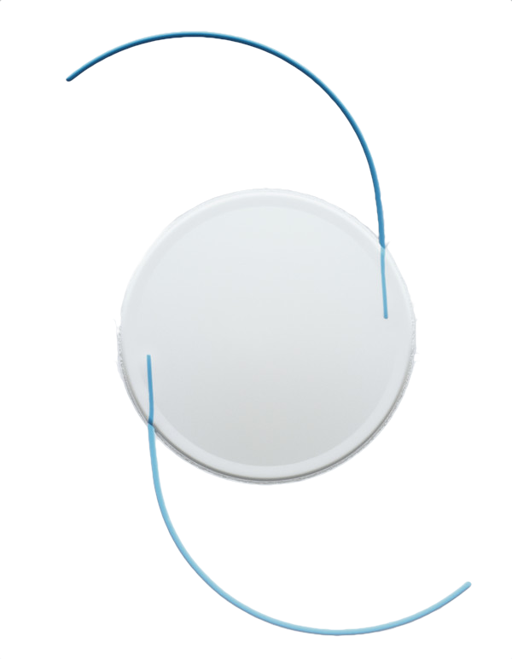
IOL and Injector
Monofocal
Multifocal Toric
Three-Piece
Anterior Chamber
www.prnewswire.com

Slide 25
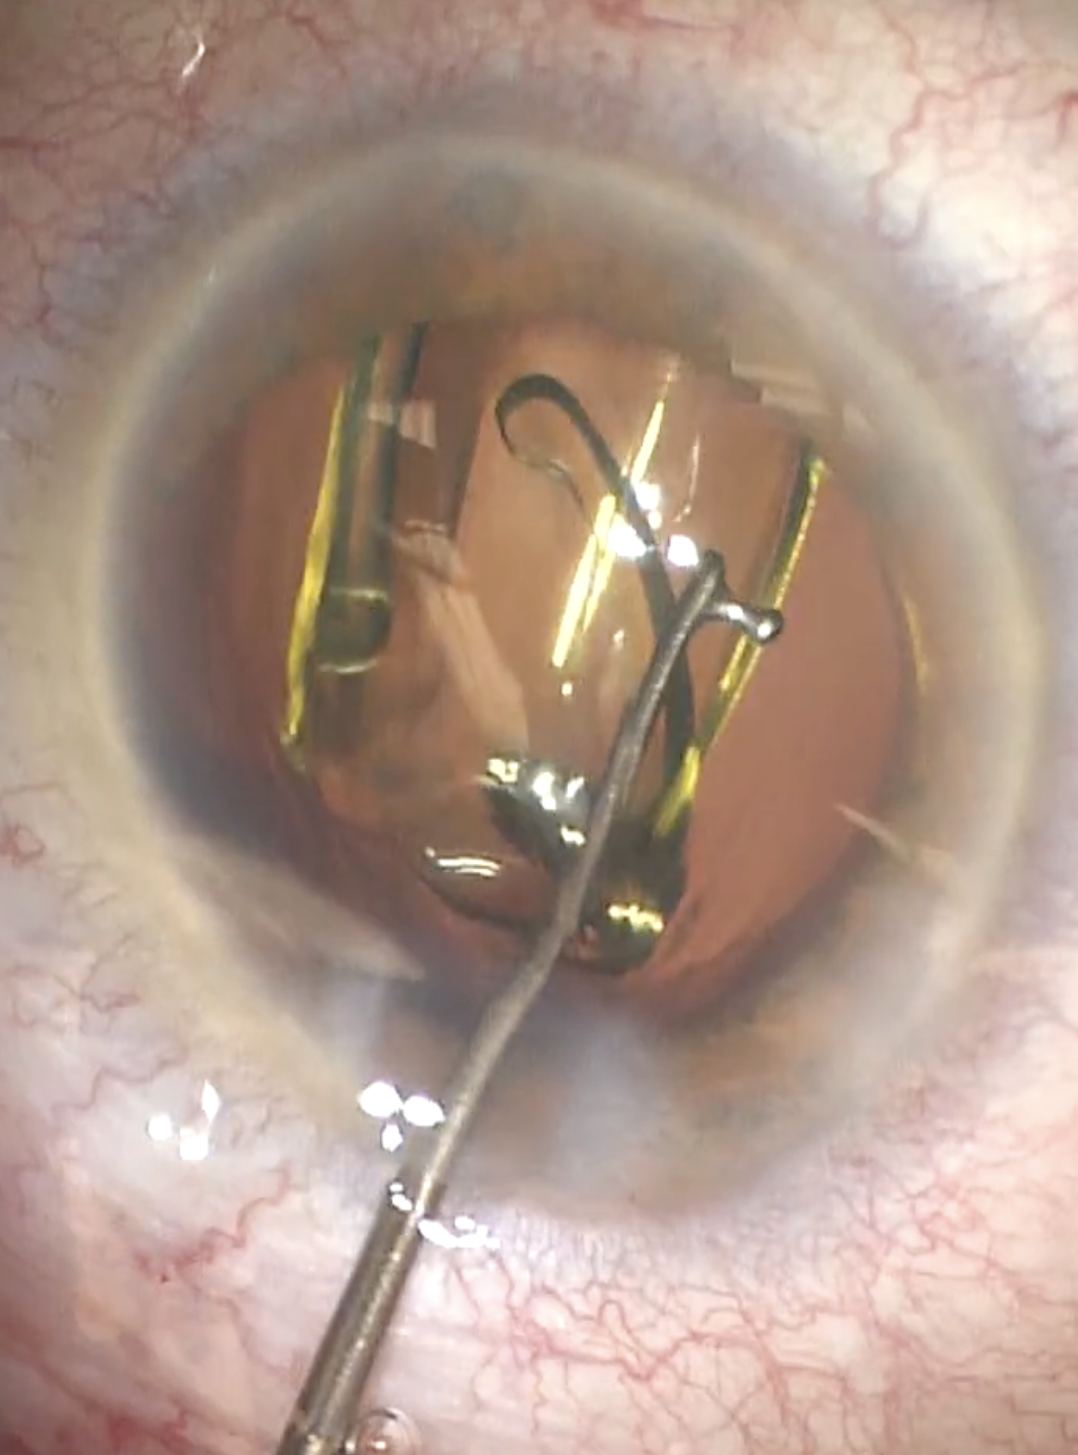
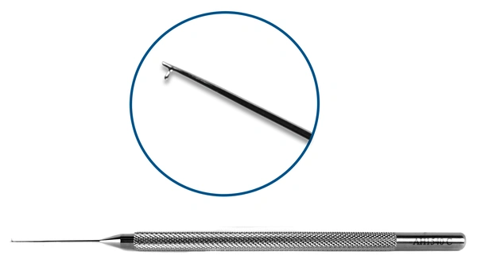
Lester Manipulator
www.accutome.com

Slide 26
Steps of Cataract Surgery
Paracentesis
Anesthetic and Viscoelastic
Main Wound
Capsulorrhexis
Hydrodissection +/- Hydrodelineation
Nuclear Disassembly
Cortex Removal
IOL Insertion
Viscoelastic Removal
Wound Hydration

Slide 27
Irrigation/Aspiration Handpiece
www.accutome.com

Slide 28
Steps of Cataract Surgery
Paracentesis
Anesthetic and Viscoelastic
Main Wound
Capsulorrhexis
Hydrodissection +/- Hydrodelineation
Nuclear Disassembly
Cortex Removal
IOL Insertion
Viscoelastic Removal
Wound Hydration

Slide 29
BSS Cannula and Weck-Cel
Round Tip
www.bvimedical.com

