Slide 1
Oculoplastic Suturing
Lecture
Alison Watson, MD

Slide 2
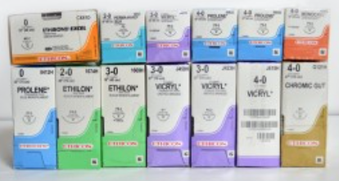
Suture Types
Three primary characteristics:
Absorbable vs. permanent
Monofilament vs. multifilament
Natural vs. synthetic vs. metal wire
Absorbable Suture
Gut (fast-absorbing, plain, or chromic
Monocryl
PDS (polydioxanone suture)
Vicryl
Permanent Suture
Nylon
Polyester
Prolene
Stainless steel

Slide 3
Needle Types
Three primary characteristics:
Size
Shape ($1/2$, $3/8$, or $1/4$ circle)
Point
Blunt
Triangular
Taper
Reverse cutting
Conventional cutting

Slide 4
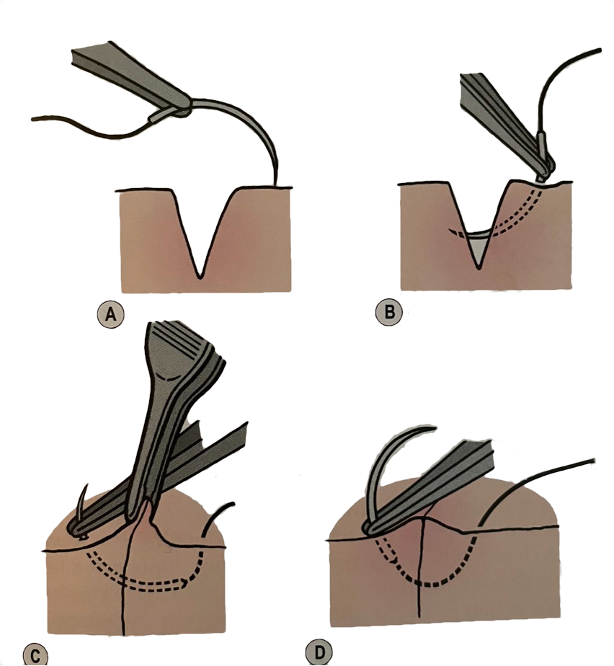
Suturing Technique
Control the tissue
Pass the needle perpendicular to the skin
Needle should leave and enter the wound edges at the same depth
When adequately advanced, reload prior to removing from the tissue
Avoid grabbing the needle tip

Slide 5
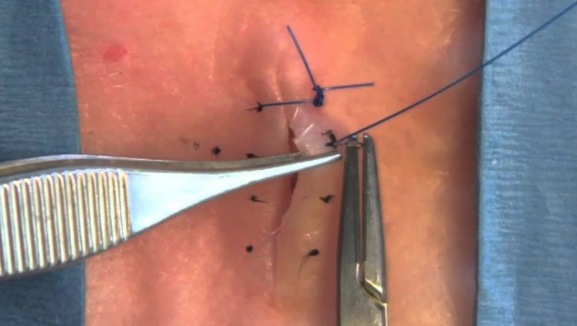
Superficial and Deep Sutures
Buried Sutures
Close dead space
Reduce wound tension
Improve wound stability
Utilize to anchor flaps
Superficial Sutures
Interrupted or running technique
Employ techniques to optimize tissue alignment
May divide a wound to avoid dog ear formation
Subcuticular runs in and out of the wound layers, parallel to incisions
Interrupted vertical mattress technique for optimal alignment and eversion
Nerad, Jeffrey. Techniques in Ophthalmic Plastic Surgery. ISBN: 9780323393188

Slide 6
Superficial and Deep Sutures

Slide 7
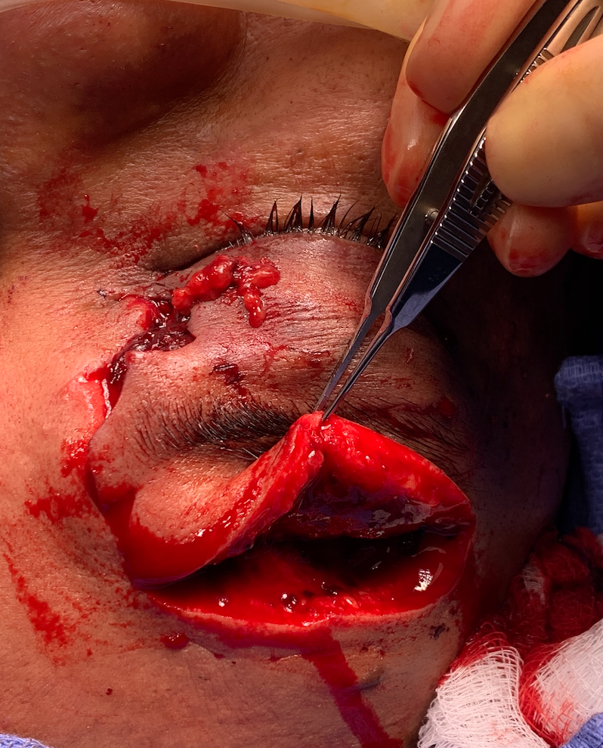
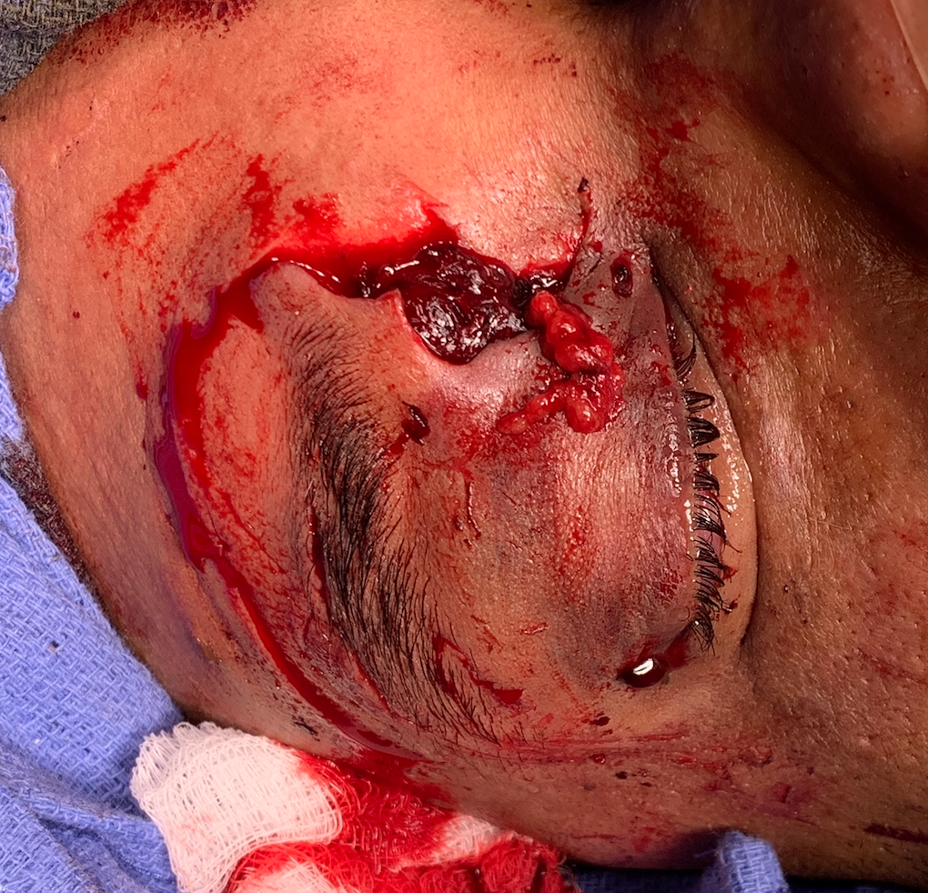

Slide 8
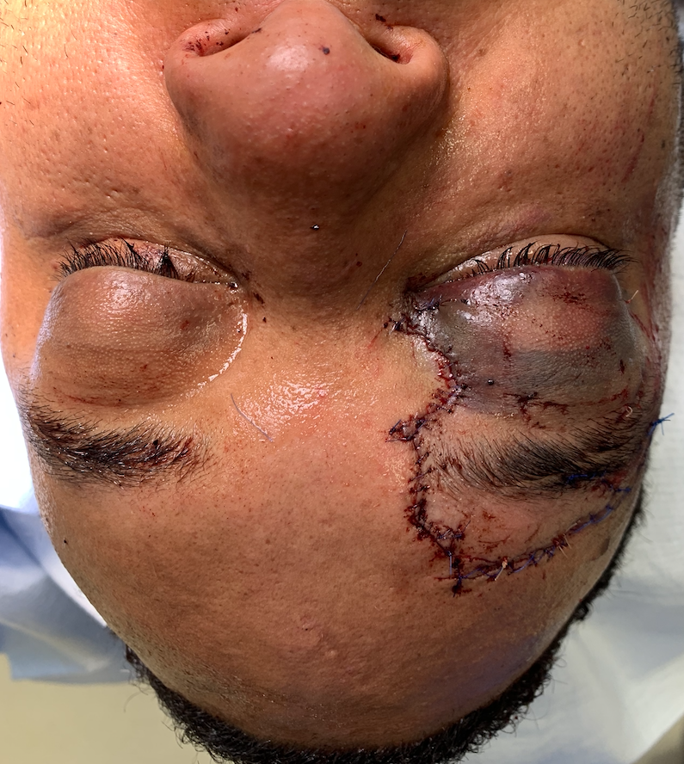
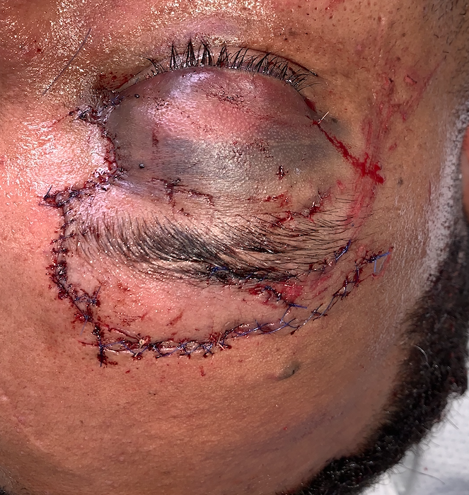
1
4
2
3

