Slide 1
Cornea Office Procedures
Christopher J. Rapuano, MD

Slide 2
Office Procedures
Office procedures are “real” surgeries
All require informing patient of what you’re doing and why
Most /all require written informed consent
Most require topical anesthesia
Most require post-op topical antibiotics
Most require frequent follow-up until epithelium has healed

Slide 3



Suture Removal
Place numbing and antibiotic drops
Using a Tb needle, cut the suture ~$1/3$ of the way from the knot
Using the Tb needle, lift both sides of the suture
Using jeweler’s forceps, grab the suture end near the knot and pull
  If the suture breaks, grab the other end and pull
If it breaks, pull here 2nd
Cut here
Lift both ends
Pull here 1st

Slide 4
Diamond Burr Polishing
Indications
  Recurrent corneal erosions, especially when central or diffuse
  Visually significant EBMD, including when affecting biometry prior to CE
Place numbing drops, antibiotic drops, and eyelid speculum
Remove all epithelium & irregular basement membrane with a semi-sharp Tooke knife and occ a #15 blade (VERY carefully)

Slide 5
Diamond Burr Polishing
Apply diamond burr for ~10 seconds
  Uniformly over entire cornea, only in one direction (e.g. vertically)
Place a BSCL (loose fitting, e.g. BC 8.8 mm)
Check at slit lamp
Place antibiotic drops
Assure adequate pain control instructions and meds post-op

Slide 6
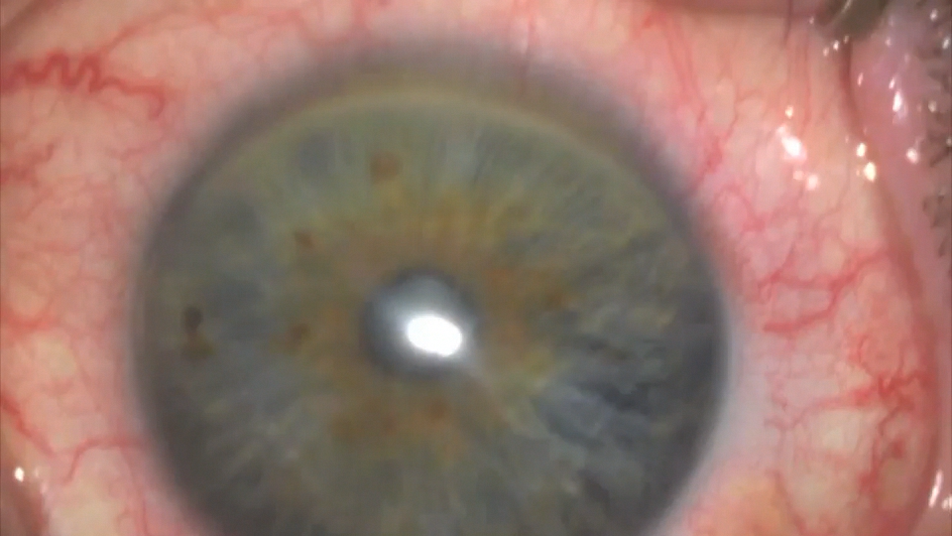

Slide 7
Anterior Stromal Puncture
Indications
  Recurrent corneal erosions outside the visual axis
  Usually post-traumatic, unilateral
Place numbing drops, antibiotic drops, and eyelid speculum
Make SURE patient’s forehead is up against the slit lamp band during the ENTIRE procedure

Slide 8
Anterior Stromal Puncture
Using a 23-25 g needle, place partial thickness (~25%), closely spaced punctures in area of erosion and ~1 mm into “normal” epithelium
Place a BSCL (loose fitting, e.g. BC 8.8 mm)
Check at slit lamp
Place antibiotic drops
Assure adequate pain control instructions and meds post-op

Slide 9
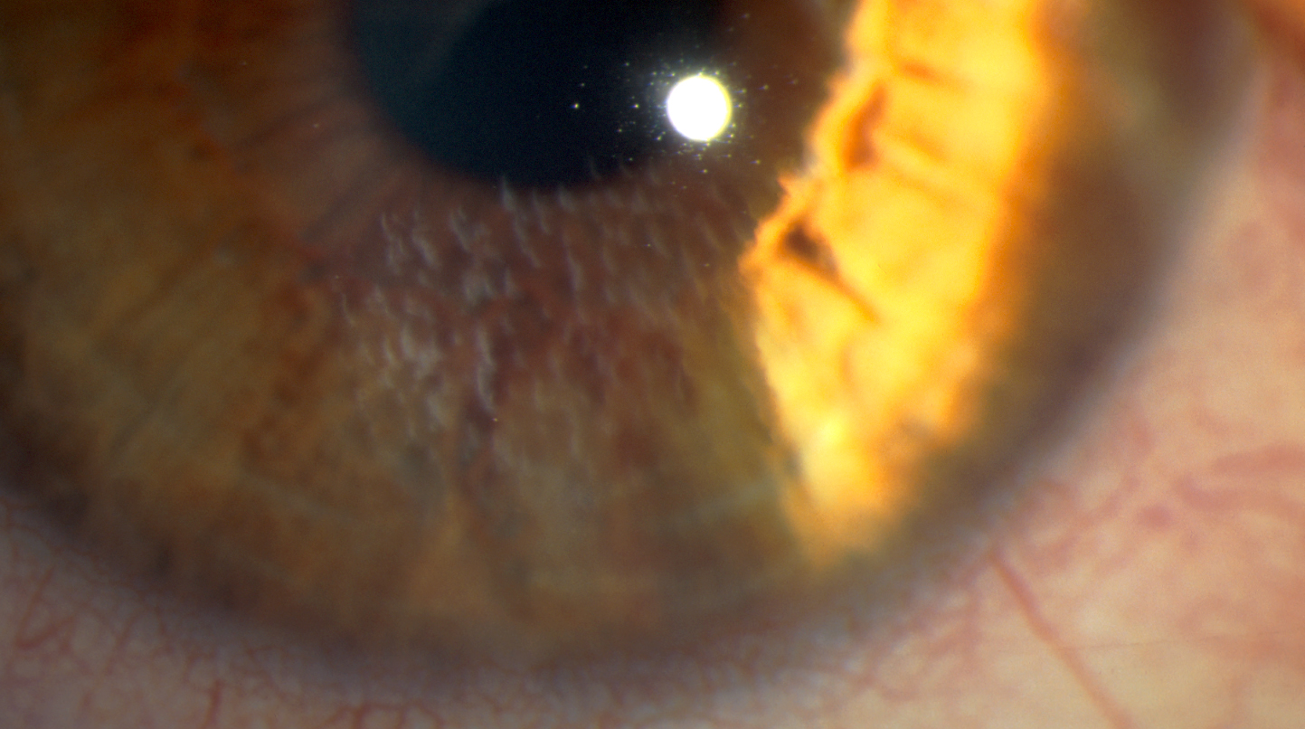

Slide 10
Corneal Gluing
Best for divots, not bulging lesions
Best for lesions not near the limbus, as glue doesn’t stick well to conjunctiva
Can be used for very thin or frankly perforated ulcers
Best for small (1-2 mm) perforations
Usually done under a microscope, but can be done at the slit lamp
Most liquid polymerizes (solidifies) glue, but NOT silicone oil

Slide 11
Corneal Gluing – Preparation
Make sure you have everything before starting the procedure
  Numbing drops, antibiotic drops, and eyelid speculum
  Cyanoacrylate tissue glue
  Some type of applicator (e.g. micropipette)
  #15 blade
  Weckcell sponges
  BSCL

Slide 12
Corneal Gluing – Procedure
Carefully place the eyelid speculum
Remove epithelium/mucus from where you want glue to adhere
Dry area to be glued
Place a small amount of glue, just enough to cover the perforation or fill the bottom of the divot
“Less is better”
Resist temptation to add more glue unless still leaking
Allow glue to polymerize on its own

Slide 13
Corneal Gluing – Procedure
DO NOT TOUCH glue with the Weckcell sponge
Once polymerized, you can place a drop of anesthetic on the glue to be 100% certain
Place a BSCL
Check at slit lamp
If AC was shallow, check at slit lamp in ~30 minutes to make sure it is reforming

Slide 14


Slide 15
Epithelium-Off Corneal Crosslinking
Epithelial debridement with a Tooke knife
Place riboflavin drops every 2 minutes for 30 minutes
Check penetration of riboflavin into cornea and AC
Check corneal thickness
If less than 400 microns, place hypotonic riboflavin drops every 5-10 seconds until thickness reaches 400 microns (~4-20 minutes)
Apply UV-A light for 30 minutes
Place a BSCL and antibiotic drops

Slide 16
EDTA Chelation
Place numbing drops, antibiotic drops, and eyelid speculum
Perform epithelial debridement over ENTIRE area of band K
Place 3% EDTA to dissolve calcium for 5-60 minutes
  Can use a corneal sponge, shaved Weckcell, or plastic well
When dissolved, rinse EDTA
Place a BSCL and antibiotic drops

Slide 17
AMT Placement in the Office – ProKera
ProKera
  While still in its plastic container, rinse off glycerin solution
  Carefully place ProKera in the eye (it is VERY slippery; do not drop it)
    Usually easiest to place under upper eyelid first
  Check at slit lamp to make sure in good position
  Place a temporary Tegaderm tarsorrhaphy
  Put sticker on slit lamp drawing sheet

Slide 18
AMT Placement in the Office – Under a BSCL
Dried AM under a BSCL
  Place eyelid speculum
  Open BSCL
  Carefully remove AM “wafer” from its package with forceps
  Place AM on dry corneal surface with forceps
    Needs to be fairly quickly as the heat & moisture of the cornea will curl the AM, making placement difficult
  Quickly place the BSCL over the AM and carefully remove BSCL
  Put AM and BSCL stickers on slit lamp drawing sheet

Slide 19
Punctal Plugs
At slit lamp, estimate size of punctum and select size of plug
  The bigger the plug that you can get into the punctum, the longer that it is likely to stay in
  Err on the side of attempting to place a larger plug
Dilate the punctum fairly aggressively
Quickly place the punctal plug
Put the punctal plug sticker on the slit lamp drawing sheet

