Slide 1
Biometry and Topography
Aditya Kanesa-thasan, MD

Slide 2
Outline
Overview of biometry
Methods of biometry
IOL calculation formulas
Special cases
Addressing astigmatism
Corneal topography

Slide 3
Overview of Biometry

Slide 4
What is Biometry?
Biometry is measurement of the eye with the goal of determining the proper IOL power
Each biometer obtains a standard set of data for this purpose
The concept of biometry has expanded to include preoperative topography, aberrometry, and OCT of the retina to help build a surgical plan

Slide 5
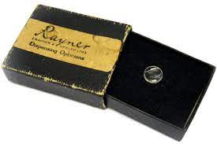
History of Biometry
When Sir Harold Ridley implanted the first IOLs, there were no IOL calculations
The first patient reportedly had a post-operative refraction of about -20D
In today’s environment, we have many IOLs available and a much higher bar for refractive outcomes following cataract surgery

Slide 6
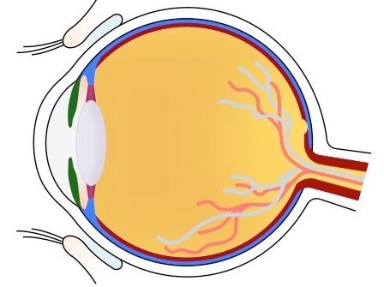
What is Captured?
WTW (White-to-White)
ACD (AC Depth)
AL (Axial Length)
AD (Aqueous Depth)
LT (Lens Thickness)
CCT (Central Corneal Thickness)

Slide 7
What is Captured?
Keratometry (flat and steep K)
AL (Axial Length)
ACD (AC Depth)
LT (Lens Thickness)
WTW (White-to-White)
CCT (Central Corneal Thickness)

Slide 8
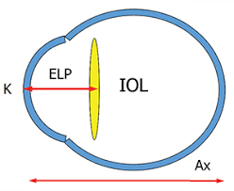
Effective Lens Position
The ultimate goal is to predict the Effective Lens Position (ELP), where the IOL will sit in the capsular bag
You can think of this as the post-operative ACD
The position of the IOL affects its refractive power

Slide 9
Methods of Biometry

Slide 10
A-Scan Biometry
Previously, contact A-scan ultrasound was the gold standard
An ultrasound probe is placed on the cornea, and peaks are read for the distances from the probe
Sources of error included variable amount of pressure from the probe and variable angle of contact
Immersion A-scan biometry uses a scleral shell to submerge the eye in water so the probe does not contact the eye

Slide 11
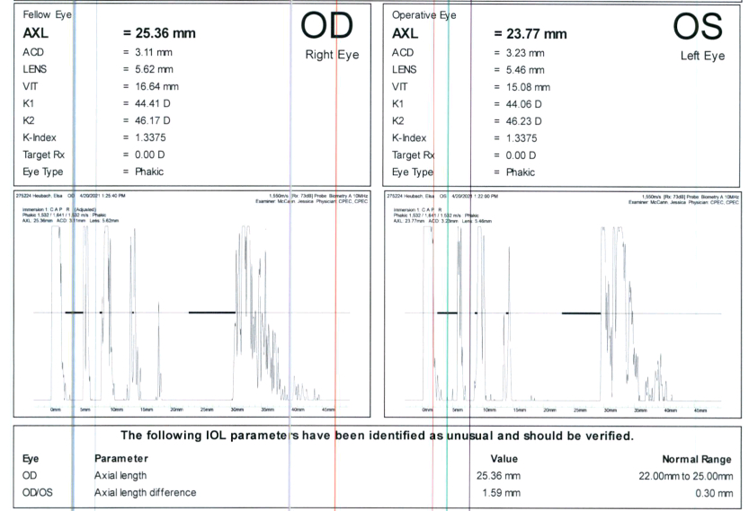
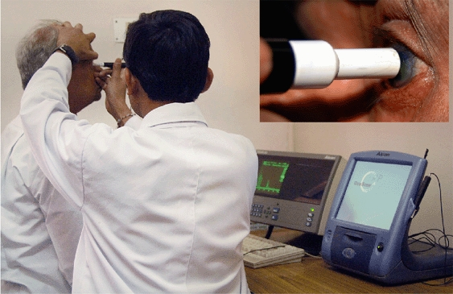
A-Scan Biometry

Slide 12
Optical Biometry
Currently, most ophthalmologists use optical biometry, which is far more accurate and repeatable for measurements
Using light instead of sound allows the patient to fixate directly on a stimulus, ensuring the measurement is axial with the macula
Many measurements can be collected with tight standard deviations

Slide 13
Optical Biometry
There are a few major machines used currently:
Zeiss IOL Master 500
Zeiss IOL Master 700 (uses swept source OCT)
Haag-Streit Lenstar LS900
Nidek AL-Scan
Topcon Aladdin
Oculus Pentacam AXL

Slide 14
IOL Calculation Formulas

Slide 15
IOL Calculation Formulas
One of the earliest IOL calculation formulas was the SRK:
IOL power = A – 0.9K – 2.5AL
Many other formulas have been developed and tested over the years, and for many years none were superior for all eyes
Recent research has shown some of the newest formulas to be very accurate for all types of eyes
Still, only about 70-88% of eyes reach +/- 0.5D of the aim in best case scenarios

Slide 16
IOL Calculation Formulas
Published in October 2016
Between Barrett Universal II, Holladay I, Hoffer Q, SRK/T, T2, Haigis, and Holladay 2, Barrett Universal II had lowest mean error over the entire axial length range, particularly in higher myopes

Slide 17
IOL Calculation Formulas
Published in September 2017
Compared a large set of formulas and graphed accuracy based on axial length, keratometry, and ACD
Barrett Universal II was the best performing formula

Slide 18
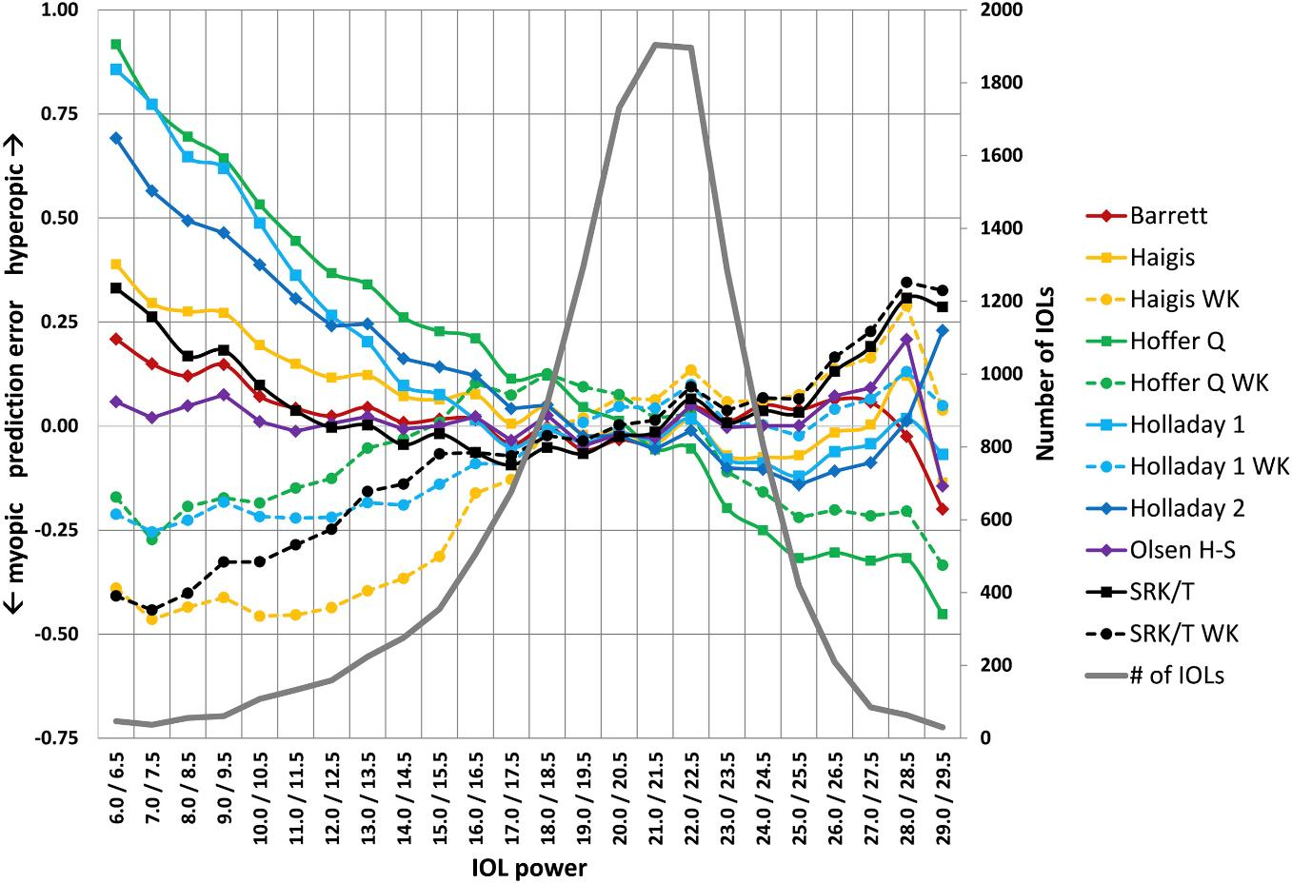
IOL Calculation Formulas
Barrett U2
Melles et al. Accuracy of Intraocular Lens Calculation Formulas.

Slide 19
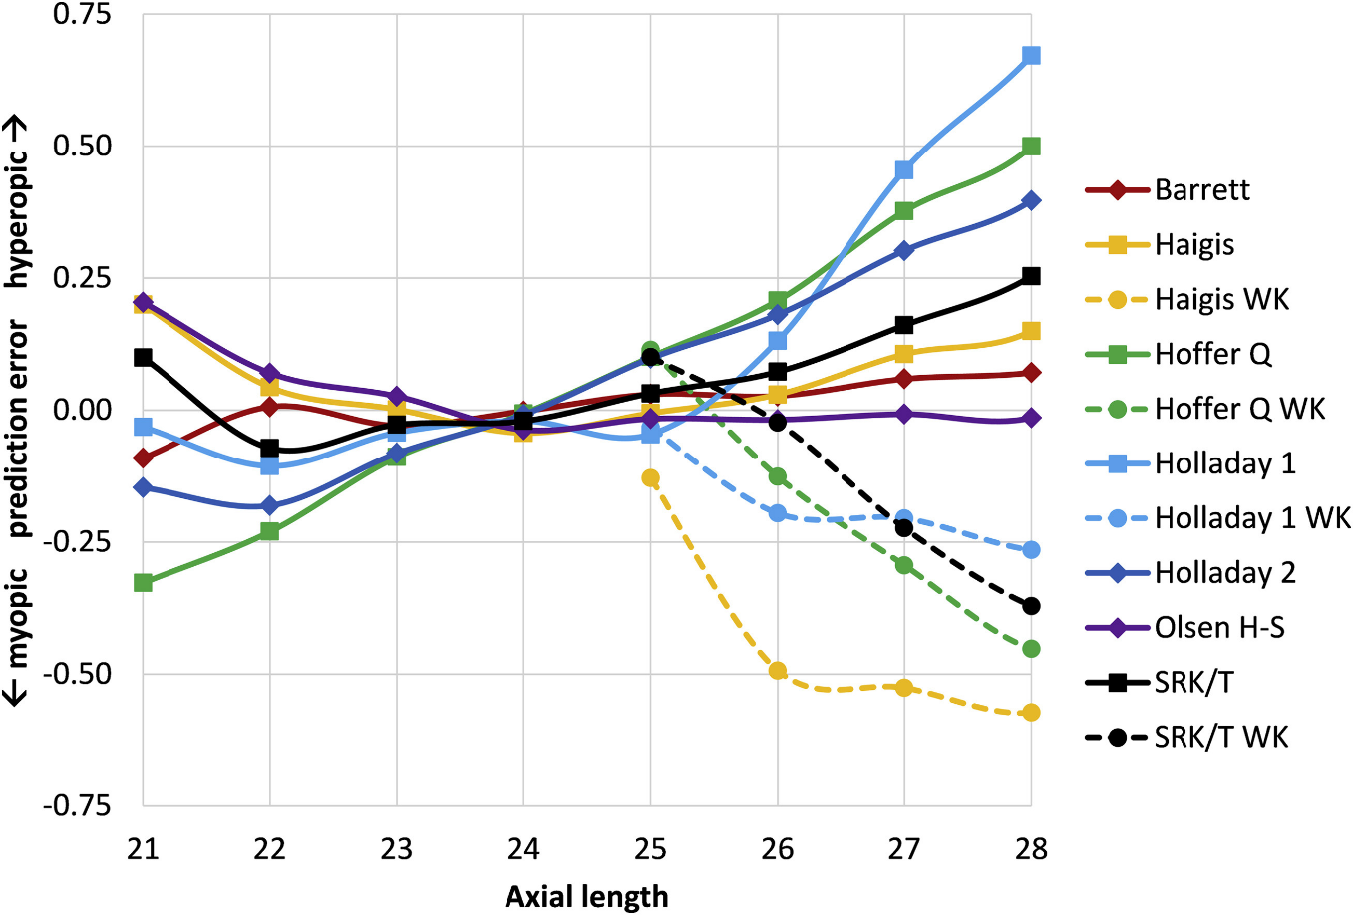
IOL Calculation Formulas
Barrett U2
Melles et al. Accuracy of Intraocular Lens Calculation Formulas.

Slide 20
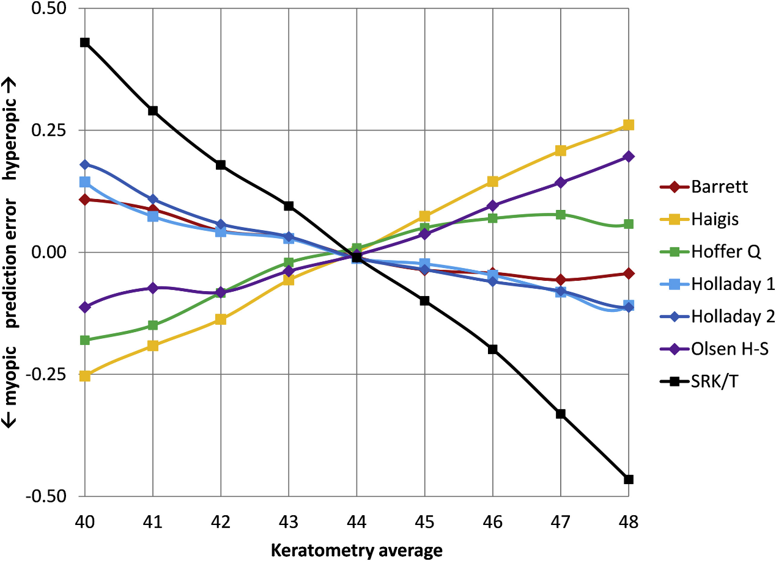
IOL Calculation Formulas
Barrett U2
Melles et al. Accuracy of Intraocular Lens Calculation Formulas.

Slide 21
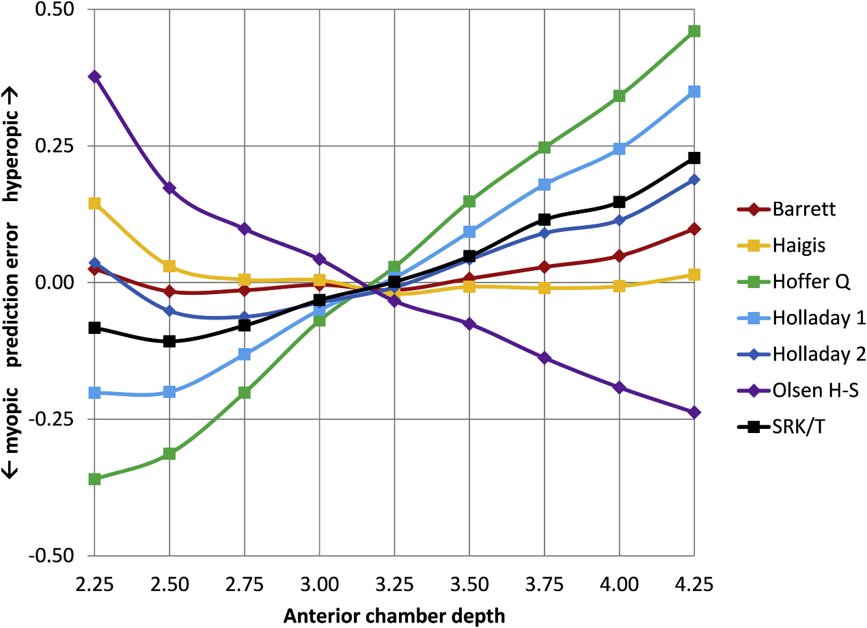
IOL Calculation Formulas
Barrett U2
Melles et al. Accuracy of Intraocular Lens Calculation Formulas.

Slide 22
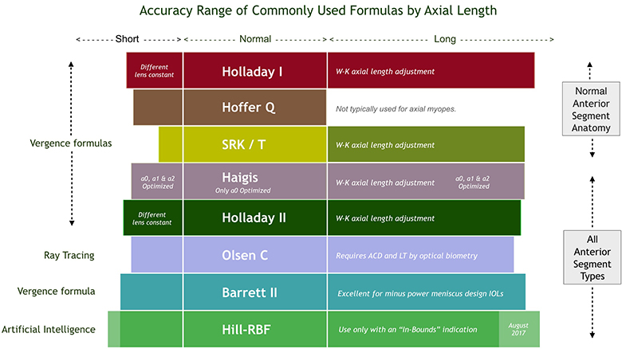
IOL Calculation Formulas
doctor-hill.com (Warren Hill, MD)

Slide 23
IOL Calculation Formulas
Published in January 2020, included 10,930 patients
Compared Kane, Hill-RBF 2.0, Holladay 2, Barrett U2, Olsen, Haigis, Holladay 1, Hoffer Q, and SRK/T for lowest absolute error
Kane had the most eyes within 0.5D (72%), followed by Hill-RBF (71.2%), Holladay 2 (71%), and Barrett U2 (70.7%)

Slide 24
IOL Calculation Formulas
Published in April 2021
The lowest absolute median error was achieved by the Kane formula (0.214), Hill-RBF 2.0 (0.215), and Barrett Universal II (0.218), followed by SRK/T (0.223)

Slide 25
IOL Calculation Formulas
Published in May 2021
Hill-RBF 3.0 showed an improvement over 2.0 with decreased mean errors compared to older formulas, but not clearly superior to other modern formulas

Slide 26
IOL Calculation Formulas
In the 2021 cataract surgery landscape, the evidence support the fact that you should only need to use a few formulas:
Barrett Universal
Hill-RBF 3.0
Kane Formula
All are readily available online and built into some biometers

Slide 27
Barrett Universal II
Evolved from Barrett Universal I, which was developed by Dr. Graham Barrett in 1987
Based on ray tracing
The formula itself is unpublished
Uses AL, K, and ACD. LT and WTW can be added optionally for higher accuracy

Slide 28
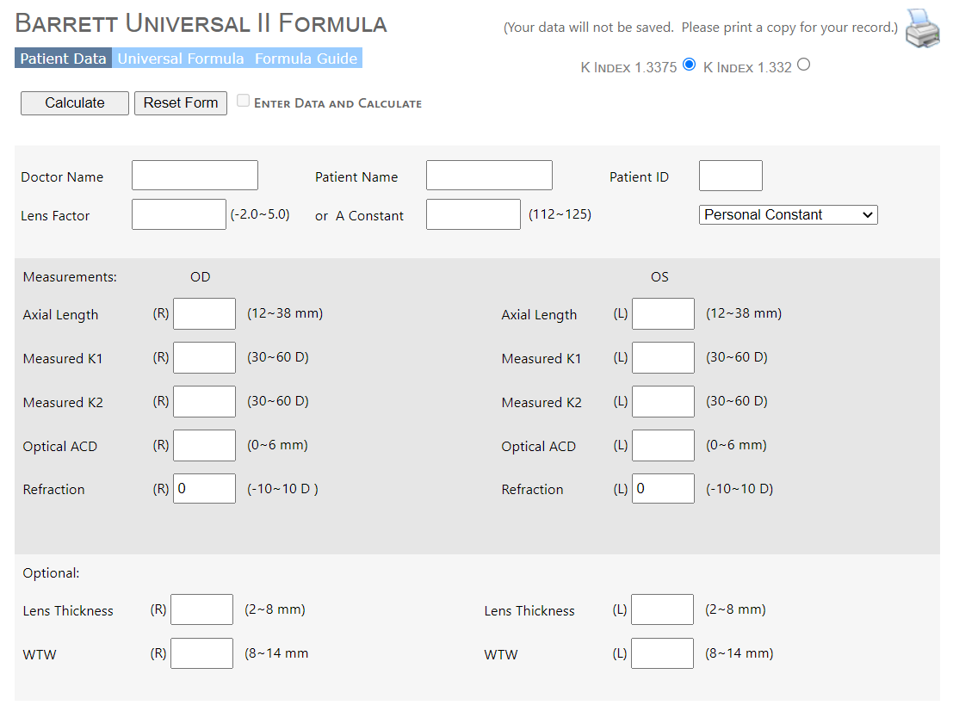
Barrett Universal II Calculator

Slide 29
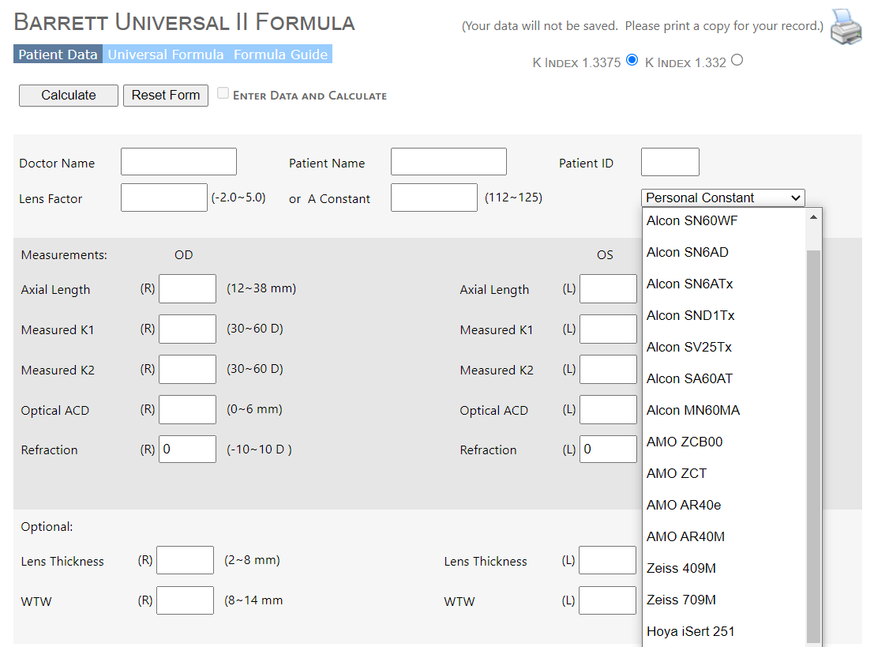
Barrett Universal II Calculator

Slide 30
Hill-RBF 3.0
Initially developed as Hill-RBF 1.0, then expanded to 2.0 then 3.0 after additional datasets were added to expand the boundaries
Based on artificial intelligence regression using a radial basis function (RBF)
The formula itself is unpublished
Uses AL, K, and ACD. Gender, LT, CCT, and WTW can be added optionally

Slide 31
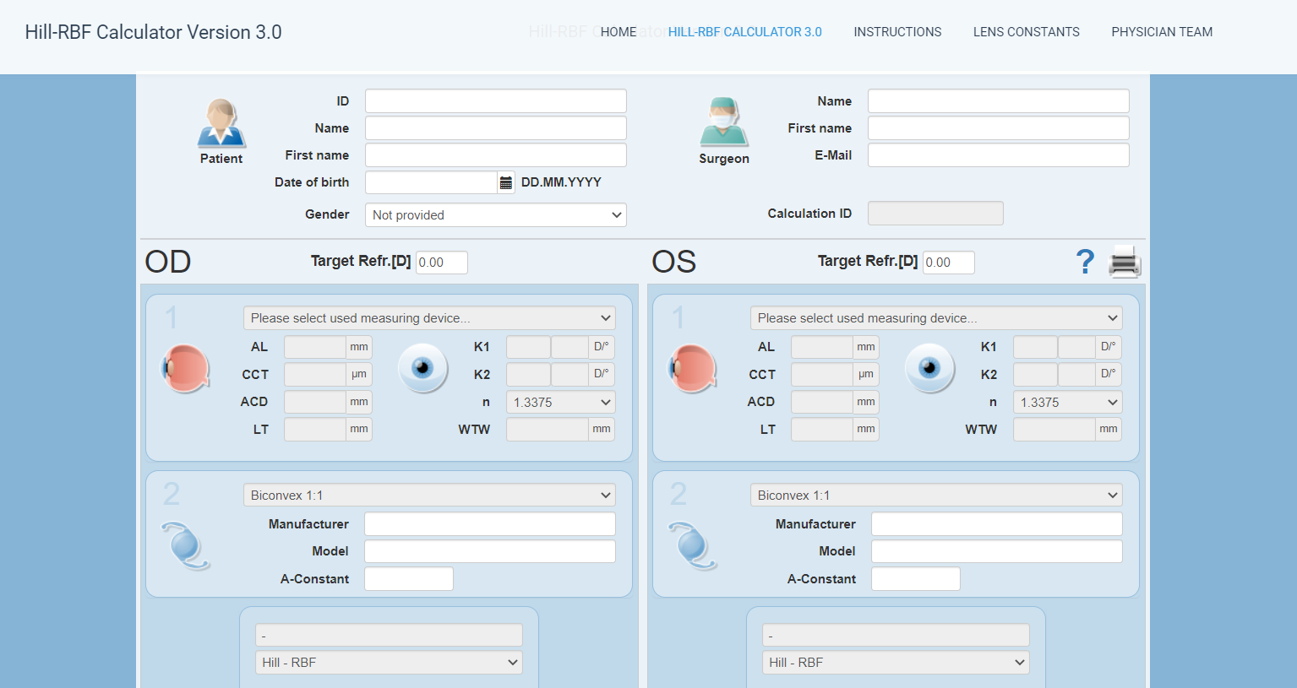
Hill-RBF 3.0 Calculator

Slide 32
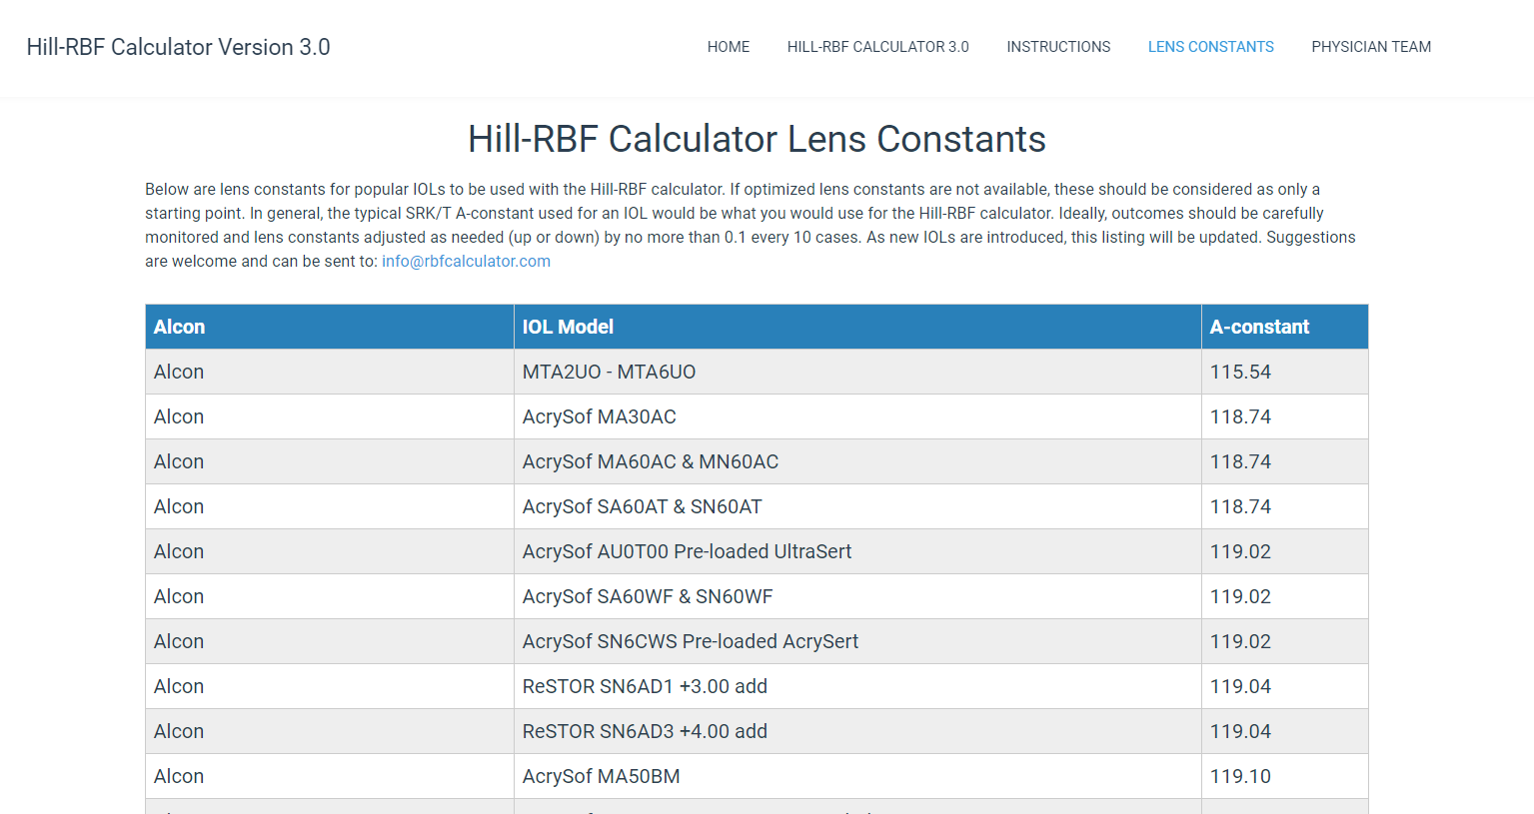
Hill-RBF 3.0 Calculator

Slide 33
Kane Formula
Based on theoretical optics and partially based on artificial intelligence
The formula itself is unpublished
Uses AL, K, ACD, and gender. LT and CCT can be added optionally for higher accuracy
Also has a built-in keratoconus option, which is highly accurate for those patients

Slide 34
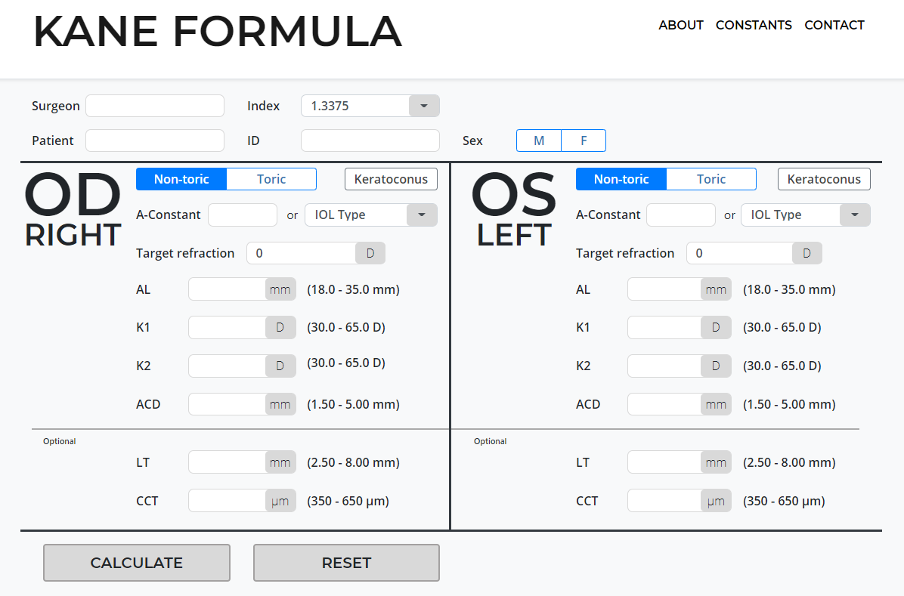
Kane Formula Calculator (+/- Keratoconus)

Slide 35
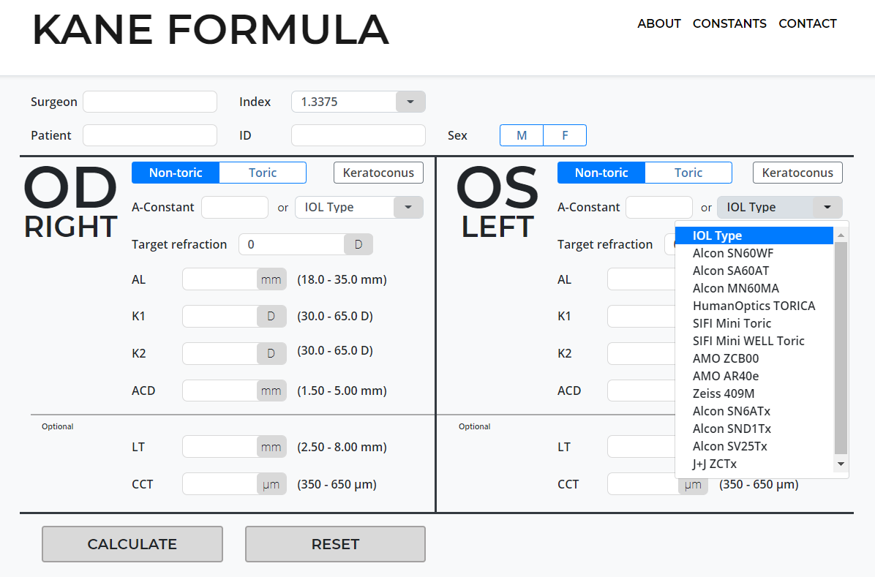
Kane Formula Calculator (+/- Keratoconus)

Slide 36
A Word on “A Constants”
You may have noticed that each of these formulas require an “A constant” or other such factor in order to calculate a lens power
Each lens comes with a manufacturer recommended lens constant, however there are generally accepted “optimized” lens constants and surgeon-specific lens constants
There are ways to optimize your lens constants to you but you should only do this after you have done 20-30 cases to reflect on, and each time you should only adjust it a very small amount
I personally use the optimized constants provided

Slide 37
Special Situations

Slide 38
Special Situations: Sulcus Placement
Most IOL formulas assume placement in the capsular bag
Placement in the ciliary sulcus without optic capture leaves the lens slightly more anterior than its position in the capsular bag (approximately 0.5mm)
To compensate for this anterior placement, you should subtract some power from most lenses, however the amount to subtract varies based on the power of the lens being placed
For optic capture of a sulcus lens, most use in the bag calculations

Slide 39
Special Situations: Sulcus Placement
Roughly:
Lens power less than 9: NO adjustment
Lens power 9.5 to 17: Subtract 0.5D
Lens power 17.5 to 28: Subtract 1D
Lens powers above 28: Subtract 1.5D
There is a chart that goes over this relationship on doctor-hill.com

Slide 40
Special Situations: Post-Refractive
For patients who develop cataract after corneal refractive surgery, there are several methods to determine the correct IOL formula
IOL formulas make assumptions about total corneal power based on the ratio of the anterior to posterior cornea (Gullstrand ratio) and other biometric parameters
LASIK/PRK alters the anterior cornea but not posterior cornea
RK flattens both

Slide 41
Special Situations: Post-Refractive
ASCRS has a post-refractive calculator online that takes multiple pieces of data and gives calculations with different formulas
Helpful pieces of information include your patient’s refraction prior to LASIK/PRK, or even keratometry if they have it
There are a few “no history” methods, including Barrett True K and Pentacam, but they are improved significantly with prior data
You can access the Barrett True K and True K toric calculator on their own online

Slide 42
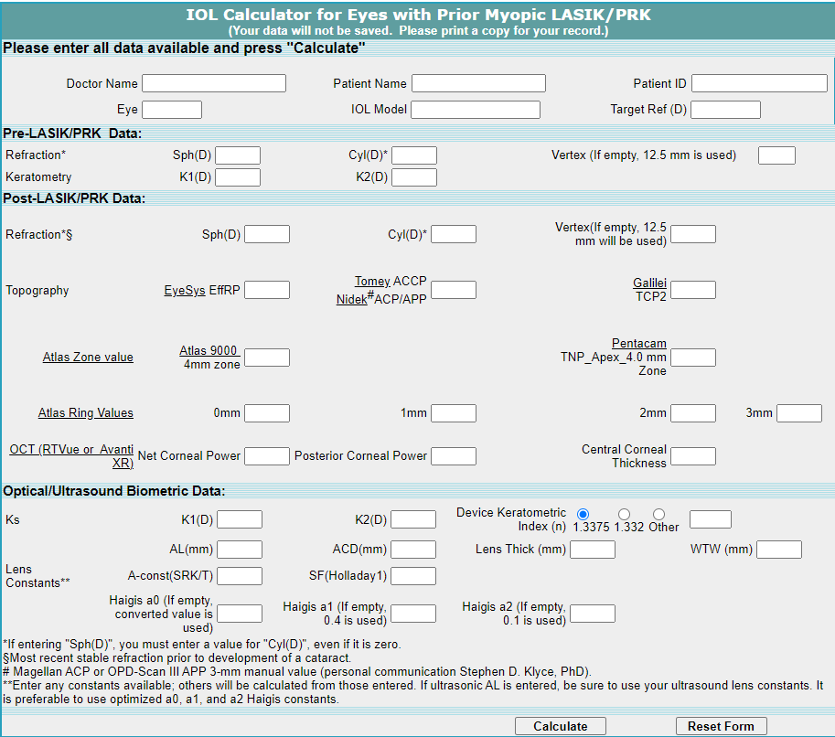
ASCRS Post-Refractive Calculator

Slide 43
Addressing Astigmatism

Slide 44
Addressing Astigmatism
One of the major needs of modern biometry is accurate and repeatable assessment of astigmatism
This has come out of major advances in toric and toric multifocal lenses, which require these measurements in order to accurately plan treatments

Slide 45
Addressing Astigmatism
Published in 2012
The posterior cornea is steeper in the vertical meridian and acts as a negative powered lens which contributes ATR astigmatism
The magnitude of this effect was ~0.3-0.5D ATR astigmatism

Slide 46
Addressing Astigmatism
Published in December 2013
Analyzed toric IOL outcomes and found that WTR anterior corneal astigmatism was overestimated by about 0.5D
ATR anterior corneal astigmatism was underestimated by 0.2-0.3D

Slide 47
Addressing Astigmatism
No longer necessary to make these corrections as these findings are now incorporated into modern toric calculators
crstodayeurope.com (Abulafia et al.)

Slide 48
Addressing Astigmatism
crstodayeurope.com (Abulafia et al.)

Slide 49
Toric IOL Calculation Formulas
Published in 2020
Compared Abulafia-Koch, Barrett Toric, Kane Toric, EVO 2.0, Holladay 2 with total SIA, Naeser-Savini in retrospective review
Kane Toric and Barrett Toric had the highest percentage of predicted refractions within 0.5D (65% and 59.5%, respectively)

Slide 50
Toric IOL Calculation Formulas
The IOL Master 700 now has the capability to measure posterior corneal astigmatism and calculate total corneal power (TK)
However, some studies have shown equivalent outcomes with and without total corneal power measurements. This may require future optimization

Slide 51
Corneal Topography

Slide 52
Corneal Topography
Topography can be its own lecture, but in the setting of biometry and cataract planning, the main goal is to evaluate and measure corneal astigmatism
If the astigmatism is regular and the axis well defined, the patient might be a good candidate for a toric IOL or other astigmatism intervention

Slide 53
Corneal Topography
Identify the steep axis and compare against autorefraction and glasses
Identify the magnitude of astigmatism and determine whether clinically significant
Determine if the astigmatism is regular or irregular
Look for signs of dry eye, ABMD, or other issues that can affect astigmatic readings

Slide 54
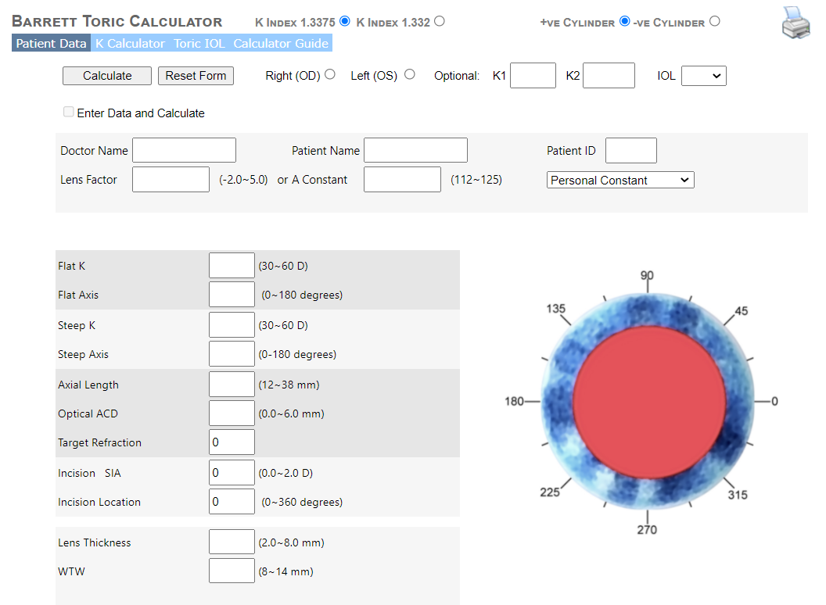
Barrett Toric Calculator

Slide 55
Surgically-Induced Astigmatism
This was evaluated by several surgeons including Warren Hill, who found wide variations in surgeon induced astigmatism
The variety has to do with wound architecture and corneal biomechanics, as well as the location of the wound
In vector analysis and in the absence of calculating individual SIA, a value of 0.12 was recommended, with the recognition that this is highly variable from case to case in any surgeon’s hands

Slide 56
Angle Alpha and Angle Kappa
Angle alpha and angle kappa are important for centration of multifocal optics
Angle alpha is the distance between the visual axis and the center of the limbus (presumed center of the capsular bag)
In biometry, this is represented as Ix and Iy for distance from iris center
Angle kappa is the distance between the visual axis and the pupil center
In biometry, this is represented as px and py, or Chang-Waring chord

Slide 57
Angle Alpha and Angle Kappa
cataractcoach.com (Uday Devgan)

Slide 58
Angle Alpha and Angle Kappa
cataractcoach.com (Uday Devgan)

Slide 59
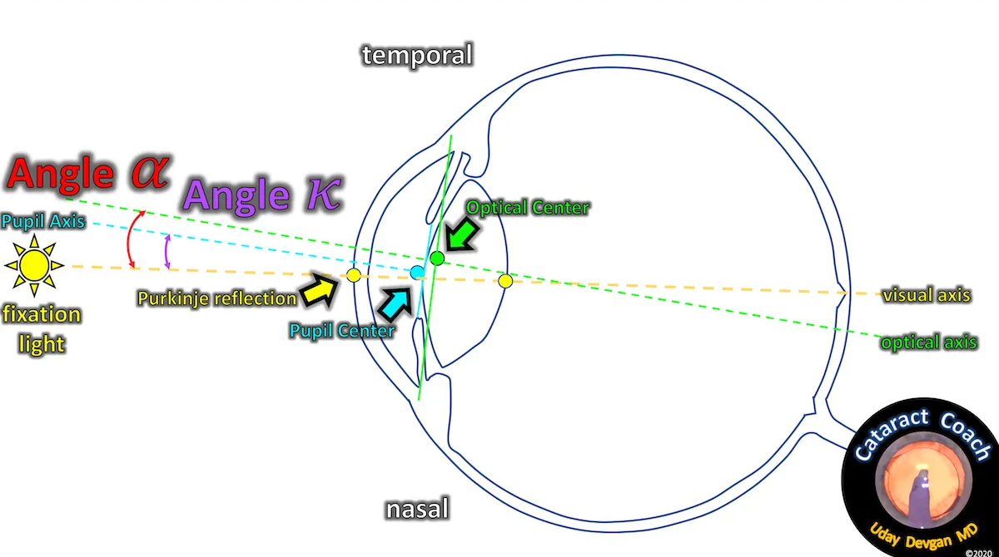
Angle Alpha and Angle Kappa
cataractcoach.com (Uday Devgan)

Slide 60
Angle Alpha and Angle Kappa
If angle alpha or kappa are sufficiently large, then the visual axis will be off from the natural centration of the lens in the capsular bag and/or from the center of the pupil
Different surgeons use different cutoffs, but a generally-accepted value is <0.6mm angle alpha for a diffractive multifocal
Centering the lens on the subject-fixated coaxially-sighted corneal light reflex helps to center on the patient’s subjective visual axis (typically slightly nasal)

Slide 61
Intraoperative Aberrometry
Intraoperative aberrometry (specifically ORA by Alcon, the only current option) can be helpful for confirming biometry in the OR
The machine takes an aphakic refraction during cataract surgery, but its IOL recommendation depends the pre-operative biometry
Therefore, if you have inaccurate pre-operative biometry, then the machine will not necessarily save you
Studies comparing the two have favored preop biometry, however this is a useful adjunct in post-refractive or white cataract cases

Slide 62
Biometry Examples

Slide 63
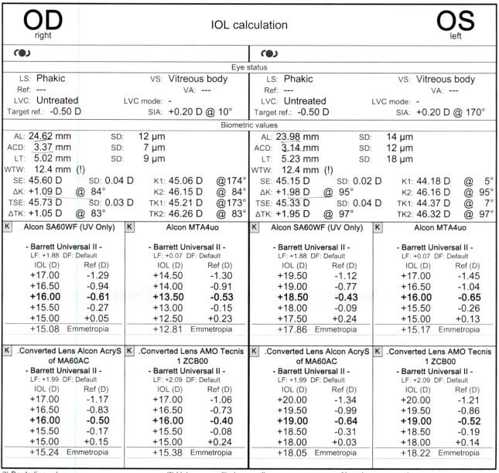
IOLMaster 700 Biometry
62

Slide 64
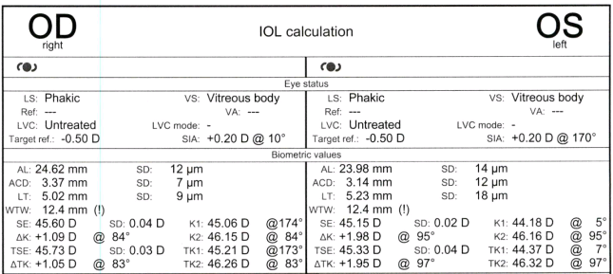
IOLMaster 700 Biometry
63

Slide 65
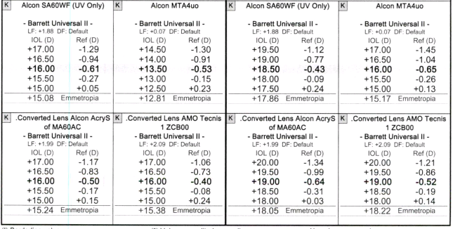
IOLMaster 700 Biometry
64

Slide 66
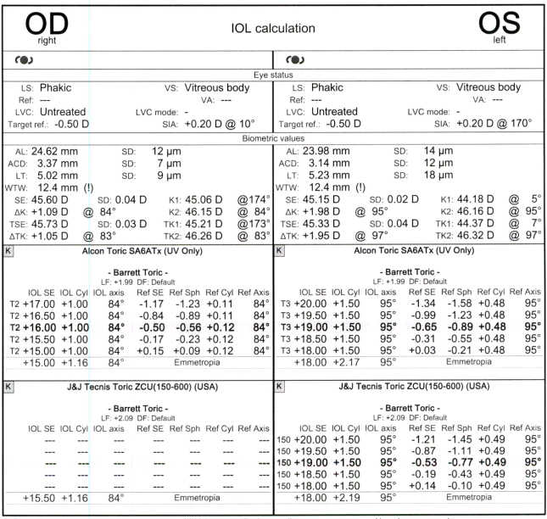
IOLMaster 700 Biometry
65

Slide 67
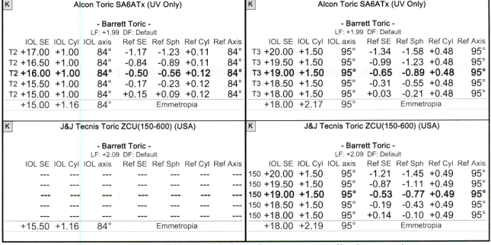
IOLMaster 700 Biometry
66

Slide 68
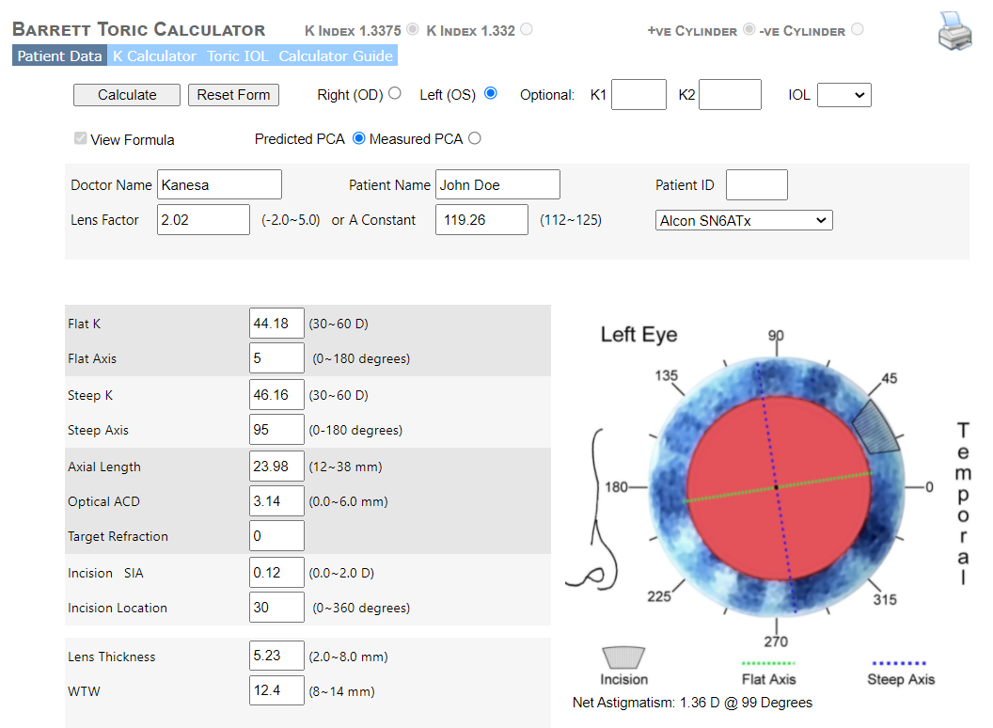
Barrett Toric Calculator
67

Slide 69
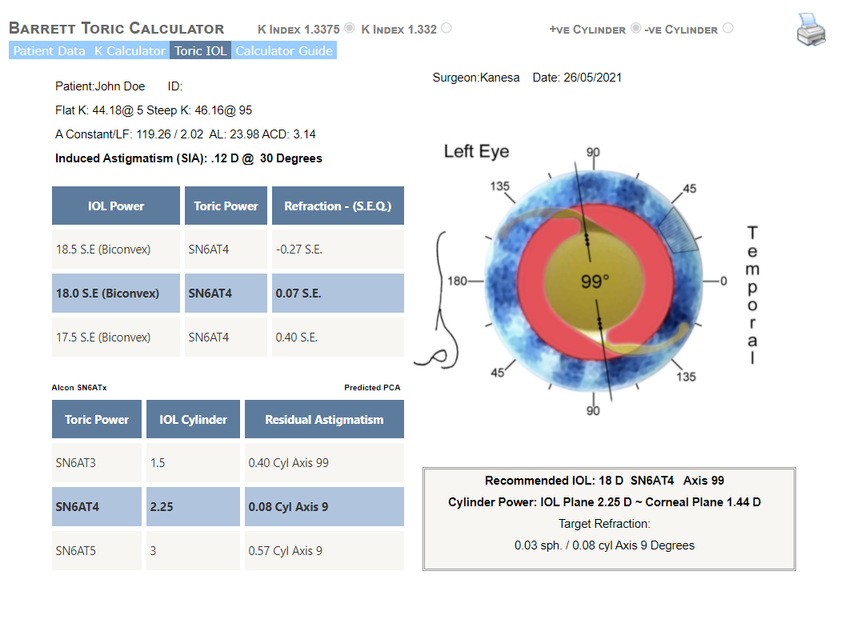
Barrett Toric Calculator
68

Slide 70
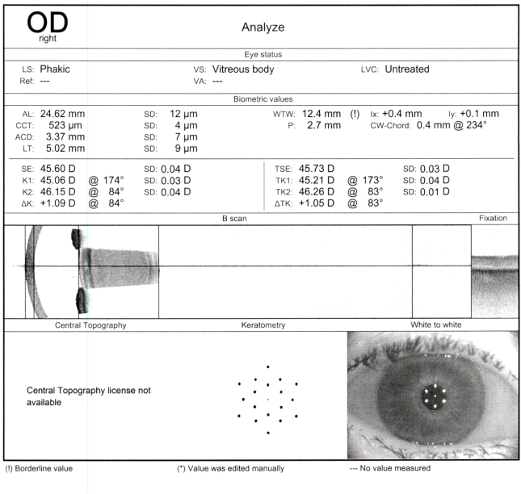
IOLMaster 700 Biometry
69

Slide 71
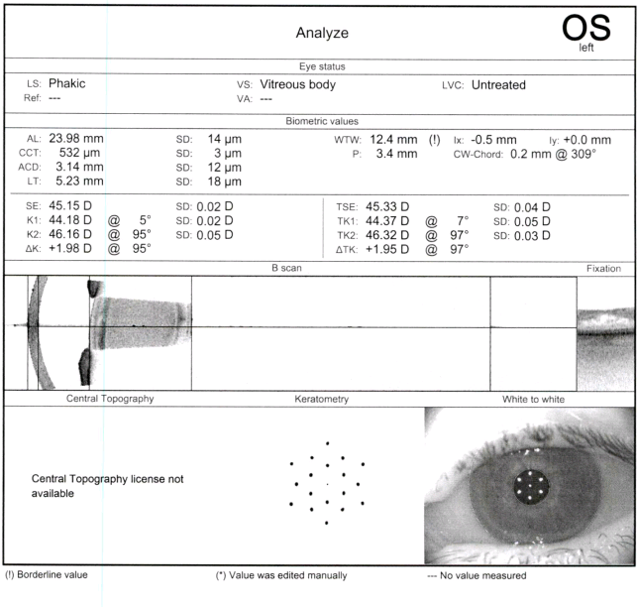
IOLMaster 700 Biometry
70

Slide 72
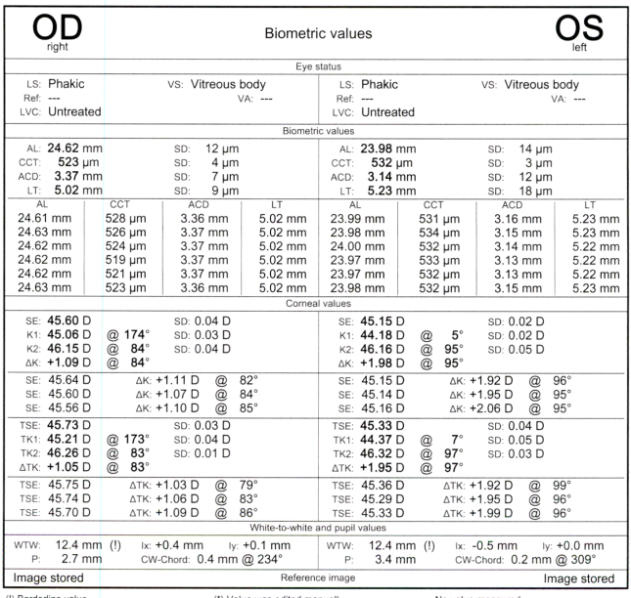
IOLMaster 700 Biometry
71

Slide 73
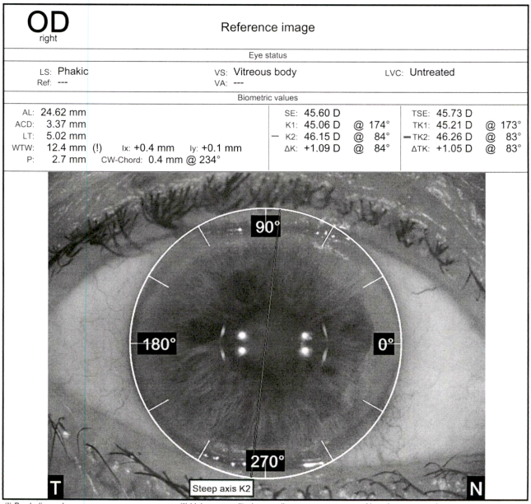
IOLMaster 700 Biometry
72

Slide 74
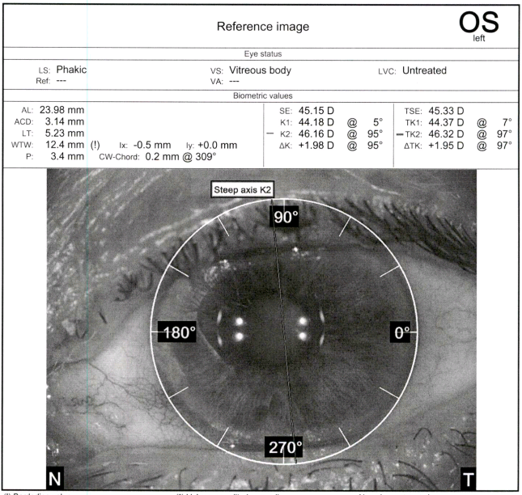
IOLMaster 700 Biometry
73

Slide 75
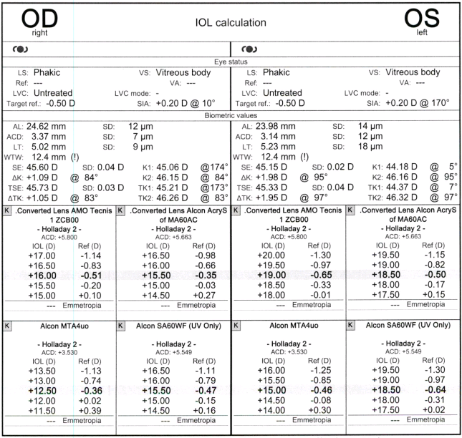
IOLMaster 700 Biometry
74

Slide 76
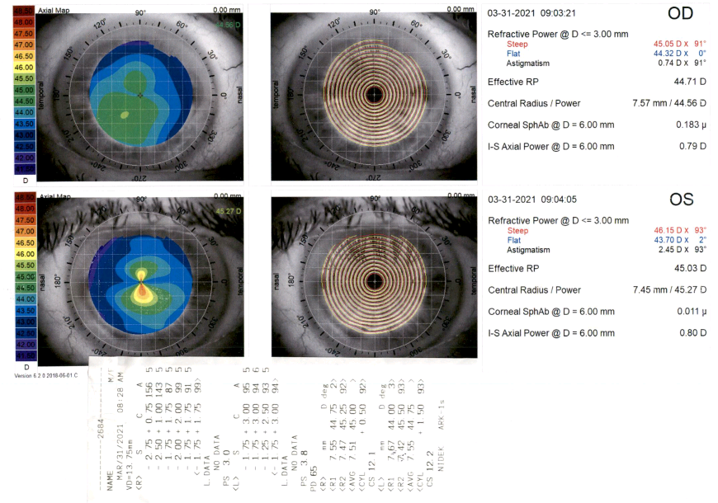
iTrace Topography/Aberrometry
75

Slide 77
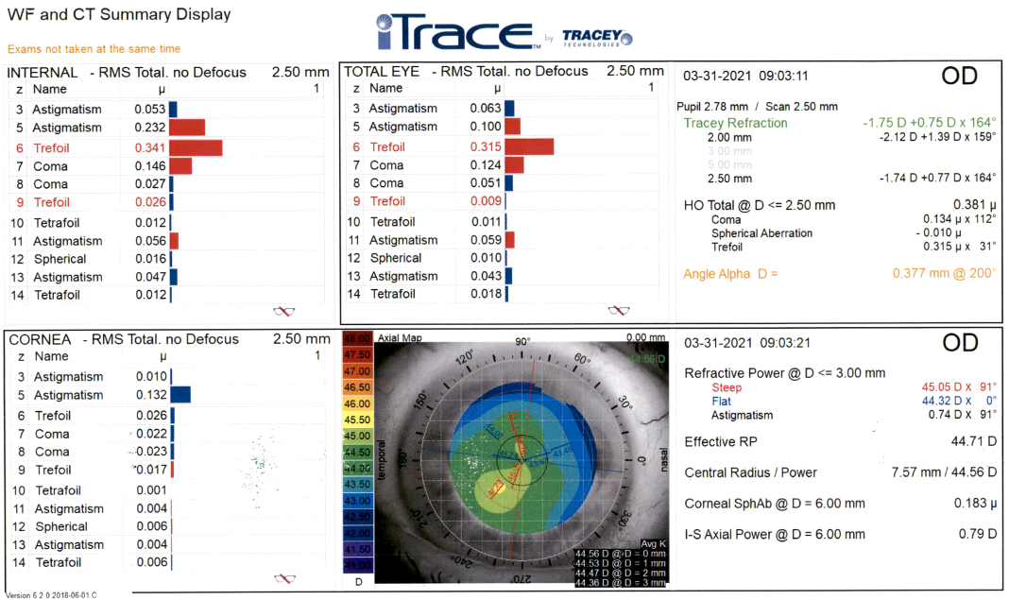
iTrace Topography/Aberrometry
76

Slide 78
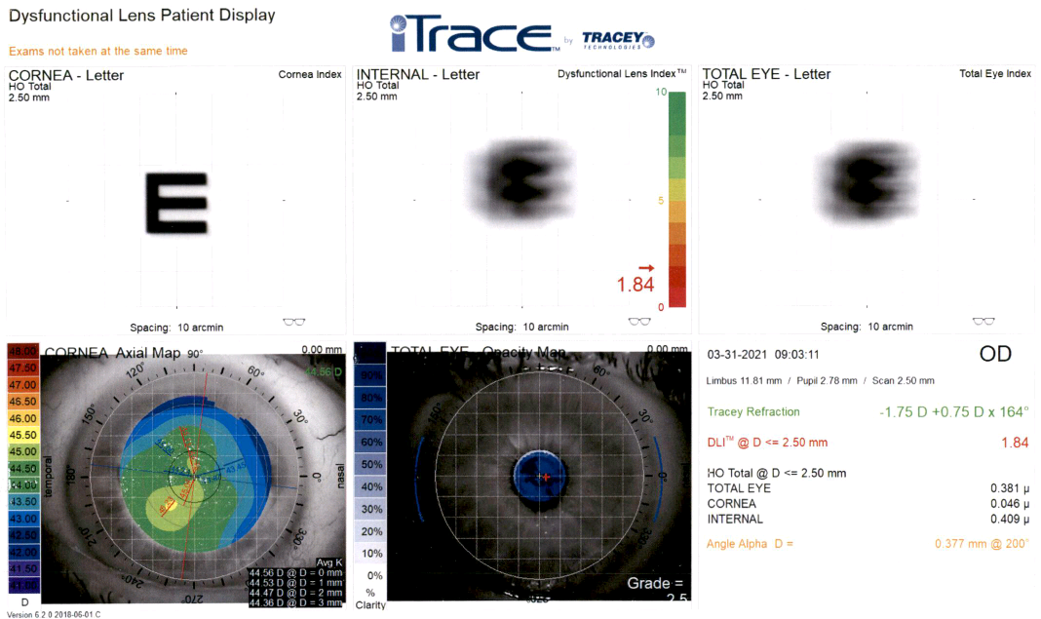
iTrace Topography/Aberrometry
77

Slide 79
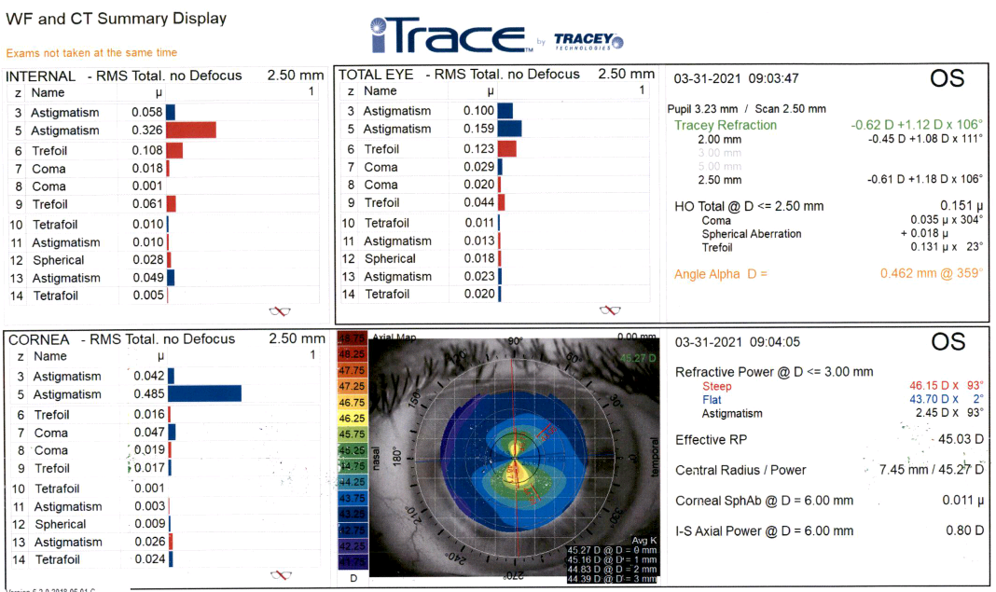
iTrace Topography/Aberrometry
78

Slide 80
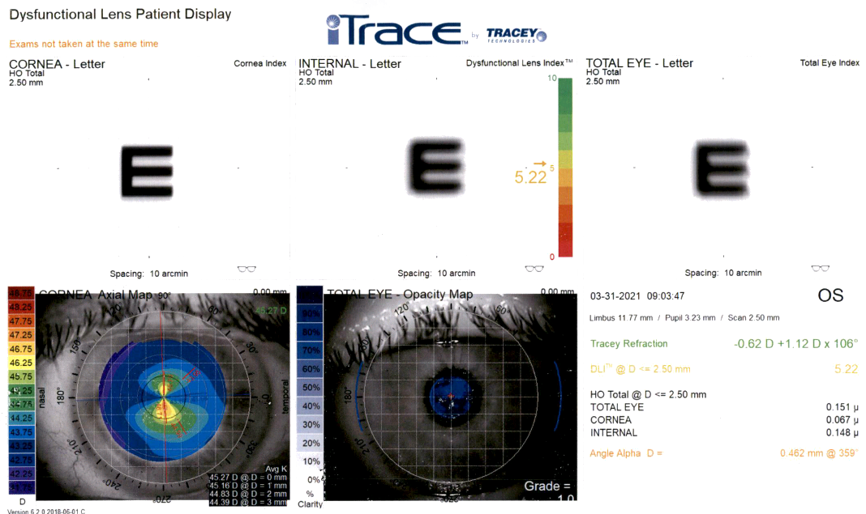
iTrace Topography/Aberrometry
79

Slide 81
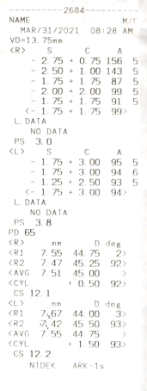
Autokeratometry
80

Slide 82
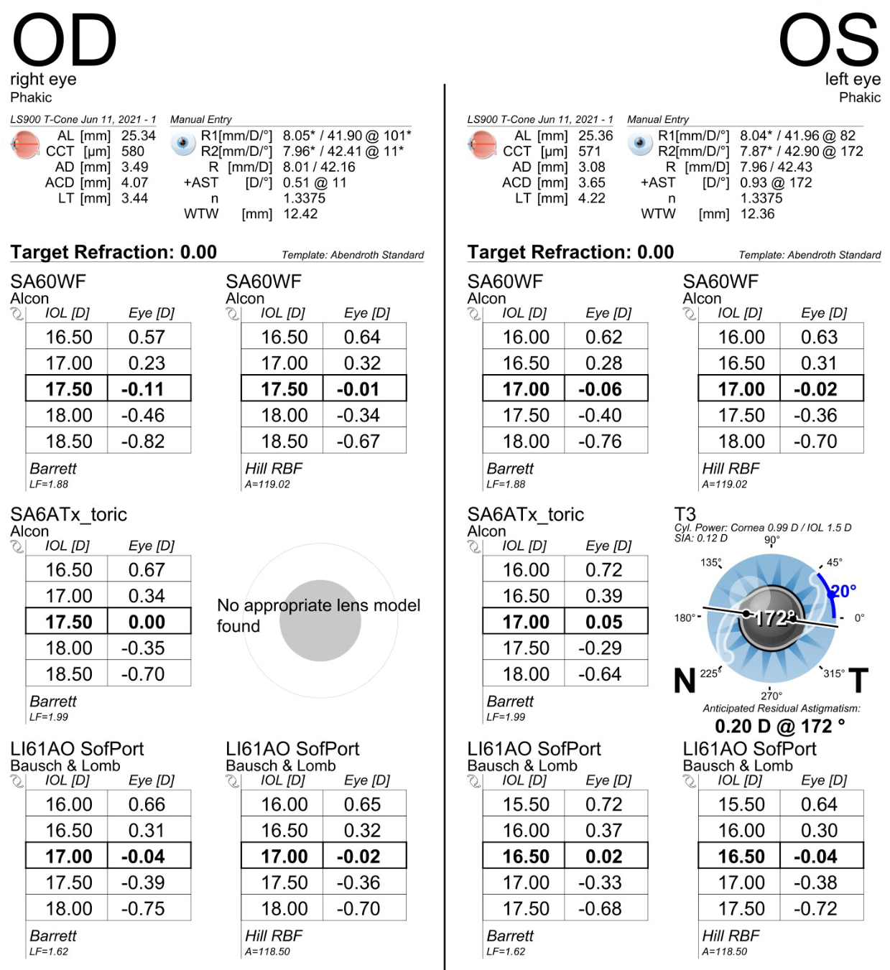
Lenstar LS900 Biometry
81

Slide 83
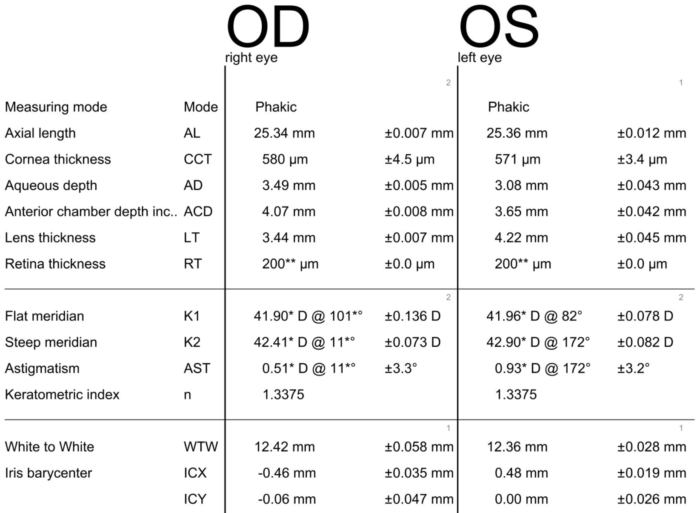
Lenstar LS900 Biometry
82

Slide 84
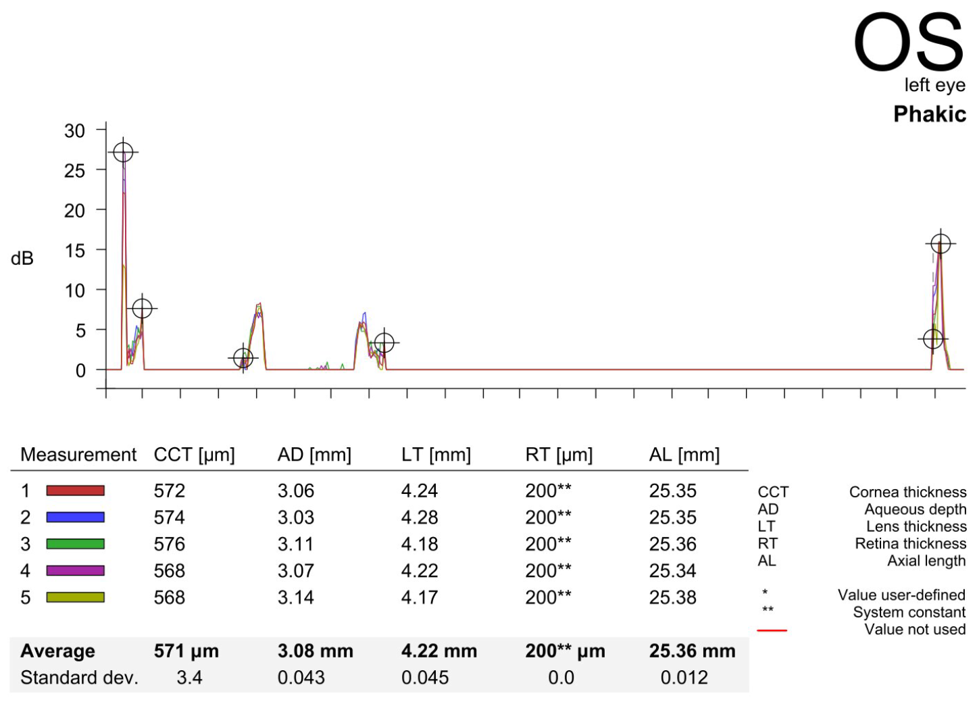
Lenstar LS900 Biometry
83

