Slide 1
Peripheral Retinal
Anatomy & Pathology
Marc Spirn, MD

Slide 2
Outline
Anatomy of peripheral retina
Visualization techniques
Normal peripheral retinal structures
Abnormal peripheral retinal structures and disorders

Slide 3
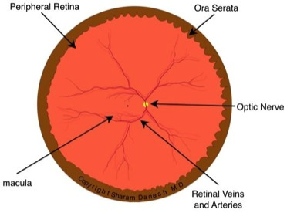
Retinal Anatomy
www.webvision.med.utah.edu/imageswv/Sagschem
www.arizonaretinainstitute.com

Slide 4
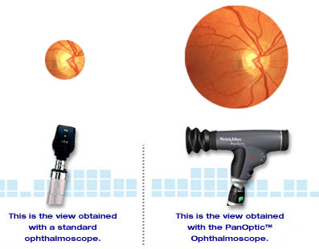
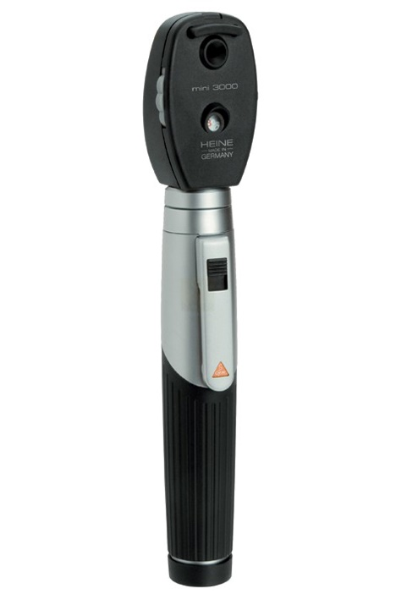
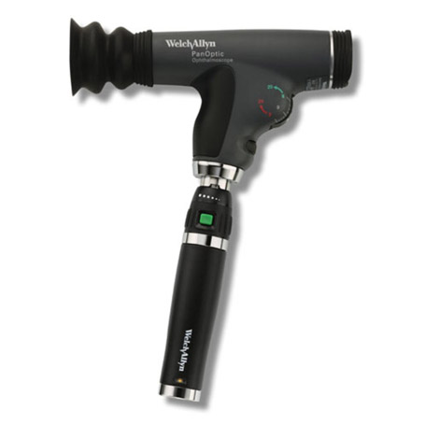
Visualizing the Peripheral Retina
Direct Ophthalmoscopy
No view of peripheral retina
Standard
10 degrees
PanOptic
25 degrees
www.eyedocdeviney.com

Slide 5
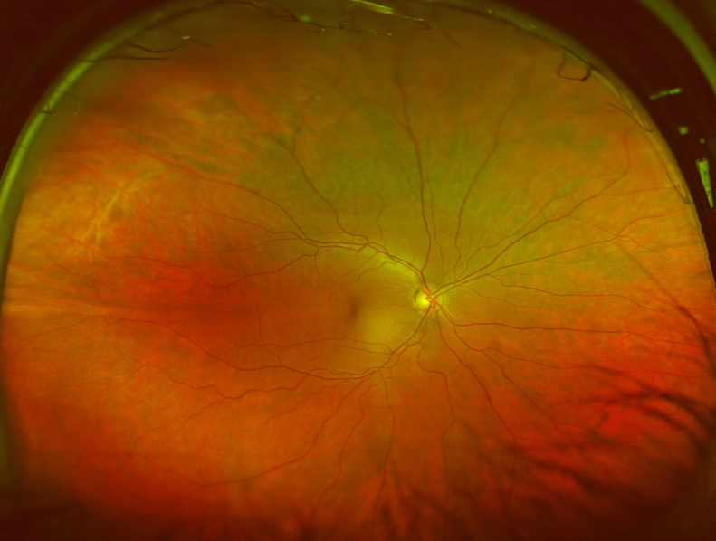
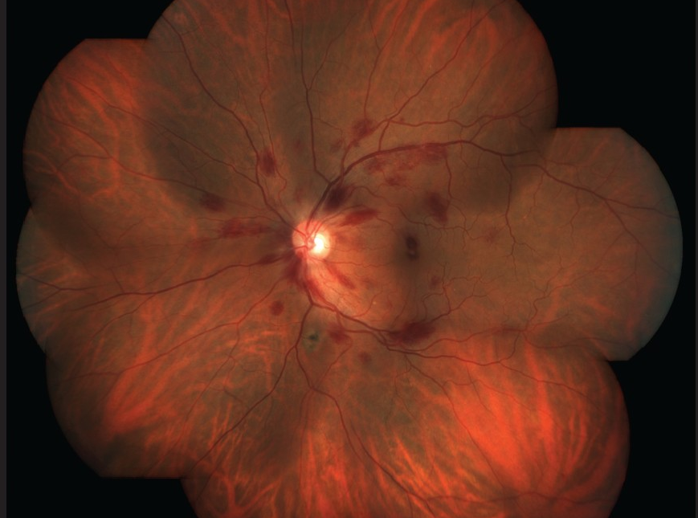
Visualizing the Peripheral Retina
Fundus Photography
Ultra-wide field imaging
Images ~200 degrees (80% of retina)
Traditional fundus camera
Requires expert photographer or contact lens to get peripheral shots
Each photo between 30-50 degrees
Staurenghi lens can be used with slit lamp cameras to capture ~150 degrees
www.optos.com
www.ijo.com

Slide 6
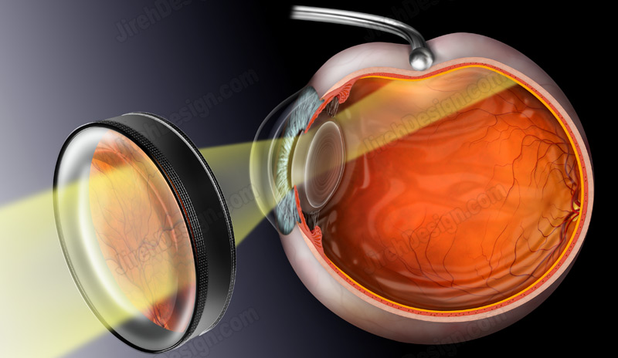
Visualizing the Peripheral Retina
Indirect Ophthalmoscopy
Condensing lens (e.g. 20D or 28D)
Without scleral depression
With scleral depression = gold standard
Contact lens (e.g. Goldman 3 mirror)
www.jirehdesign.com

Slide 7
Scleral Depression

Slide 8
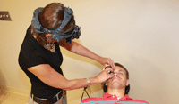
Scleral Depression
Keys:
Patient positioning
Physician positioning
Anterior-posterior dynamic motion
Practice!!
www.reviewofoptometry.com

Slide 9
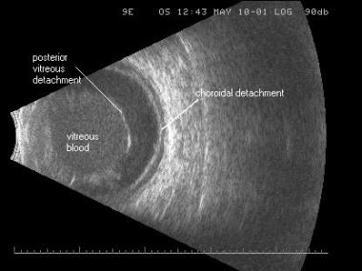
Ancillary Imaging: B-Scan Ultrasonography
Helpful when:
Media opacity
Small pupil prevents adequate peripheral exam
Diagnostic uncertainty
www.emedicine.medscape.com

Slide 10
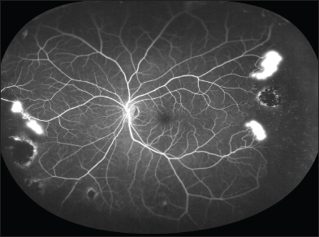
Ancillary Imaging: Wide Field Angiography
Helpful when:
Media opacity
Small pupil prevents adequate peripheral exam
Diagnostic uncertainty
www.retinalphysician.com

Slide 11
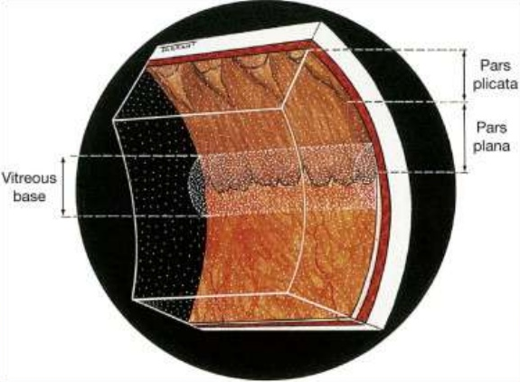
Vitreous Base
Very important peripheral retinal structure
Straddles peripheral retina and pars plana
Posterior attachment is point of retinal tears
www.slideshare.net

Slide 12
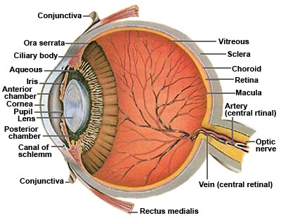
Ora Serrata
Often marked to small rows of cystoid cavities (normal)
www.amazingpointofview.com

Slide 13
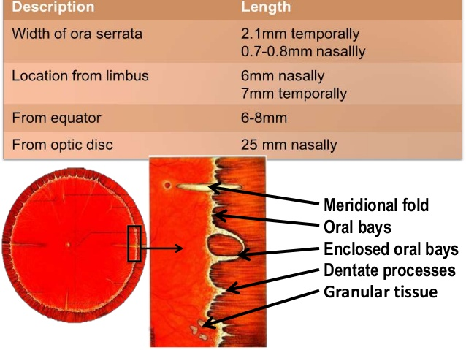
Ora Serrata

Slide 14
Ora Serrata
Usually 20-30 dentate processes per eye
Correspond to intervals between ciliary processes
Dentate processes join to form oral bay
Oral bay may be confused with a retinal tear

Slide 15
Meridonal Folds
Begin at ora serrata
Run perpendicular and posterior
Contain all neural retinal layers
Found in 20% of eyes
More common nasally
Tears often occur at posterior edge

Slide 16
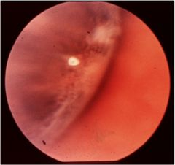
Oral Pearl
Glistening opacity often found over a dentate process
Usually incidental
When multiple and milky, may be associated with multiple myeloma
www. cram.com

Slide 17
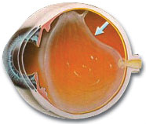
Posterior Vitreous Detachment (PVD)
10% result in tears
50-70% when VH present
Examine within 24-48 hours
Serial dilated exams
E.g. 1 day, 4-6 weeks, 3 months for PVD
E.g. 1 day, 2 weeks, 6 weeks, 3 months for hemorrhagic PVD
OCT can confirm PVD
www. thefloaterdoctor.com

Slide 18
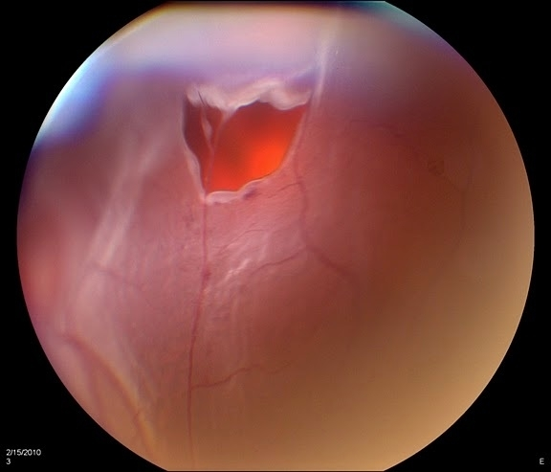
Retinal Tear
Occurs after PVD
Types:
Horseshoe – high risk
Operculated – lower risk
Ancillary signs:
Vitreous hemorrhage (50-70% of PVD with VH have a tear)
Tobacco dust (Shafer’s sign)
Falling ash sign on OCT
www.imagebank.asrs.org

Slide 19
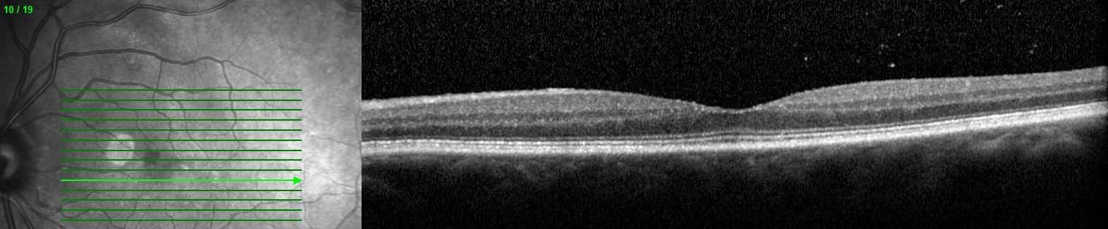
Falling Ash Sign

Slide 20
Retinal Tear
Treat to prevent retinal detachment (RD)
Treatments:
Laser
Cryo (if media opacity)
Laser/cryo should:
Encircle the tear and associated fluid
Extend to ora if possible
www.imagebank.asrs.org

Slide 21
Retinal Tear Pre- and Post-Laser

Slide 22
Retinal Tear One Month Post-Laser

Slide 23
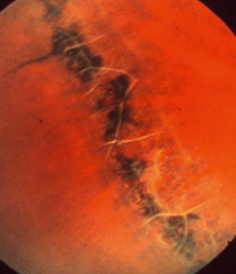
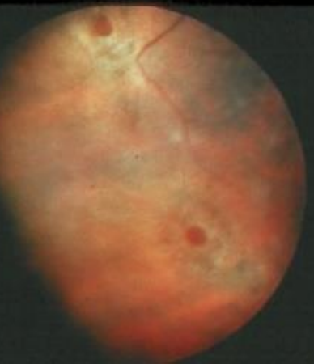
Lattice Degeneration
Band(s) of retinal thinning
Increased risk of RD
Typically parallel to ora and more common superiorly
Radial lattice is harder to see and may be associated with Stickler syndrome
www.studyblue.com

Slide 24
Lattice Degeneration and Retinal Detachment
Two main causes of retinal detachment over lattice:
Atrophic holes:
Cause RD slowly due to overlying vitreous liquefaction
Often occur in absence of PVD
Common cause of RD in patients under 50
Treat early with laser if:
Subretinal fluid present
Significant history of RD in family or fellow eye
PVD-associated:
Vitreous strongly adherent at lattice
High risk of tears
RD usually quicker than atrophic hole-associated RD
Prophylactic laser retinopexy is controversial

Slide 25
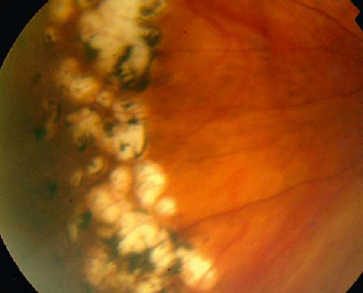
Cobblestone Degeneration
Chronic, slowly progressive disorder
Not associated with symptoms or complications
Can be confused with:
Lattice degeneration
Toxoplasmosis
Atrophic holes
CHRPE
www.studyblue.com

Slide 26
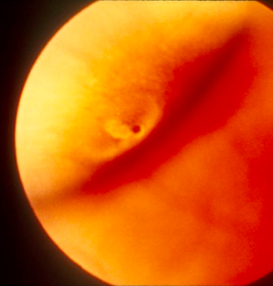
Retinal Tuft
Small, pyramidal projections into vitreous cavity
Typically occur in vitreous base
Retinal breaks are more common at these sites
www.studyblue.com

Slide 27
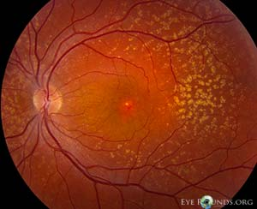
Peripheral Drusen
Typically asymptomatic and of little clinical significance
Can be associated with CNV (e.g. in peripheral exudative hemorrhagic chorioretinopathy)
www.studyblue.com

Slide 28
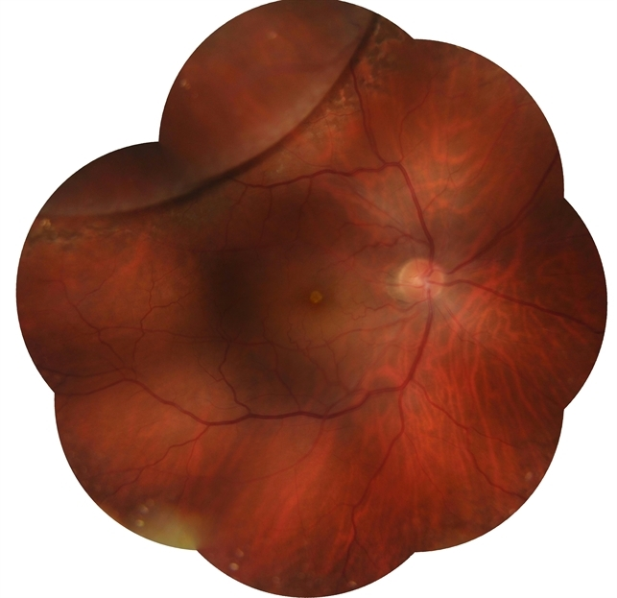
Retinoschisis
Three types:
Degenerative (adult acquired)
X-linked
Secondary
www.imagebank.asrs.org

Slide 29
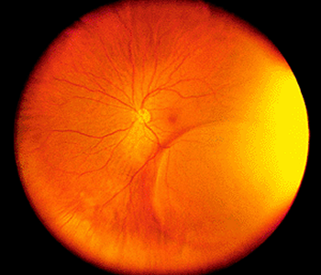
Degenerative Retinoschisis
Splitting at level between inner nuclear and outer plexiform layers
Usually:
Bilateral
Symmetric
Bullous
Inferotemporal
Often have:
Sheathed vessels
Fine white dots on inner surface (Muller’s fibers transversing cavity)
www.montanaretinaconsultants.com

Slide 30
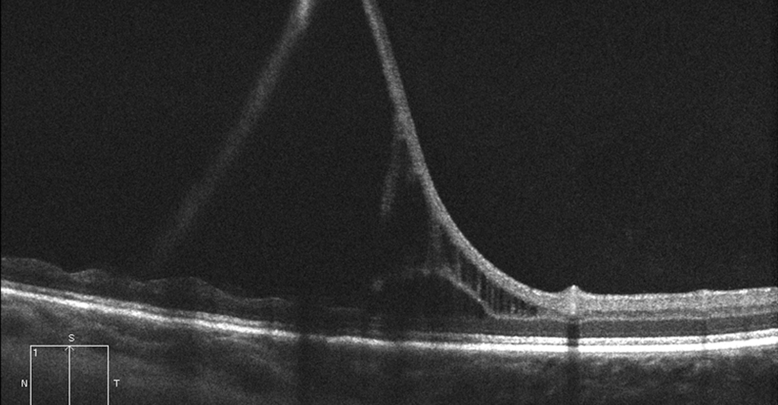
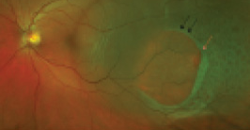
Degenerative Retinoschisis
RD is a major complication
Account for about 2.5% of RD patients requiring surgery
Associated with outer retinal holes +/- inner retinal holes
May progress slowly over time
www.octmd.com
www.retinatoday.com

Slide 31
Distinguishing Schisis from Detachment
Check OCT if possible
Demarcation line (schisis no, RD yes)
Laser uptake (schisis yes, RD no)
Scleral depression (schisis indents with depression, RD does not)
Visual field (schisis absolute scotoma, RD relative scotoma)

Slide 32
Secondary Retinoschisis
May be seen in:
Diabetes
Retinopathy of prematurity (ROP)
Familial exudative vitreoretinopathy (FEVR)

Slide 33
X-Linked Retinoschisis
More common in males (due to X-linked inheritance)
Macular schisis is hallmark of disease
May look like macular edema that doesn’t leak on FA
Associated with VH or RD (usually later in life)
Schisis occurs in nerve fiber layer
OCT studies show this may not be the case

Slide 34
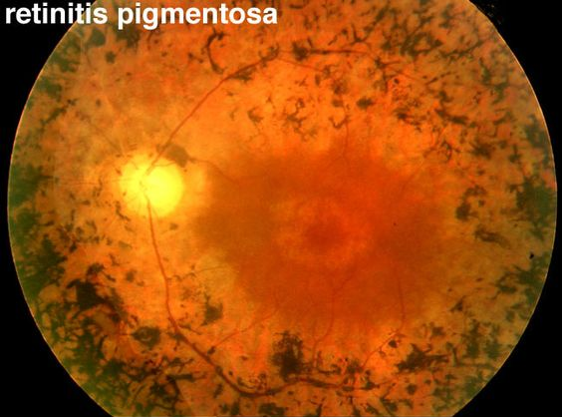
Bone Spicules
Common finding in retinal degenerations (e.g. retinitis pigmentosa)
Usually bilateral
Can be sign of previous RD (may be unilateral)
Can occur around the long posterior nerves
www.pinterest.com/pin/433612270345301962

Slide 35
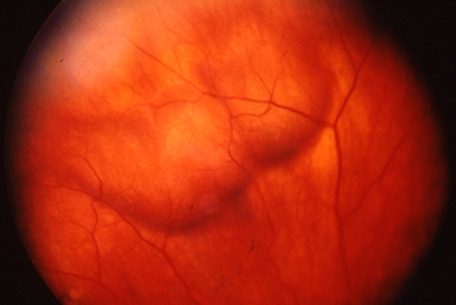
Enlarged Vortex Vein
Can be confused with tumor
More common with upgaze/downgaze
www.imagebank.asrs.org

Slide 36
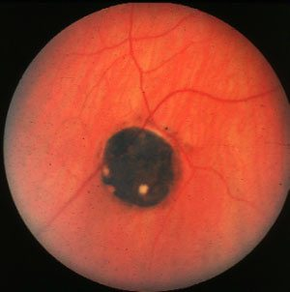
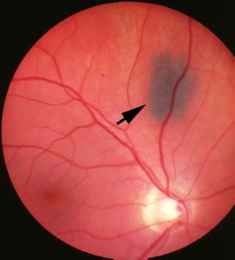
Congenital Hypertrophy of RPE (CHRPE)
Not clinically significant
May be confused with choroidal nevus
Hallmark features:
Flat
Lacunae
Surrounding halo
CHRPE
Nevus
www.mrcophth.com

Slide 37
White With Pressure
White peripheral retinal finding seen with scleral depression
Seen in about 35% of patients
No clinical significance, but may be confused with RD

Slide 38
White Without Pressure
White peripheral retina without pressure (i.e. scleral depression)
Increased whiteness with scleral depression
Scleral depression can differentiate from RD/schisis

Slide 39
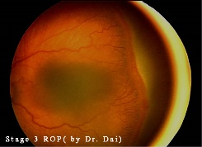
Vascular Abnormalities of Peripheral Retina
Peripheral proliferative retinopathies:
Diabetes
Sickle cell and related diseases
ROP
FEVR
Incontinentia pigmenti
Norrie disease
Retinal vein occlusion
www.pinterest.com

Slide 40
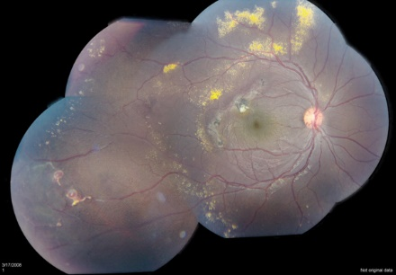
Vascular Abnormalities of Peripheral Retina
Coats disease
www.pinterest.com

Slide 41
Vascular Abnormalities of Peripheral Retina
Peripheral exudative hemorrhagic chorioretinopathy (PEHCR)
May be self limited
If not, treat with anti-VEGF, laser, or cryo
www.pinterest.com

Slide 42
Conclusions
Peripheral retinal diseases are a common cause of vision loss
Understanding normal peripheral anatomy can help differentiate normal from abnormal
Diagnosing peripheral retinal disease can be challenging
The best way to see the peripheral retina is to practice, practice, practice examining the peripheral retina

