Slide 1
Phaco Fluidics and
Lens Division Techniques
Robert Bailey, MD

Slide 2
Phaco Basics

Slide 3
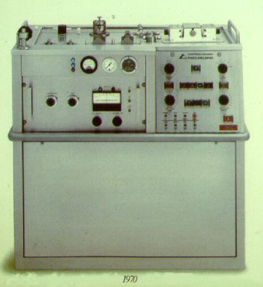
Phaco Device: Model 7001 (circa 1970)

Slide 4
Background
Modern phacoemulsification – a highly evolved technique
Charles Kelman, MD circa 1970
Advanced technology adds to safety and shortens learning curve

Slide 5
The Four Dynamic Components
Aspiration Flow Rate
Vacuum
Ultrasonic Power
Bottle Height

Slide 6
Balancing Surgical Forces
Fluidics
Ultrasound
Technique

Slide 7
Phaco Machine
Three basic functions:
  Irrigation: fluid flow into eye
  Aspiration: suction of material out of eye
  Ultrasound: cavitation energy emulsifies lens
All three controlled by foot pedal

Slide 8
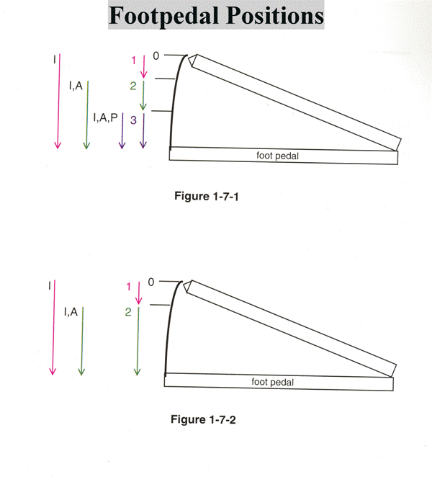
Phaco Foot Pedal Positions
Position 1: Irrigation only
Position 2: Irrigation and Aspiration
Position 3: Irrigation, Aspiration, and Ultrasound
Phaco mode
I/A mode

Slide 9
Phaco Fluidics

Slide 10
Infusion / Irrigation
What is it?
  Inflow of fluid into the anterior chamber

Slide 11
Aspiration
What is it?
  Removal of fluid from the anterior chamber

Slide 12
Aspiration Flow Rate (AFR)
What is it?
  The amount/speed at which fluid is removed from the eye
  Measured in cc/min
What does it do?
  Determines how quickly material is drawn to the phaco tip

Slide 13
Followability
What is it?
  The ability to attract material to the phaco tip
What controls it?
  Aspiration Flow Rate
Notes:
How can you increase or decrease followability?
Use overheads for pump types
Peristaltic - venturi - diaphragm

Slide 14
Case Example
Lens material comes to tip too fast. What do you do?
  Decrease AFR

Slide 15
Vacuum
What is it?
  Negative pressure or holding force
  Measured in mmHg
What does it do?
  Holds material against the tip
  The higher the vacuum, the greater the holding force

Slide 16
Occlusion
What is it?
  Obstruction of the phaco tip

Slide 17
Occlusion
How does it affect vacuum?
  Peristaltic (flow-based fluidics)
    Occlusion dependent, i.e. vacuum doesn’t build until tip is occluded
  Venturi (vacuum-based fluidics)
    Occlusion independent, i.e. vacuum is always present

Slide 18
Rise Time
What is it?
  Measurement of how quickly vacuum builds
  Directly related to Aspiration Flow Rate (AFR)
  The faster the AFR, the shorter the Rise Time

Slide 19
Surge
What is it?
  Effect caused by fluidic imbalance
What causes it?
  AFR exceeding irrigation
What results from it?
  Chamber fluctuations / mini-collapse
  Iris flutter
  Anterior movement of posterior capsule

Slide 20
Effect of High Compliance

Slide 21
Surge Caused by Compliance

Slide 22
Case Example
Chamber shallows when occlusion breaks. What do you do?
  Increase bottle height
  Decrease vacuum
  Consider incisional leakage – usually the cause
    Feel instrument floating in wound

Slide 23
Bottle Height
Difference between IV pole height and patient eye level
Produces adequate IOP to maintain anterior chamber despite aspiration (outflow), surge, and incisional drainage
Higher flow rate requires higher bottle height, and lower bottle height requires lower flow rate

Slide 24
Bottle Height Considerations
When to raise bottle height:
  To deepen the anterior chamber
  If aspiration is causing anterior chamber shallowing
When to lower bottle height:
  Zonular issues
  Capsular break
  Anterior vitrectomy

Slide 25
Case Example
The chamber shallows when the foot pedal enters position 2. What do you do?
  Increase bottle height
  Decrease aspiration flow rate

Slide 26
Review of Fluidics
Inflow = Infusion
Outflow = Aspiration and Incision Leakage

Slide 27
Alcon Centurion – Active Fluidics
Surgeon selects target IOP, patient eye level, irrigation factor, and leakage flow rate
Compression plate drives irrigation
System responsiveness maintains target IOP by monitoring and responding to changes in:
  Vacuum
  Infusion pressure
  Aspiration flow rate

Slide 28
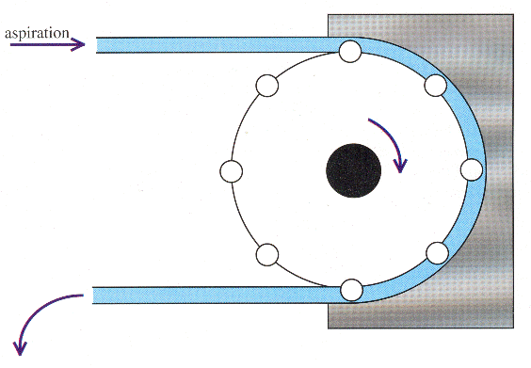
Pump Types
Peristaltic, e.g. Alcon Centurion
Venturi, e.g. J&J Whitestar
Diaphragm / Bellows
All create vacuum to drive aspiration. Difference is vacuum rise time
Peristaltic = slower rise time; may be safer
Venturi = fastest rise time; may be more efficient
*Newest peristaltic machines have adjustable rise time
Peristaltic Pump

Slide 29
Peristaltic Pump
Fluid-based system
Peristaltic action is created by one of two methods:
  Flexible tubing is compressed against a rigid surface by diametrically-positioned rollers on the pump head
  Flexible tubing is pulled around the pump head, which compresses the tubing against the diametrically-positioned rollers

Slide 30
Peristaltic Pump Characteristics
Vacuum and AFR are independent
AFR is determined by pump speed
Vacuum will build after Occlusion
Vacuum will reduce after Occlusion has broken
Vacuum levels can build regardless of Flow Rate
Rise Time is determined by Flow Rate

Slide 31
Dynamic Rise
Controls how quickly maximum vacuum is achieved when tip is occluded
Can program faster (+) or slower (-) rise time once Occlusion

Slide 32
Peristaltic Pump Tradeoff
Advantages:
  Customize flow and vacuum limits for personal technique
  Access to high vacuum limits
  Allows for moderate flow with low vacuum for maximal thermal safety during sculpting
Disadvantages:
  Need to adjust both flow and vacuum limit to optimize settings

Slide 33
Venturi Pump Characteristics
Compressed air system
Vacuum is always present
Vacuum is independent of Occlusion
Vacuum and Flow Rate are directly related
  Higher Vacuum = Higher Flow Rate
Control of Vacuum/Flow Rate is linear
Vacuum will only be reduced in relation to footswitch position

Slide 34
Venturi Pump Tradeoff
Advantages:
  Not occlusion dependent
  One variable to change
Disadvantages:
  Flow is dependent on vacuum level
  Limited availability of high vacuum levels
  Potential tip overheating with low vacuum sculpting

Slide 35
Emulsification Forces

Slide 36
Frequency
What is it?
  How fast the phaco needle moves back and forth
What is the frequency range?
  The frequency of ultrasonic handpieces is 27,000-60,000 times/second
Frequency

Slide 37
Stroke
What is it?
  How far the phaco tip moves back and forth
Stroke

Slide 38
Chatter
What is it?
  Rebound from the ultrasonic tip
What causes it?
  Stroke overcoming AFR and Vacuum

Slide 39
Case Example
During quadrant removal, you find that nuclear material is not following adequately. What do you do?
  Increase AFR
  Decrease ultrasound power
  Increase Vacuum
  Usually hard nucleus (Chatter)
  Not seen with OZil™ torsional phaco

Slide 40
Reducing Phaco Energy
Change Technique
  Divide and Conquer
  Stop and Chop
  Quick Chop
Software
  Pulse
  Burst
Sonic technology

Slide 41
Traditional Pulse
START
FOOT PEDAL
POSITION 3
FINISH
FOOT PEDAL
POSITION 3
Fixed Duty Cycle
50% On, 50% Off

Slide 42
Ultrasound Burst Mode
START
FOOT PEDAL
POSITION 3
FINISH
FOOT PEDAL
POSITION 3

Slide 43
Ultrasound Mode Illustration
continuous
pulse
power
burst
foot pedal position

Slide 44
OZil™ Torsional Phaco
What is it?
  The use of oscillatory torsional amplitude to facilitate a lateral tip movement that cuts more efficiently due to less repulsion with decreased thermal energy

Slide 45
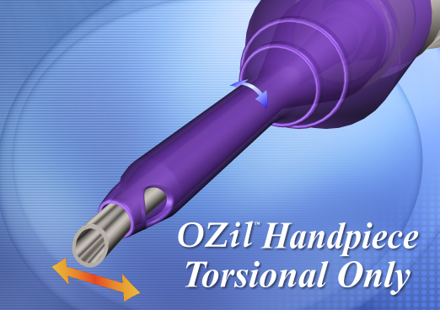
OZil™ Torsional Phaco
Reduces repulsion
  Shearing of lens material
  Decreases chatter and dispersion of lens material
  Decreased potential for turbulence
Increases efficiency of emulsification
  Traditional ultrasound is 50% effective because backwards movement of stroke does not contact lens material
  100% of torsional stroke is used to shear material

Slide 46
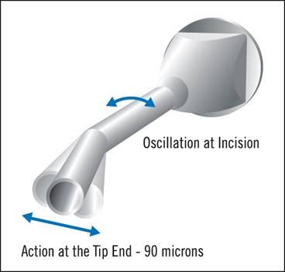
Torsional Phaco Tips
Recommended to use Kelman or angled tips
  Amplification of movement at tip end
  Cutting movement at tip is side-to-side
  Creates equivalent stroke at tip end as traditional phaco
    Approximately 3.5 mils or 90 microns for tapered tips
Straight tips reduce the amplification of the movement and need traditional ultrasound to make effective
Tapered Tip

Slide 47
Intelligent Phaco (IP)
The software senses any rise in vacuum and responds by emitting short pulses of longitudinal ultrasonic energy to briefly repel the material from the tip and give the tip space to continue shearing
The surgeon can set the IP software to respond at a determined vacuum level

Slide 48
IP Activation
Only activates in foot position 3 in torsional mode
Engages when vacuum threshold is reached
Delivers short pulse of longitudinal phaco
Disengages when vacuum falls below threshold
Helps prevent tip clogging with dense nucleus

Slide 49
Concept of Phaco Time / CDE
Estimated phaco time (EPT) = duration of time that ultrasound energy is activated x average percent power
Analogous to cumulative dissipated energy (CDE) on machine with torsional phaco (e.g. Alcon Centurion)
Marker of surgical efficiency/nuclear density
  The higher the EPT/CDE, the more ultrasound was used
Post-op corneal edema more likely with increased ultrasound

Slide 50
Phaco Tips

Slide 51
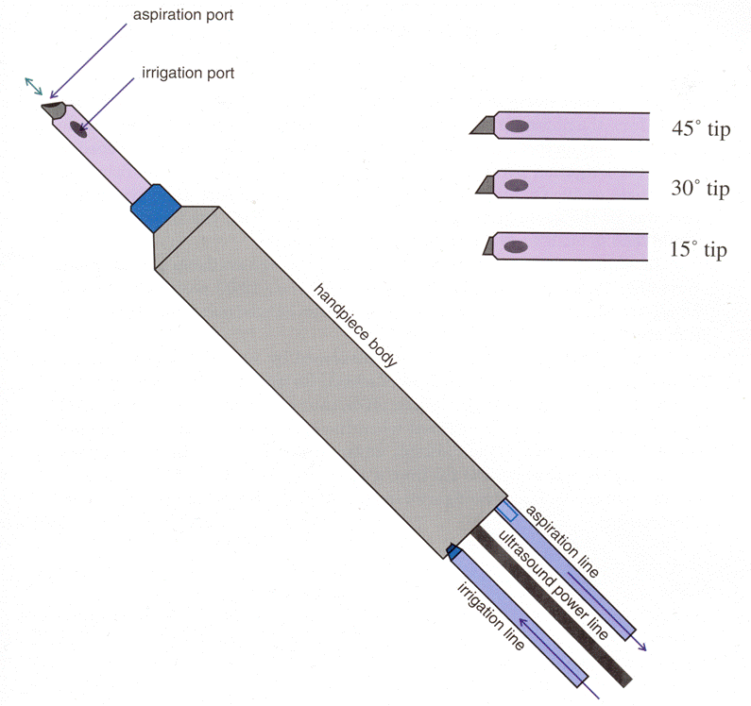
Phaco Tip Options
Tip types (shapes)
  Standard (straight)
  Kelman (angled)
  Flare (fluted)
  Balanced (humped)
Needle bevel angle
  0, 15, 30, 45 degree
Diameter
  Standard: 1.1 mm
  Microtip: 0.9 mm

Slide 52
Why Is Tip Angulation Important?
Enhanced cutting ability with high angle tips, e.g. 45 degree
  Sculpting
Enhanced ability to occlude with low angle tips, e.g. 0 degree
  Chopping
Need to balance surgical techniques and goals
30 degree is the most popular

Slide 53
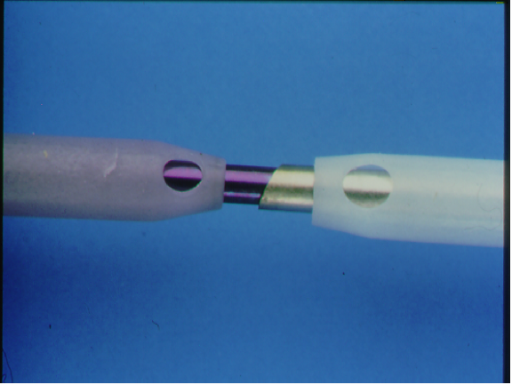
Microtip vs. Standard Tip
Cutting Area is 48% Smaller
0.9 mm
1.1 mm
Decreased inner diameter increases surge suppression

Slide 54
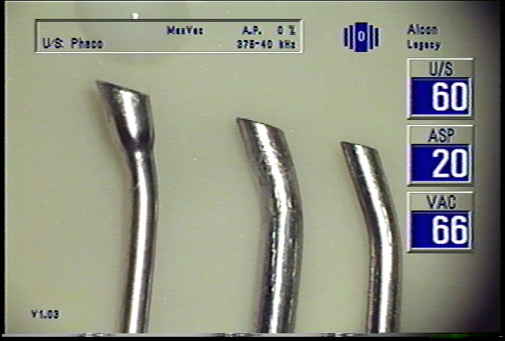
Kelman Angled Tips
Changes angle of mechanical force
Enhances emulsification
Some learning curve

Slide 55
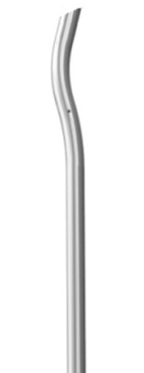
Intrepid Balanced Tip
Maximizes torsional movement at the distal end
Minimizes tip movement at the incision

Slide 56
Holding Force Formula
Holding Force = Vacuum x surface area of phaco tip

Slide 57
Holding Force Comparison

Slide 58
Capsulorrhexis and Hydrodissection

Slide 59
Capsulorrhexis with Shearing
Begin capsulotomy with formation of a flap
Using a cystotome or capsular forceps, direct the flap in the direction that you wish the tear to proceed
When using a cystotome, press only hard enough to move the flap
Point of instrument engagement
  One or two clock hours away from point of shearing
  Inside peripheral edge of flap to provide safety margin
Change in direction of tear can be accomplished, but only a gradual change in curvature is possible

Slide 60
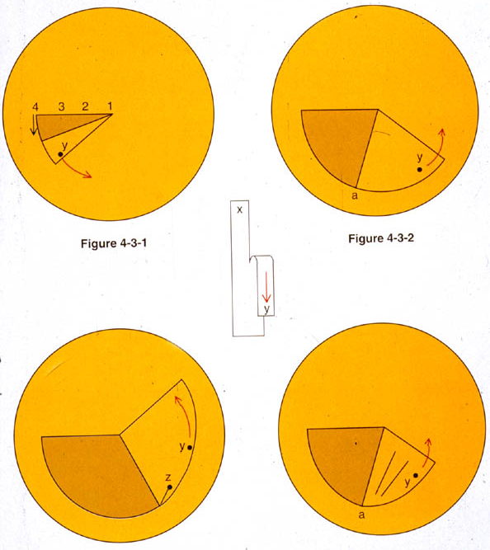
Capsulorrhexis with Ripping
Flap is engaged closer to tear
Direction of pulling is more toward the center of the capsule
Greater tendency to extend peripherally if force and direction are not correct
Advantage over-shearing if more abrupt changes in direction of tear are desired

Slide 61
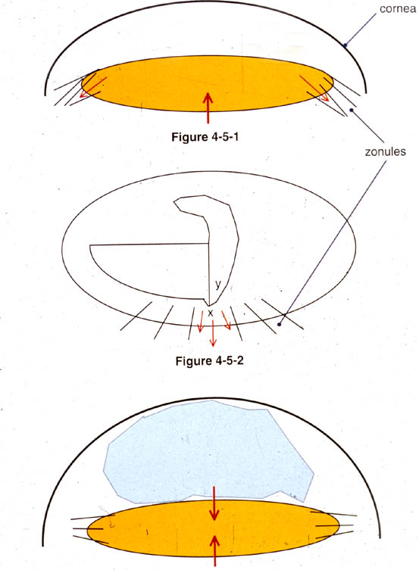
Maintain Chamber Depth
Shallowing of anterior chamber will:
  Extend rhexis tear peripherally
  Increase vitreous pressure
  Displace lens anteriorly and cause zonular stress
Use viscoelastic to deepen chamber

Slide 62
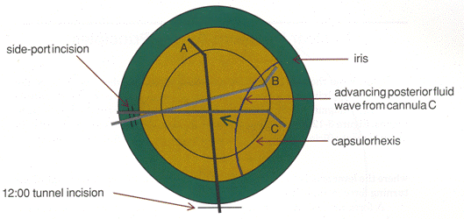
Hydrodissection

Slide 63
Phaco Techniques

Slide 64
Technique Considerations
Need to adjust machine settings according to surgeon experience, technique, and nuclear density

Slide 65
Sculpting
Low flow rate
Low vacuum
Phaco power high enough to cut nucleus efficiently

Slide 66
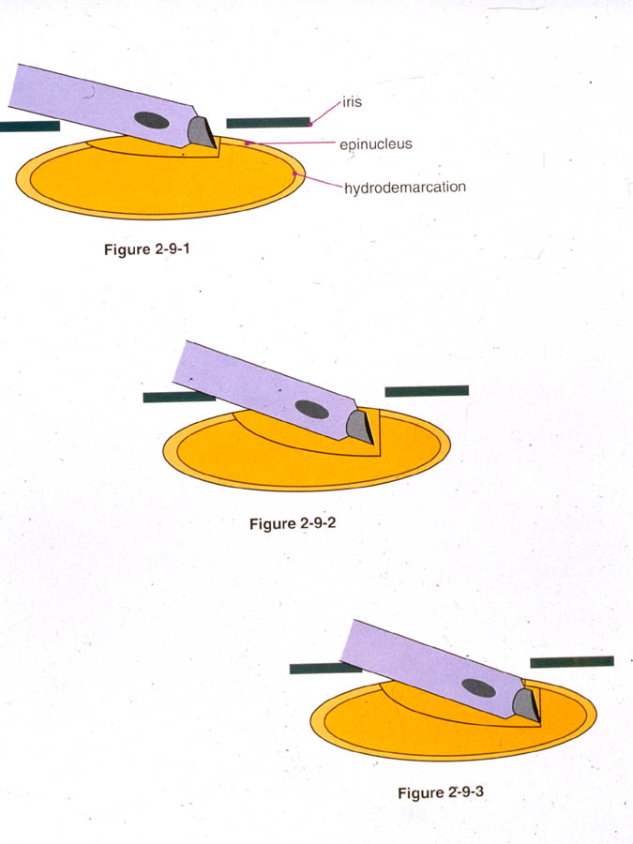
Sculpting
Avoid iris and rhexis during sculpting!

Slide 67
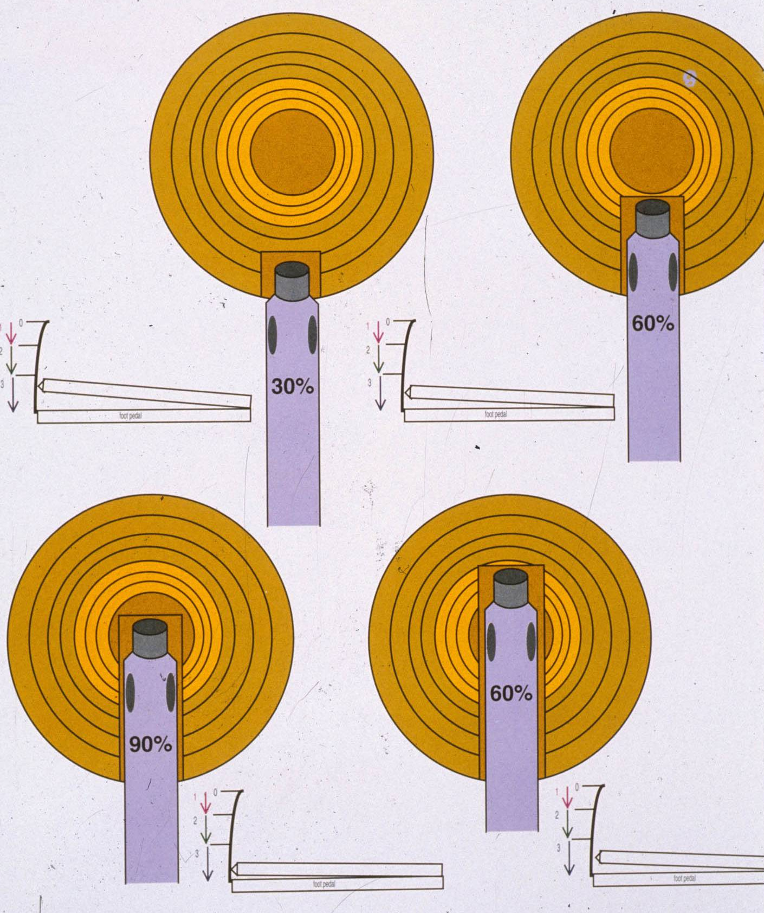
Phacoemulsification Power
Nucleus usually has variable density, with the central portion being densest
Need to vary phaco power to deliver ultrasonic energy most efficiently and provide greatest safety

Slide 68
Phacoemulsification Power
Appropriate phaco power is determined by:
  Nucleus density engaged
  Amount of tip engaged
  Linear velocity of tip during emulsification
If too little power:
  Phaco tip will push rather than carve the nucleus, risking zonular stress and/or capsular tears

Slide 69
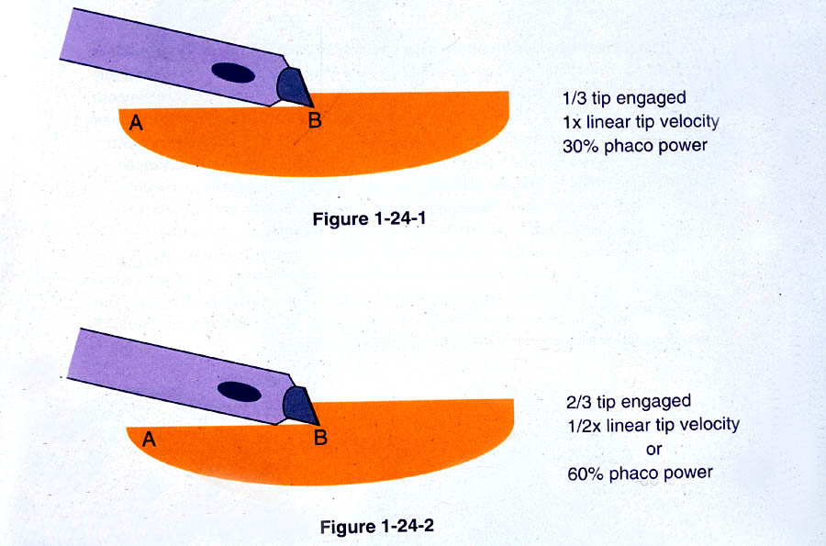
Phacoemulsification Power

Slide 70
Case Example
During sculpting, you see that the nucleus is being pushed by the phaco needle. What do you do?
  Depress foot pedal further in position 3
  Increase maximum phaco power
  Reduce amount of nucleus being removed with each pass

Slide 71
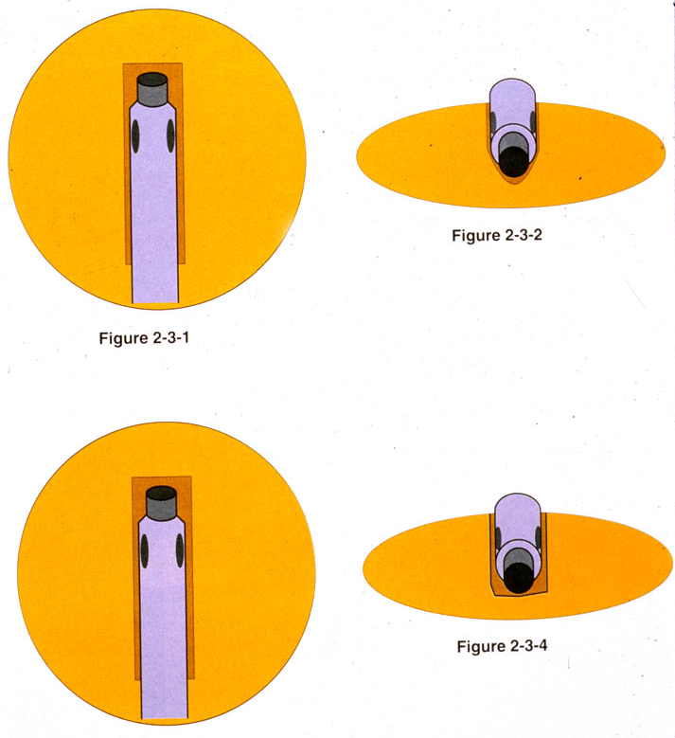
Case Example
During sculpting, you are unable to groove to adequate depth. What do you do?
  Widen phaco groove
Phaco groove must be wide enough to accommodate the phaco needle and the sleeve

Slide 72
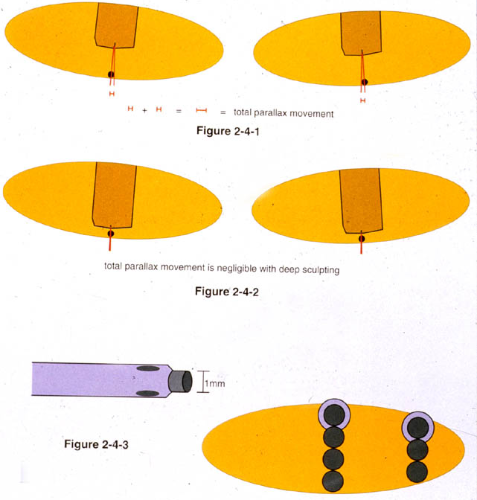
Judging Groove Depth
Red Reflex brightens
Needle thickness
  4 needles thick centrally
  3 needles thick in mid-periphery

Slide 73
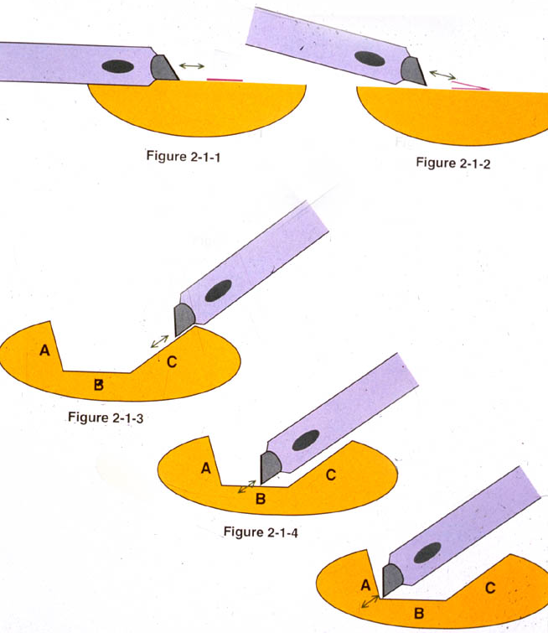
Sculpting Angle of Attack
Needle oscillates in axial direction
Need to introduce angle of attack to sculpt nucleus
Difficult to sculpt at 12:00
Nucleus rotation is necessary to complete grooves or sculpt bowl equally

Slide 74
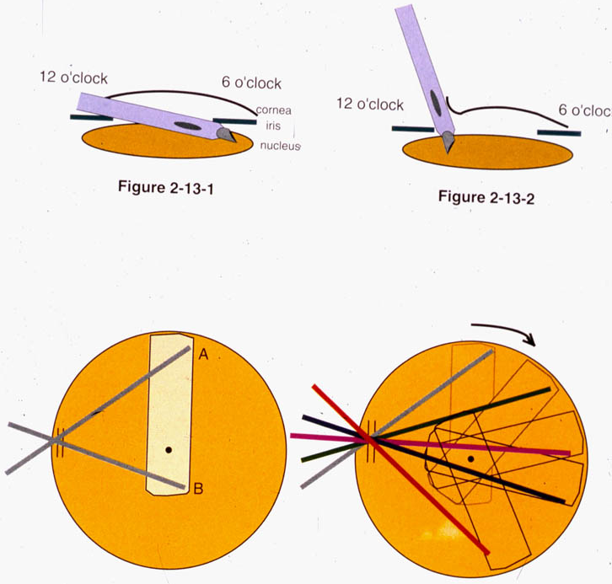
Nuclear Rotation: Torque Application
Easiest to rotate nucleus by pressure applied at the most peripheral extent of the groove
Also apply pressure against the densest part of remaining nucleus

Slide 75
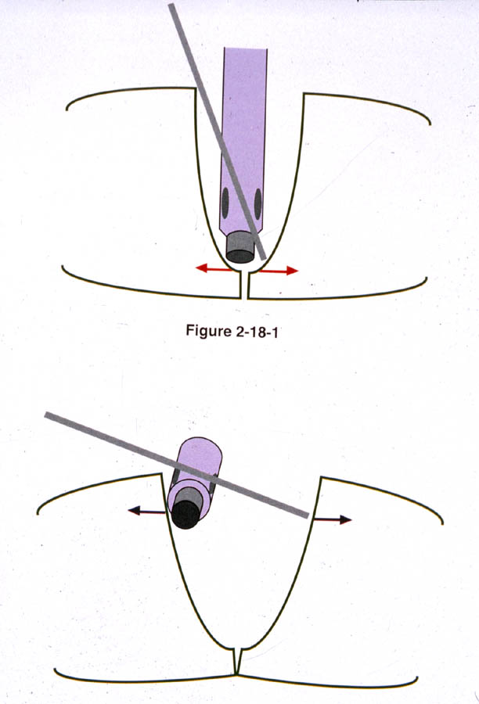
Nuclear Segmentation
Apply force at bottom of groove
  Less force required
  Less displacement of nuclear halves

Slide 76
Chopping or Quadrant Removal
Higher flow rate
Higher vacuum
Phaco: pulse or burst mode
Soft nucleus: lower vacuum to hold nucleus
Hard nucleus: higher vacuum to hold nucleus

Slide 77
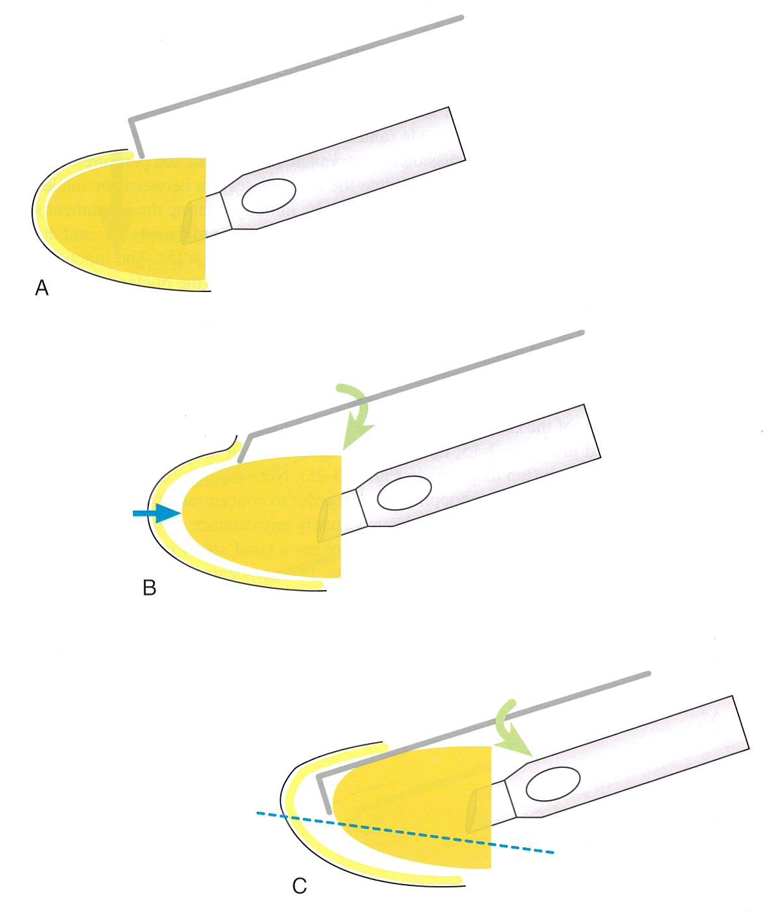
Horizontal Chop

Slide 78
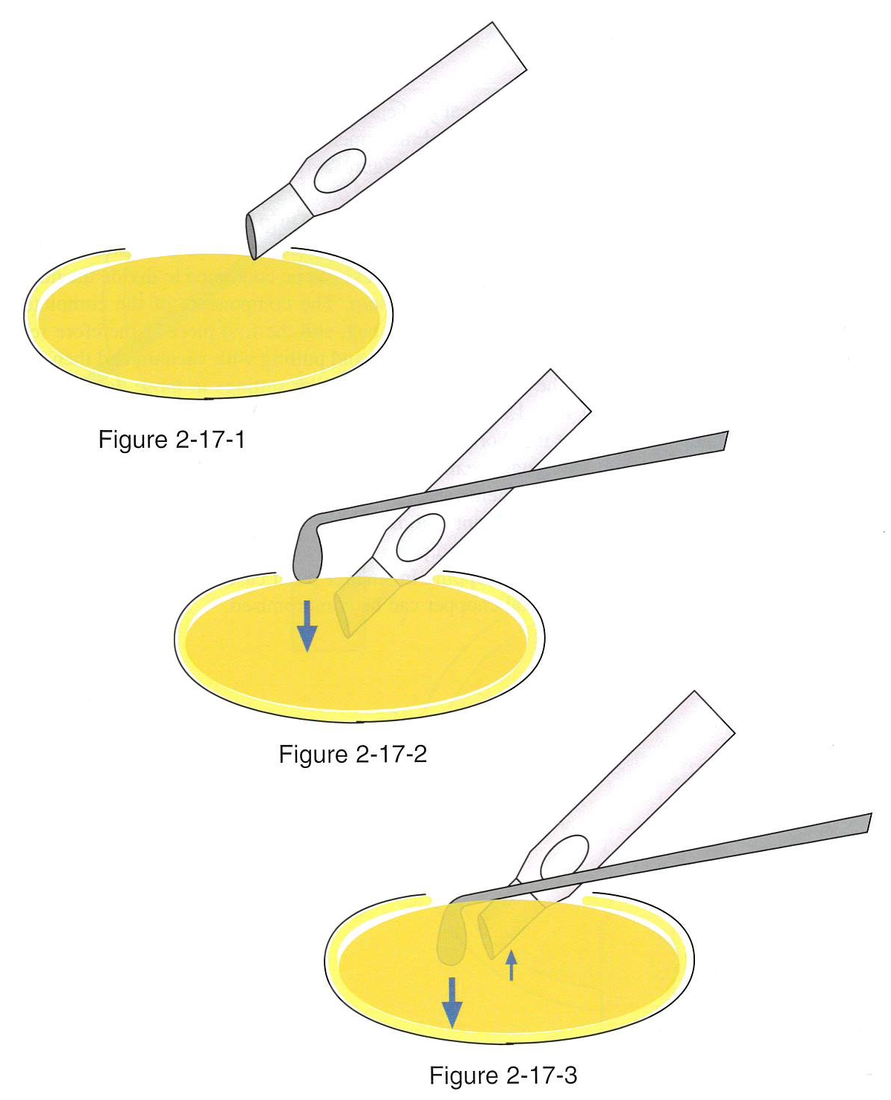
Vertical Chop

Slide 79
Vertical Chop

Slide 80
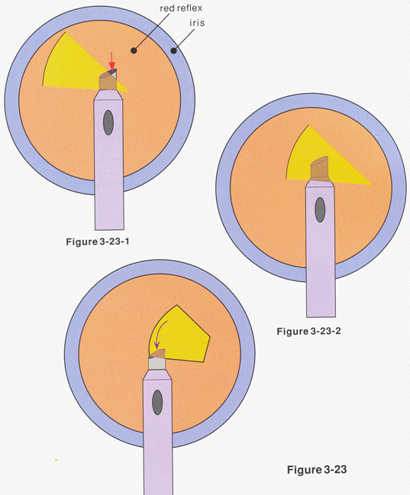
Quadrant Removal

Slide 81
Case Example
During quadrant removal, you are unable to maintain occlusion. What do you do?
  Decrease phaco power
  Decrease vacuum
  Decrease AFR

Slide 82
Case Example
During quadrant removal, your instrument is not cutting sufficiently. What do you do?
  Retighten tip and retune handpiece
  Increase U/S power
  Increase vacuum
  Increase AFR and bottle height

Slide 83
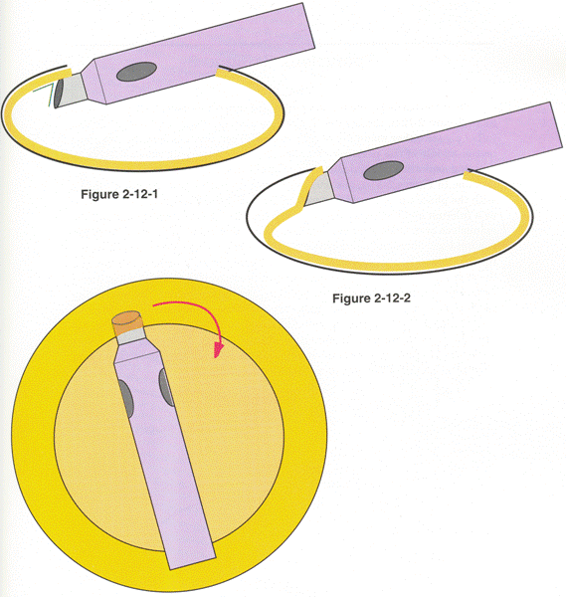
Epinucleus Removal

Slide 84
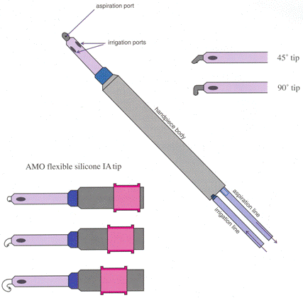
Cortex Removal
Irrigation/Aspiration (I/A) handpiece
Options
  Straight tip
  Angled tip, 45 or 90 degree
  Bi-manual
  Curved soft silicone
Manual J-cannula if needed
Optional capsule vacuum

Slide 85
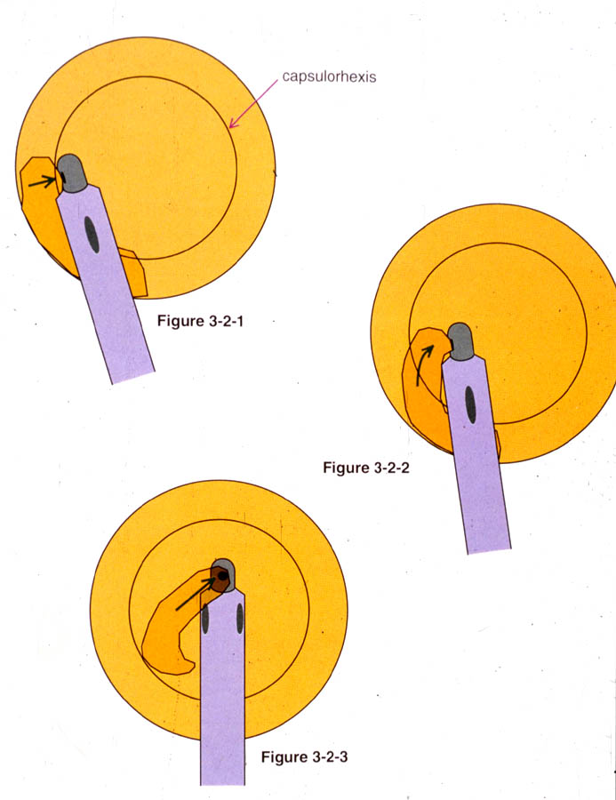
Cortex Removal
Use Linear Control to engage cortex without aspirating
Peel cortex away in center of chamber, rotating port superiorly

Slide 86
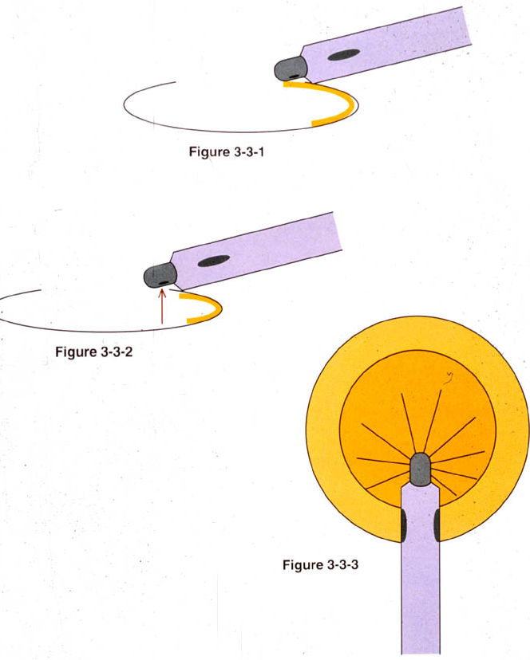
12:00 Cortex Removal
Must turn aspiration port posteriorly to engage
If port clears, capsule may become engaged
If capsule is engaged:
  DO NOT MOVE TIP
  Come off foot pedal and/or use reflux to disengage capsule

Slide 87
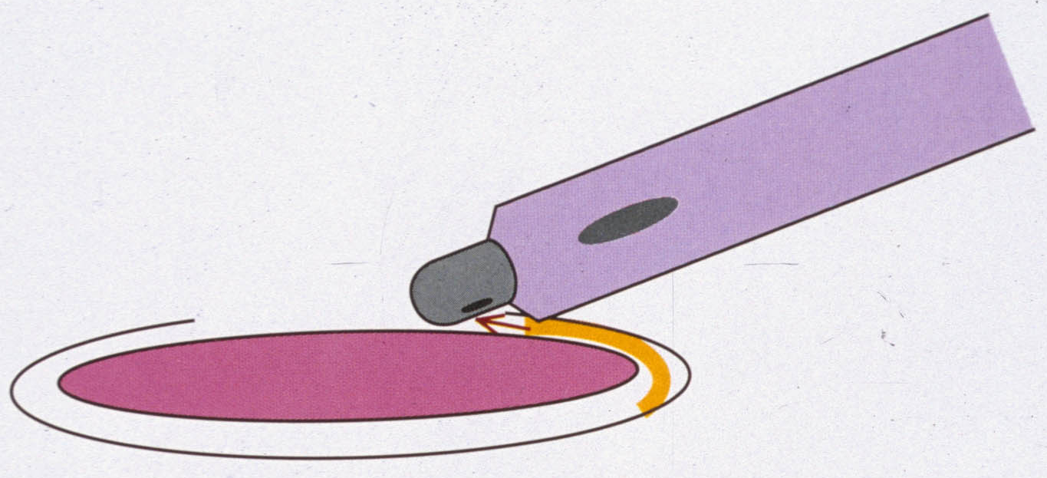
Using the IOL to Help Remove Cortex
Rotate IOL in the bag – haptics help dislodge peripheral cortex
Using IOL as physical barrier between the posterior capsule and the aspiration port

Slide 88
Additional Resources
Basic and Clinical Science Course, AAO, Section 11, Lens and Cataract.
Barry Seibel, Phacodynamics, 4th ed., Slack Inc.
Bonnie An Henderson et. al., Essentials of Cataract Surgery, 2nd ed., Slack Inc.
Richard J. Mackool, Phaco Tips: The First Ten Years, Alcon Laboratories.

