Slide 1
Iris Management & Capsulorrhexis Lab
Brett Weinstock, MD

Slide 2
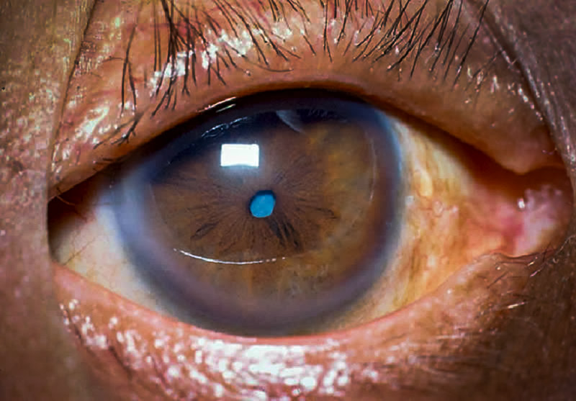
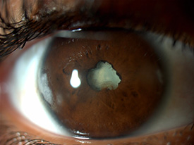
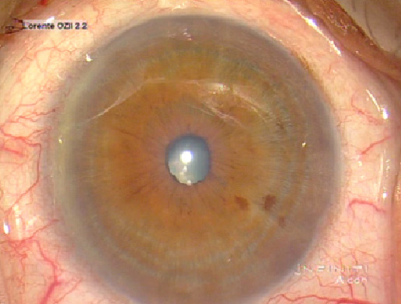
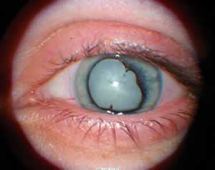

Slide 3
So…that’s not 8 mm. What now?
Management of the small pupil
Small pupils can happen for many reasons
Age, atrophy, synechiae, trauma, alpha blockers, pseudoexfoliation, the list goes on!
Questions to consider:
What scenario requires which technique?
What are the pros and cons of the various forms of pupillary dilation? How does it make your surgery easier or more complicated?
What is the “point of no return” when you should consider each of these options?
Other Resources: For a more in-depth text/procedural overview, check out the BSCS Basic Techniques of Ophthalmic Surgery, Chapter 2, Intraoperative Pupillary Dilation (pages 11-18)
Adapted from Mass Eye and Ear Curriculum

Slide 4
What tools are in YOUR toolbox?
Pharmacologic:
Preoperative drops: phenylephrine 2.5%, cyclopentolate, tropicamide
Can also use 10% phenylephrine in certain cases without contraindications
Intraoperative
Epi-Shugarcaine (epinephrine and lidocaine)
Omidria (phenylephrine and ketorolac)
Mechanical/Surgical:
Malyugin Ring
Iris hooks
Manual iris stretching
Synechiolysis with viscodissection
Adapted from Mass Eye and Ear Curriculum

Slide 5
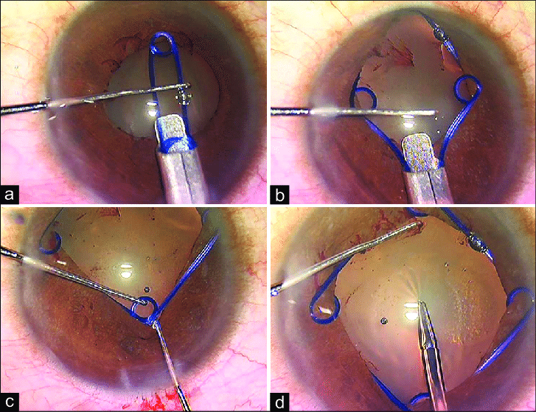
Malyugin Ring
www.aao.org/clinical-video/malyugin-ring-2-0
Technique:
Inject Viscoat under pupil
Inject ring, catching iris distally
Use manipulator to adjust
Disinsert with manipulator or Lester
Remove with manipulator or injector

Slide 6
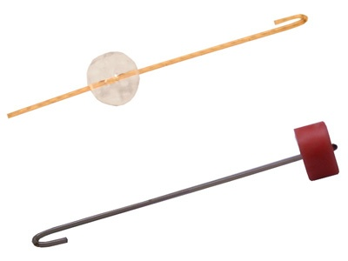
Iris Hooks
www.aao.org/clinical-video/iris-hook-technique
Technique:
25-gauge needle at iris plane
Do not make too anterior or will tent up
Push in iris hook, rotate to iris border, and retract slowly to pull iris back, then adjust rubber stopper to keep in place
Carefully remove in reverse order at end of case

Slide 7
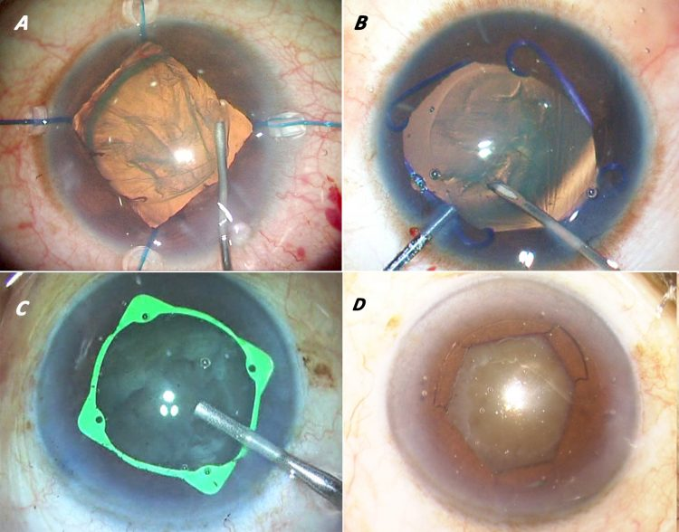
Wet Lab Stations: 15-Minute Rotations
Malyugin Ring, iRing
Simulated Eye
2-3 residents
Iris Hooks
Simulated Eye
2-3 residents
Capsulorrhexis
EyeSi
2-3 residents

