Slide 1
Introduction to
Cataract Surgery
Christina McGowan, MD

Slide 2
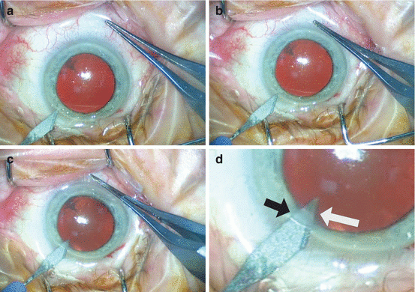
Step 1: Paracentesis
Can use different blades, including a 30-degree blade or a Supersharp blade

Slide 3
Step 2: Intracameral Anesthetic
Preservative-free lidocaine or Epi-Shugarcaine (epinephrine with lidocaine)
Epi-Shugarcaine maximizes pupillary dilation and iris stability
Injected through the paracentesis wound
If Trypan is used to stain the anterior capsule, it is injected after the anesthetic then irrigated out of the eye with BSS after ~10 seconds

Slide 4
Step 3: Dispersive Viscoelastic
Injected through the paracentesis to deepen the anterior chamber for the main incision formation
Common brands:
Viscoat (Alcon)
Amvisc (B&L)
Healon (J&J)

Slide 5
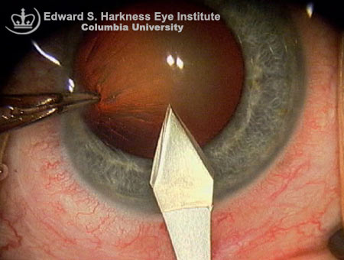
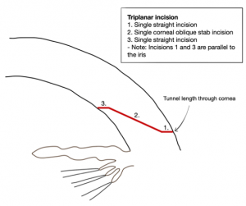
Step 4: Main Wound
Typically use a 2.4 mm keratome to make a triplanar wound
Stabilize the eye using 0.12 forceps in the paracentesis wound

Slide 6
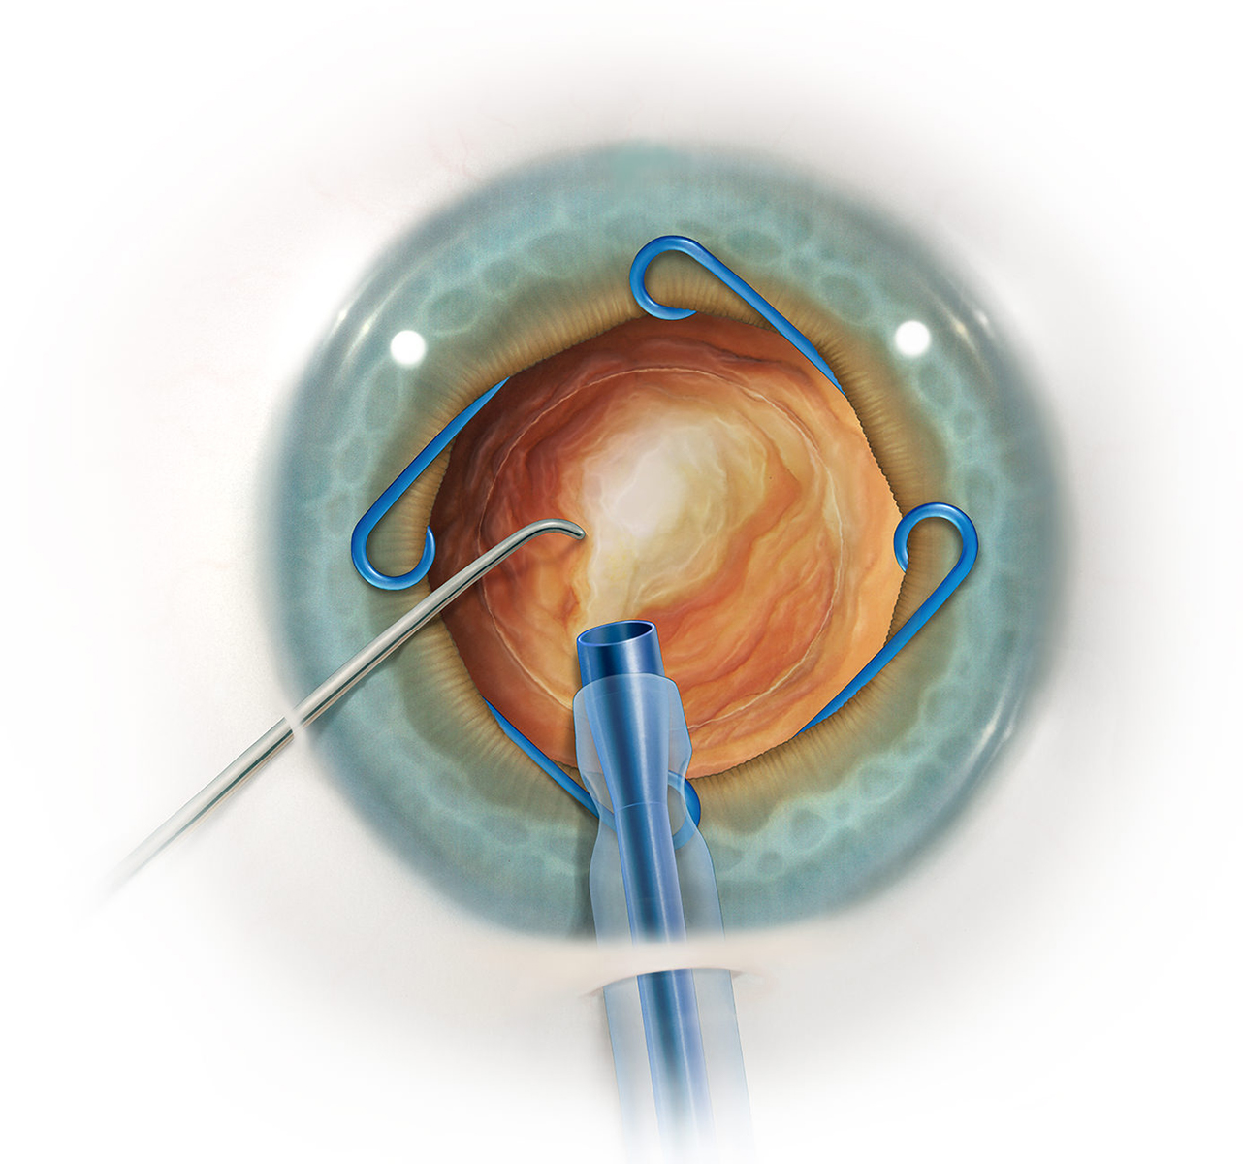
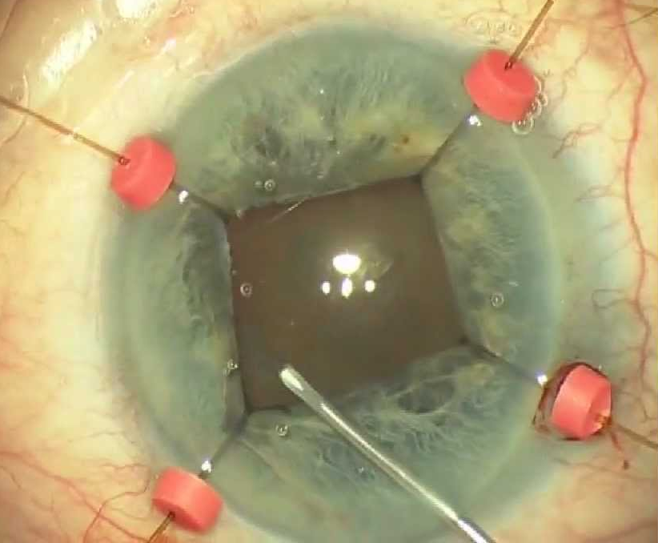
Step 5: Iris Expansive Devices (if Needed)
Place an Malyugin ring or iris hooks, if needed, to expand the iris

Slide 7
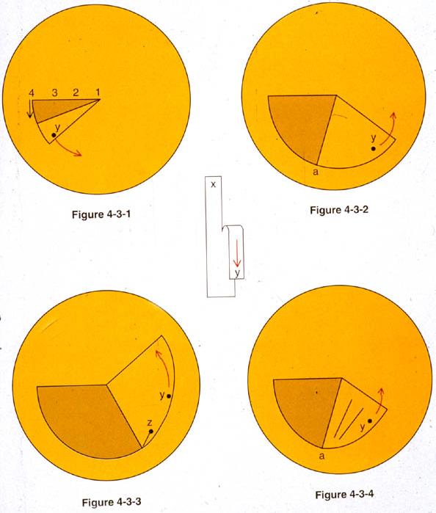
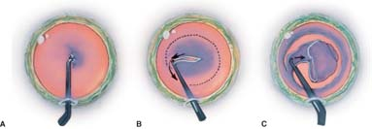
Step 6: Capsulorrhexis
Use a cystotome to begin the capsulotomy with a capsular flap
Use a cystotome or Utrata forceps to direct the flap along a continuous curvilinear capsulorrhexis

Slide 8
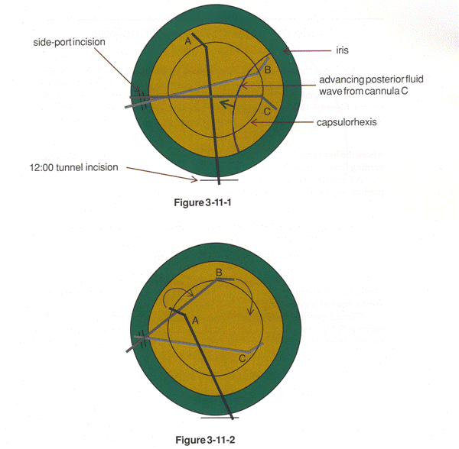
Step 7: Hydrodissection
Use a cannula with BSS to inject a fluid wave around the lens to break cortical adhesions and mobilize the lens in the capsular bag

Slide 9
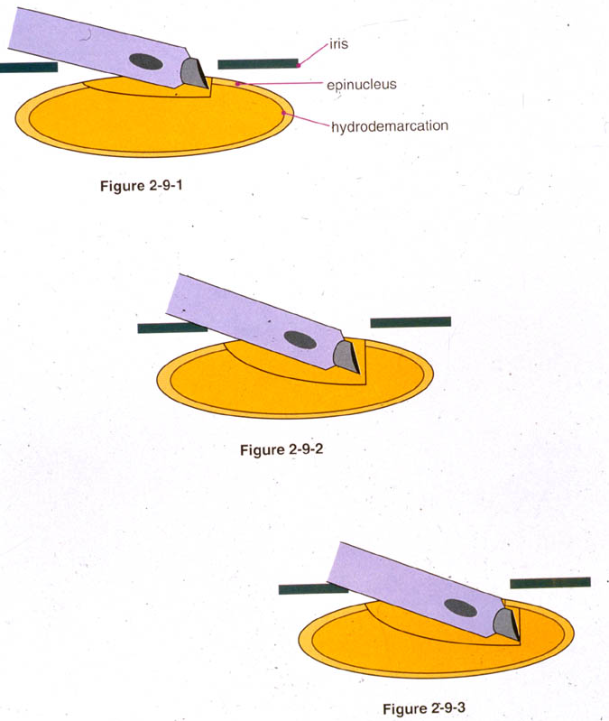
Step 8a: Grooving
Use the sculpt setting
Judge depth of groove
Red reflex brightens the deeper you are
Needle thickness
3 needle thickness centrally
2 needle thickness in mid-periphery

Slide 10
Step 8b: Nuclear Rotation
Torque application
Rotate nucleus by applying pressure at most peripheral extent of groove
Also apply pressure against densest part of remaining nucleus

Slide 11
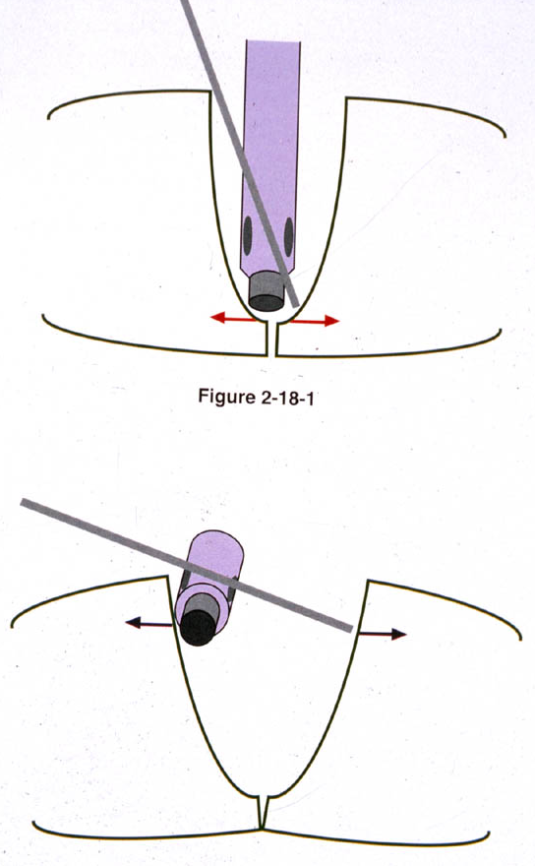
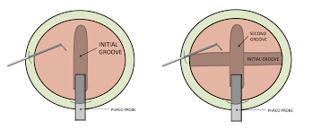
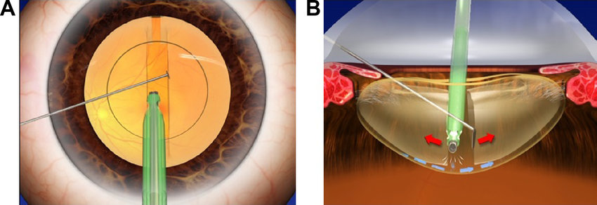
Step 8c: Nuclear Division – Divide & Conquer

Slide 12
Step 8c: Nuclear Division – Horizontal Chop

Slide 13
Step 8c: Nuclear Division – Vertical Chop

Slide 14
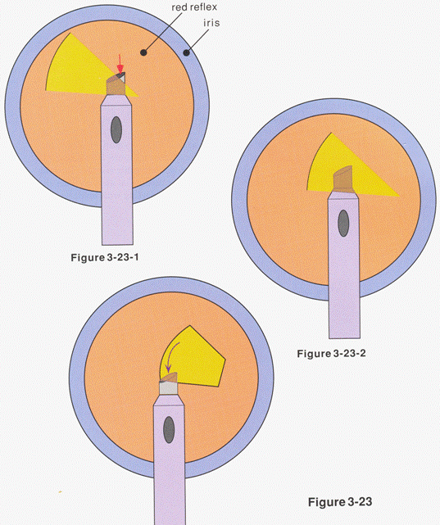
Step 8d: Nuclear Removal

Slide 15
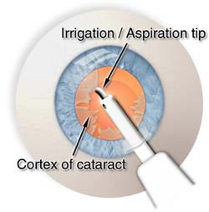
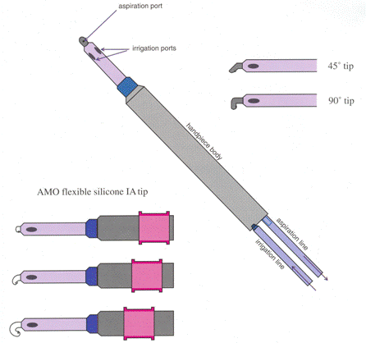
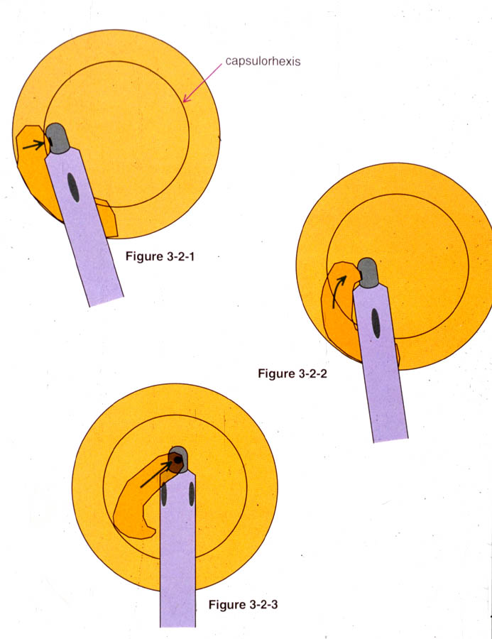
Step 9: Cortical Removal
Irrigation/Aspiration (I/A) handpiece
Options
Straight tip
Angled tip: 45- or 90-degree
Bimanual
Curved soft silicone
Manual J-cannula if needed

Slide 16
Step 10: Cohesive Viscoelastic
Fill the capsular bag with cohesive viscoelastic to create space for the intraocular lens

Slide 17
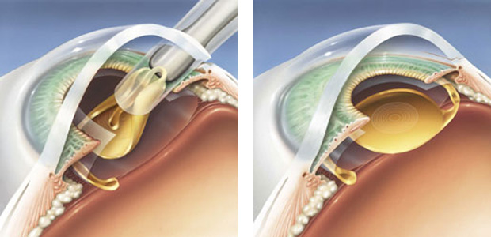
Step 11: Intraocular Lens

Slide 18
Step 12: Aspiration of Viscoelastic
Confirm that the IOL is centered within the capsular bag
Aspirate the viscoelastic from the capsular bag and anterior chamber to prevent post-operative IOP spike

Slide 19
Step 13: Hydration of Corneal Wounds
Hydrate the main corneal incision and paracentesis incision(s) with balanced salt solution to seal the incisions
Pressurize the eye to 20-25 mmHg
Check the wounds with a Weck-Cel sponge to confirm that they are Seidel negative

