Slide 1
Gonioscopy
Daniel Lee, MD

Slide 2
We are not doing enough gonioscopy…
More than 50% of patients with a glaucoma diagnosis have never had gonioscopy
1 out of 10 patients referred by other ophthalmologists with “open angle glaucoma” actually had angle closure glaucoma
Angle closure accounts for half of glaucoma blindness worldwide

Slide 3
Why aren’t we doing it more?
It’s inconvenient and time-consuming
Patients find it uncomfortable
It’s difficult to master
Angle anatomy is confusing…
Gonioscopy is the scleral depression of the anterior segment.

Slide 4
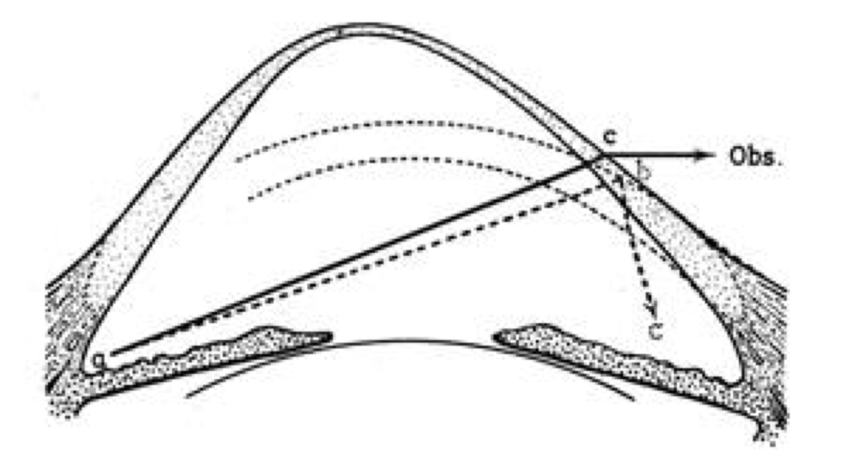
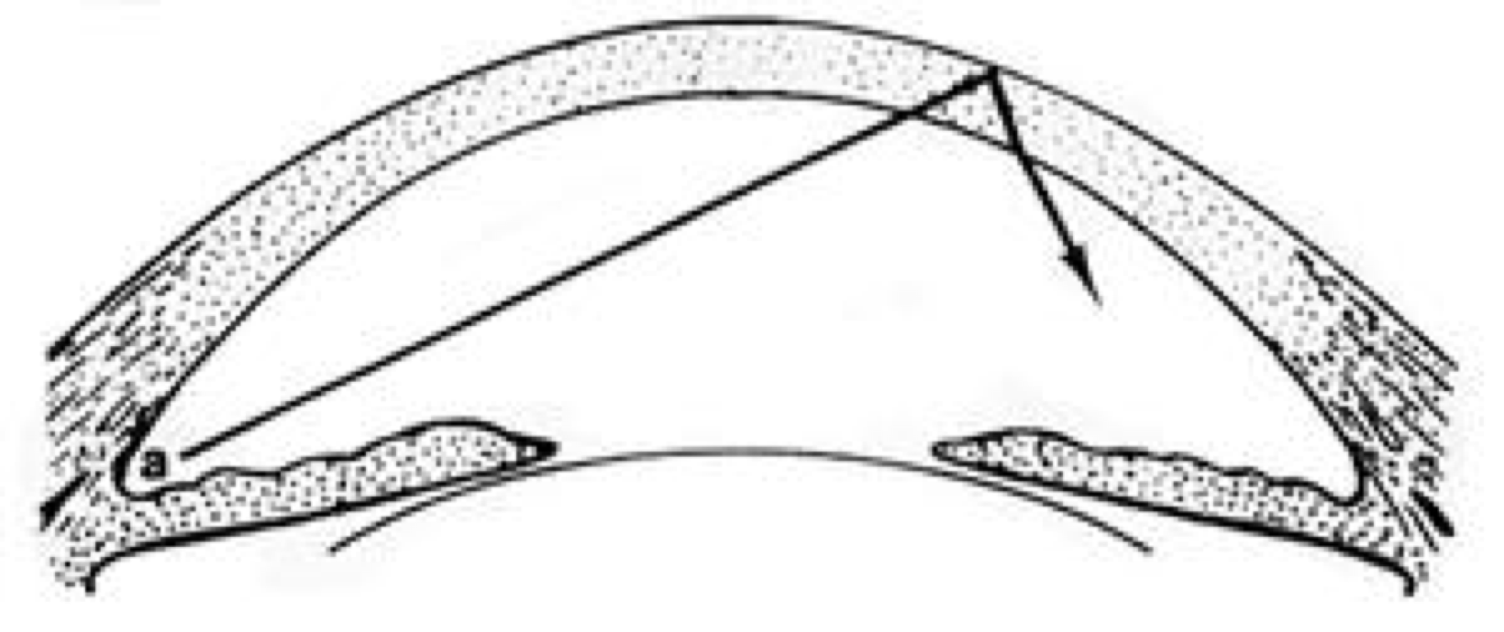
Total Internal Reflection
The light from the trabecular meshwork does not exit the eye
Snell’s Law
Rays approaching the air-tear interface < 46 degrees are reflected back

Slide 5
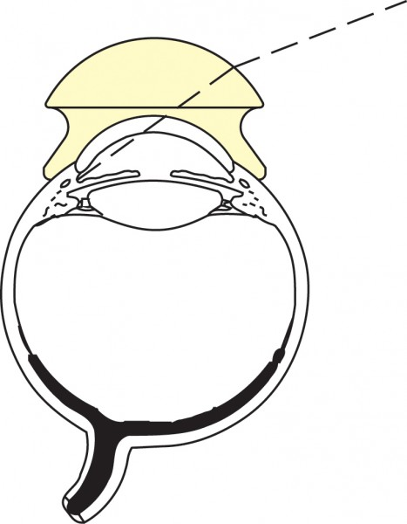
Gonioscopy Overcomes Total Internal Reflection
Direct Gonioscopy
Lens is placed on the eye, replacing the air-tear interface
Allows for “direct” or upright visualization of the angle
Most commonly used for intra-operative visualization of the angle
Patient must be supine
Awkward viewing angle
Koeppe, Barkan, and Swan Jacob

Slide 6
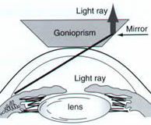
Gonioscopy Overcomes Total Internal Reflection
Indirect Gonioscopy
The angle is visualized “indirectly” through a mirror
Able to visualize the angle with a slit lamp
Light rays are reflected off the mirror and exit parallel to the optical axis

Slide 7
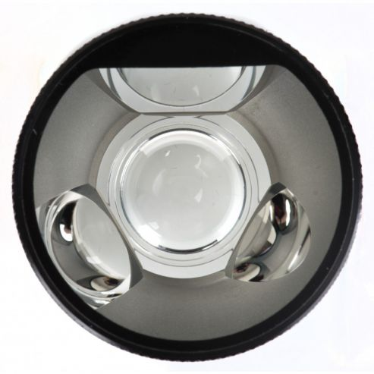
Types of Indirect Gonio Lenses
Goldmann
3 mirrors
Excellent view of angle (also peripheral retina)
Usually needs a viscous coupling agent
Easier to use
15 mm contact diameter
Cannot perform indentation gonioscopy

Slide 8
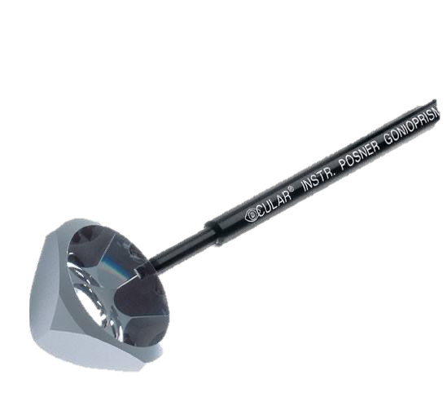
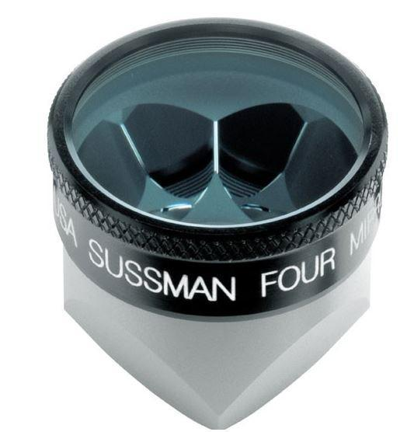
Types of Indirect Gonio Lenses
Zeiss, Posner, and Sussman
4 mirrors
No coupling agent necessary
More difficult to master
9 mm contact diameter
Allows for indentation gonioscopy

Slide 9
Technique
Anesthetize the eye
Position patient in slit lamp
Have patient look up
Brace upper and lower lid with fingers
Gently place gonio lens on cornea
Ask patient to look straight

Slide 10
Technique
Minimize light going through the pupil
Induced pupillary constriction may artificially open the angle
Turn room lights off and keep slit beam small on dim setting
Note: When evaluating for neovascularization, it’s helpful to have high illumination.

Slide 11
Technique
Excess light induces pupillary constriction and artificially opens the angle

Slide 12
Technique
The gonio lens should very gently contact the corneal surface
Posterior pressure and corneal indentation will artificially open the angle

Slide 14
Technique
Begin your examination at the superior lens = inferior angle
Typically the most open
The most defined pigmentation
Can go clockwise or counter-clockwise
Just be consistent

Slide 15
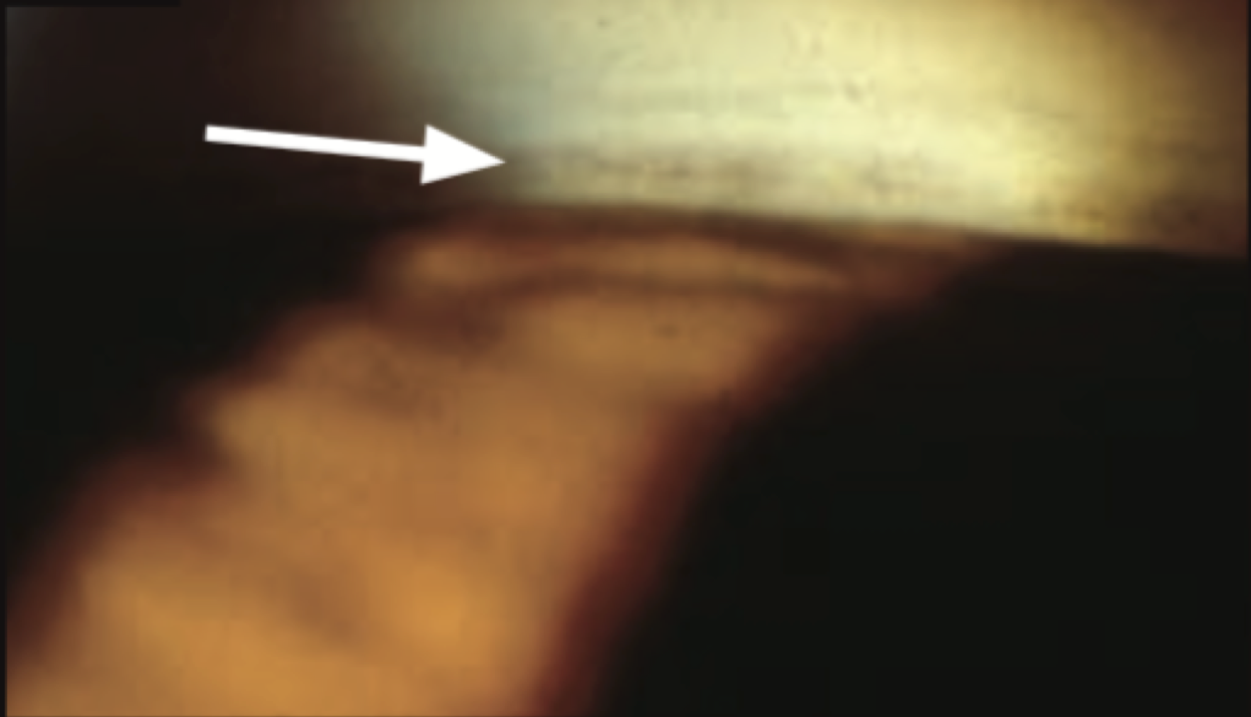

Slide 16
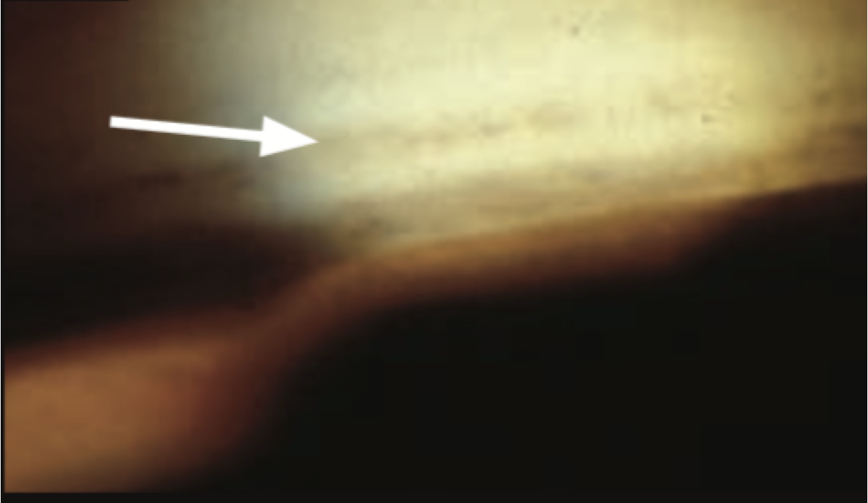

Slide 17
Indentation Gonioscopy
The lens diameter is smaller than the corneal diameter
Pushing posteriorly drives the lens-iris diaphragm back, which exposes the obscured angle
Determine if angle closure is appositional or synechial
“Double hump sign” in plateau iris

Slide 18
Great Gonioscopy Resources

