Slide 1
White and Dense Cataracts
and Potential Complications
Douglas M. Wisner, MD

Slide 2
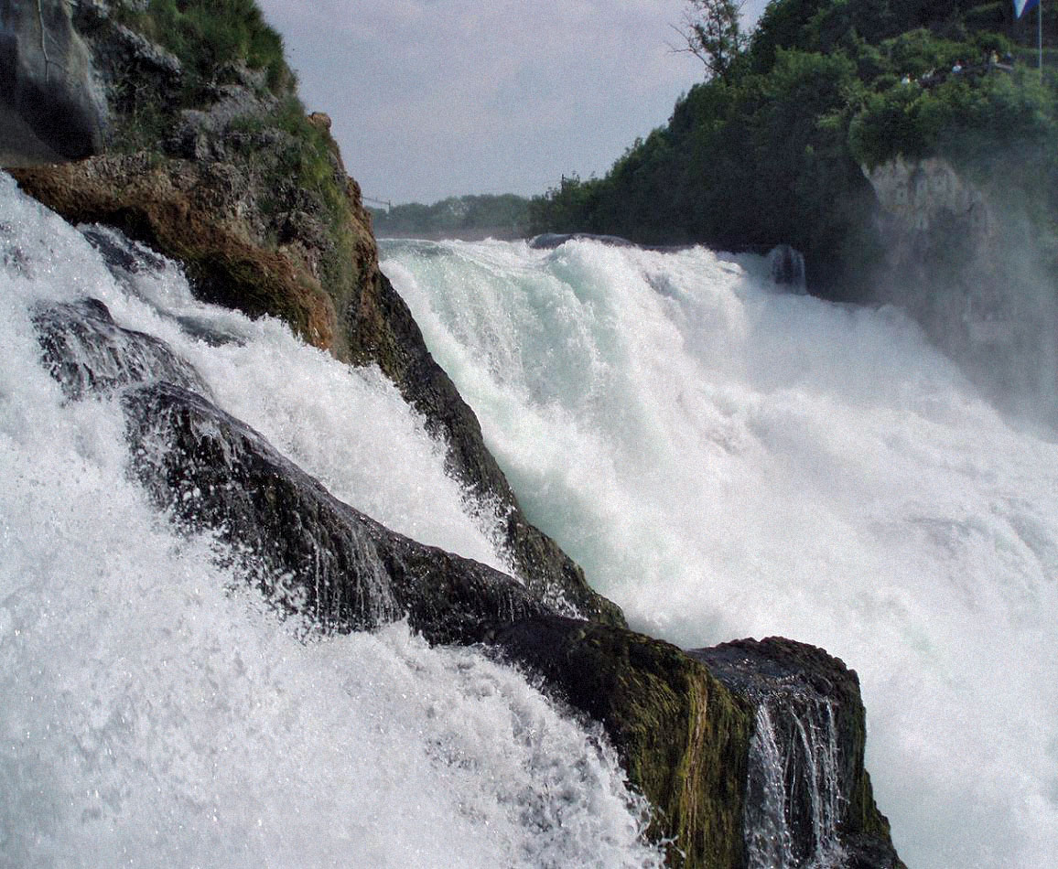
Considerations
Surgery is more challenging
Increased lens density
Decreased visualization
Possible zonulopathy
HIGHER COMPLICATION RATE
Patient may be more complex
Anesthesia issues
Medical co-morbidities
Cognitive co-morbidities
Non-English speaking
Inconsistent follow-up

Slide 3
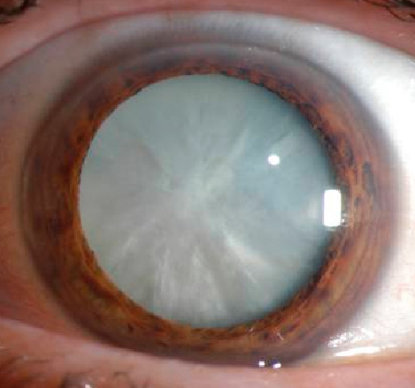
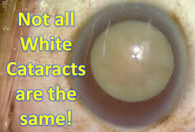
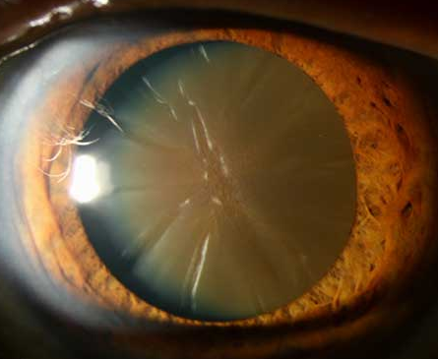
Definitions
White cataract
Complete cortical opacification
Brunescent cataract
Extremely dense nucleus
THEY CAN COEXIST!

Slide 4
Grading

Slide 5
Preoperative Assessment – Risk/Benefit Analysis
Vision potential
Nerve status (rAPD)
Macula status (dense RPE changes)
Sensory XT
Longstanding vs. new
PAM, red/green perception
Amblyopia
ASK!
A difference
Contralateral eye status
Monocular
Exam
Density/opacity
VA CORRELATION!
Zonulopathy
Intumescence
Cornea
Visualization
Fuchs
Etiology
Age, trauma, iatrogenic, secondary, medication-induced
Patient
Understanding
Cooperation

Slide 6
Anesthesia
 | Uncomplicated Eye | Complex Eye | Complicated Eye
Cooperative Patient | MAC + topical | MAC + topical | MAC + Block
Unknown Cooperativity | MAC + topical | MAC + block | GA
Uncooperative Patient | GA | GA | GA
Risk factors for an uncooperative patient
Dementia, psych hx or meds, difficult pre-op exam, developmental delay
Consider anesthesia risk
Increases with medical co-morbidities
If on anticoagulants and need to block: cut-down sub-Tenons “on the field” rather than peribulbar block
Minimizes risk of retrobulbar hemorrhage
Supplemental sub-Tenons if globe formed

Slide 7
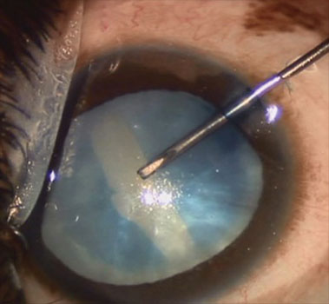
Lens Access
Pupil management
Iris hooks
Malyugin ring
Capsulotomy
Trypan Blue
Consider needle decompression
25G needle bevel DOWN

Slide 8
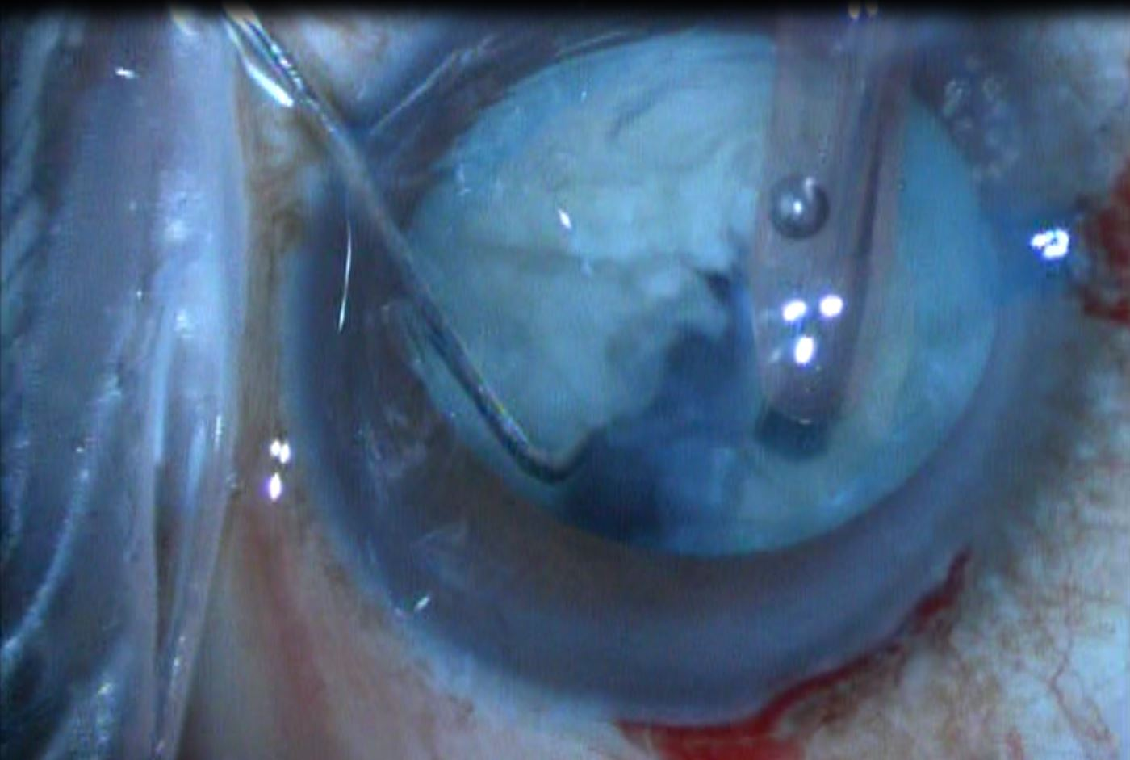
Phaco
Contraindications
Truly brunescent lens
Benefits
Small incision
Considerations
Incorporate chopping
Crater
Copious viscoelastic

Slide 9
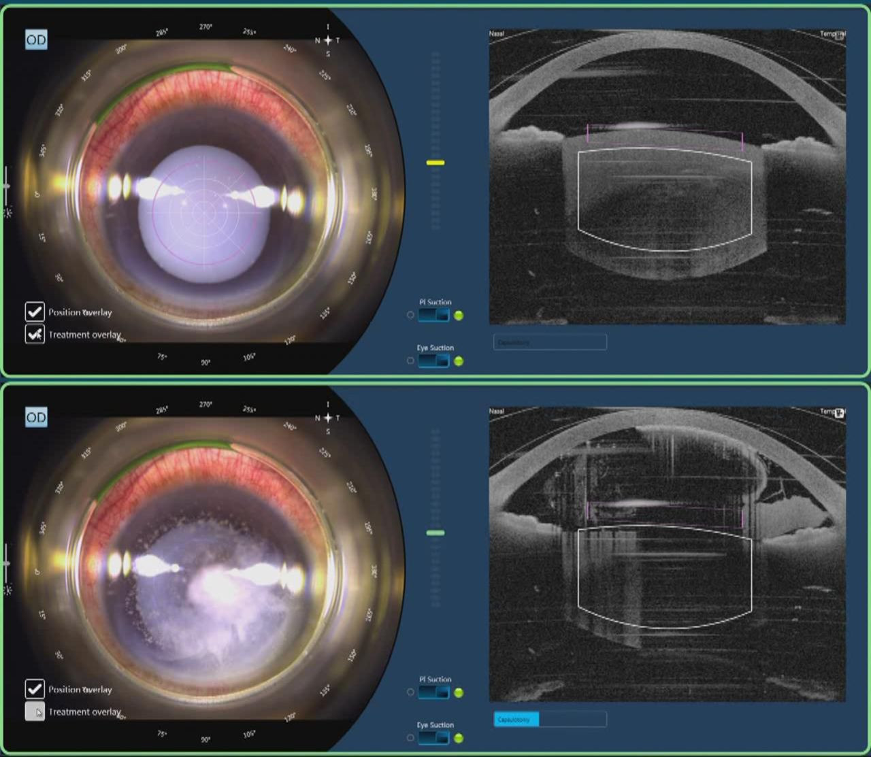
Femto
Contraindications
Brunescent lens
Benefits
Small incision
Capsulotomy
Decreased phaco energy
Considerations
Anterior fragmentation only
18% risk of incomplete capsulotomy
Soon-Phaik, BJO 2019
Requires
Cooperation
Large IPF
Adequate dilation (7 mm)

Slide 10
MiLoop
What is it?
Nitinol loop
Mechanically slices lens
Contraindications
Zonular instability
Benefits
Small incision
Heminuclear fragmentation
Decreased phaco energy
Considerations
Copious viscoelastic
Cautious technique

Slide 11
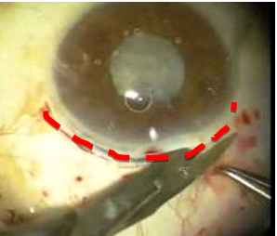
Traditional Extracap (ECCE) – Limbal Approach
Contraindications
Soft lens
Uncooperative at slit lamp
Benefits
NO phaco energy
Less zonular trauma
Quick access
Technically easy
Considerations
Large wound
Suture management
Induced astigmatism
Potential for wound dehiscence

Slide 12
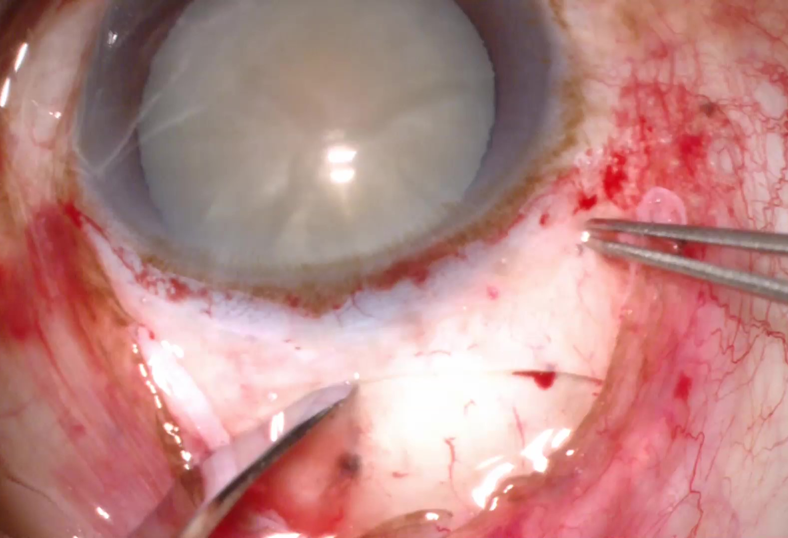
Manual Small Incision Cataract Surgery (MSICS)
Contraindications
Soft lens
Unable to stop anticoagulants
Benefits
NO phaco energy
Less zonular trauma
No suture management
Minimal induced astigmatism
Considerations
IPF
Technical proficiency

Slide 13
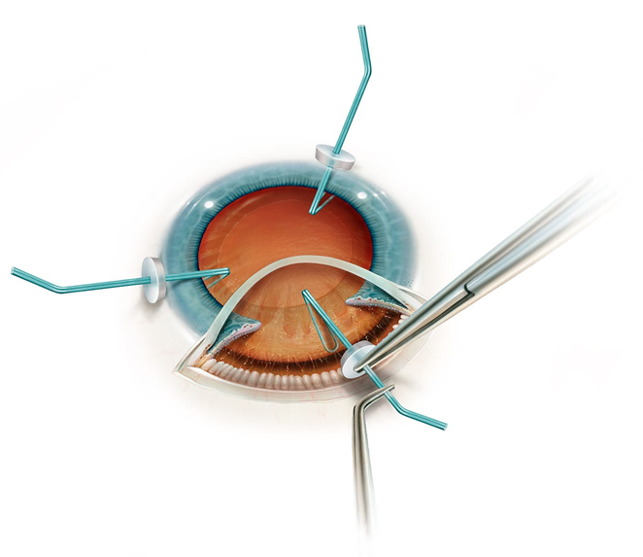
Zonulopathy
Maintain a high level of suspicion
Whatever you see pre-op will be WAY worse intra-op
Signs
Capsular wrinkle with capsulotomy
Capsulorrhexis wants to extend out
Difficulty with bringing rhexis back in
Sudden mydriasis, miosis, or pupil peaking (V)
Sudden shallowing or deepening of chamber (V)
Management
Capsular hooks (EARLY)
Capsular tension ring +/- segments
Bag sacrifice with scleral-fixated IOL
Can leave aphakic
eyewiki.aao.org/Zonulopathy%3A_Evaluation_and_Surgical_Management

Slide 14
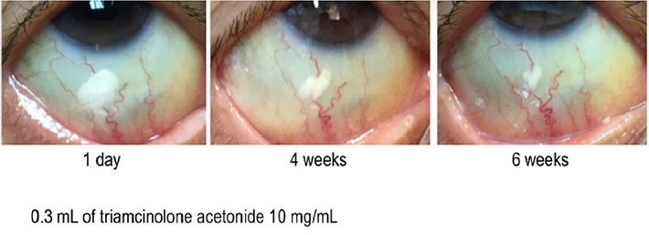
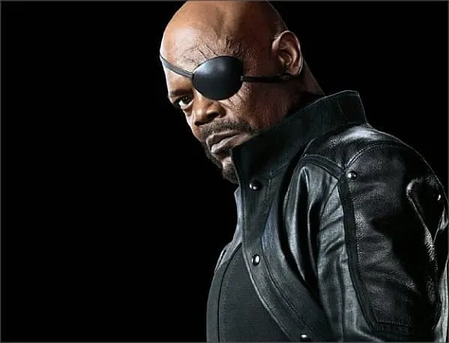
Closing the Case
Consider suture
Intracameral antibiotics
PF moxifloxacin
Subconjunctival steroids
Diamox?
Patch and shield?
Maintain until seen the next day

Slide 15
Post-Op – Meds
Standard Regimen
Antibiotic
Polytrim/ofloxacin QID x 1 w
Besivance BID x 1 w
Steroid
PA 1% QID x 2 w then BID x 2 w
Durezol BID x 2 w then daily x 2 w
NSAID
Ketorolac 0.5% QID x 4 w
Ilevro daily x 4 w
Enhanced Regimen
Antibiotic
Consider extended course
Especially if managing sutures
Steroid
PA 1% 6x x 2 w then QID x 2 w then BID x 2 w
Durezol QID x 2 w then BID x 2 w then daily x 2 w
NSAID – higher concern for CME
Ketorolac 0.5% QID x 6 w
Ilevro daily x 6 w

Slide 16
Post-Op – Hiccups
Post-cataract dry eye
Mention pre-op
Especially if pre-existing DES
Manage
PFATS, Restasis, punctal plugs
It is NORMAL for many patients
Will resolve over 2-3 months
Taper preservative-containing drops rapidly
Lotemax ointment is non-preserved
Corneal toxicity
Usually secondary to
Ketorolac
Polytrim
D/C or switch drops if able
NSAID important in
Epiretinal membrane
Diabetic retinopathy
Iris manipulation

Slide 17
Post-Op – Hiccups
IOP spike
Usually retained viscoelastic
Burp wound
Day 1 or 2
Para ONLY
Under antibiotics or betadine
Cosopt or Combigan
D/c 1 day prior to next visit
Oral Diamox
Corneal edema
Usually 2/2 phaco or direct trauma
Increase topical steroids
Consider Muro if severe
Reassure
It will almost always get better unless pre-existing Fuchs

Slide 18
Post-Op – Hiccups
Dysphotopsia
Temporal crescent or shadow
Related to optical effect from new light/lens interface
Reassure
Resolves after 2-4 weeks
Almost always
Can do reverse optic capture if persists > 6 months
PVD
Common within 90 days post-op
AC volume fluctuations intra-op
IOL thinner than crystalline lens
Potential vitreous volume expands
Anterior shift of vitreous gel
Dilate patients with new flashes and/or floaters
Breaks are often smaller

Slide 19
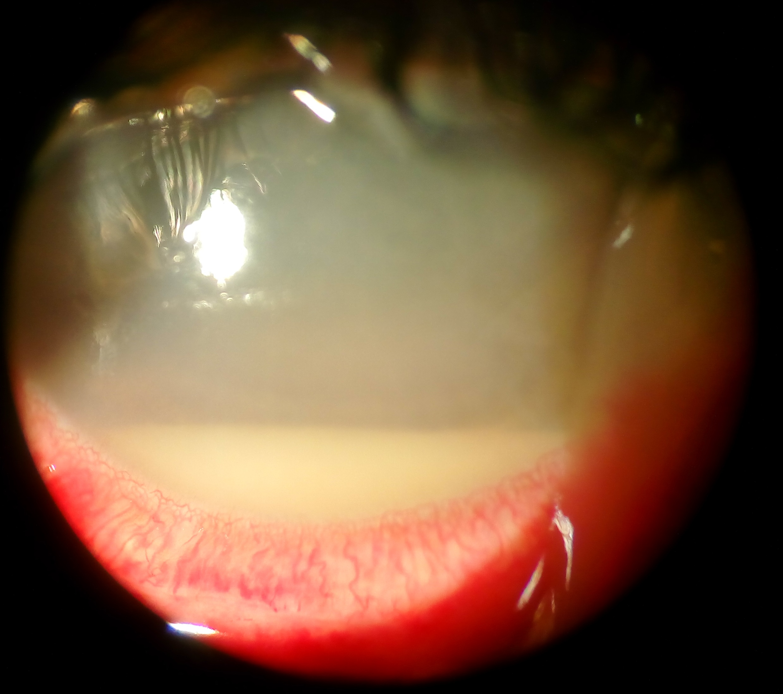
Complications – Endophthalmitis
Incidence ~1/4,000 after cataract surgery
Povidone Iodine
Intracameral antibiotics
Usually Days 2-5
Pain, redness, decreased vision
25% of patients without pain
Risk factors
Wound leak
Retained lens material
Vitreous presentation
Endophthalmitis Vitrectomy Study (EVS)
HM or better → T&I
Ceftaz/Vanco
LP → immediate PPV

Slide 20
Complications – Vitreous in AC Post-Op
Ideally, identified and managed intra-op
Management post-op depends on extent
Vitreous to wound
External wick → OR immediately
Internal lip → can observe closely
May cause iritis
Consider OR vs. YAG vitreolysis
Knuckle in A/C
May be asymptomatic
Large volume can clog TM

Slide 21
Complications – Retained Lens Material
Risk factor for endophthalmitis
Cause of post-op iritis
GONIO!
If in AC
Nuclear fragment
To OR
Cortical remnant (small)
Can observe
Modulate steroids
If trapped in capsular bag
Can observe
Modulate steroids
www.cataractcoach.com

Slide 22
Complications – IOL Malposition
Management
Observe
If symptomatic
Attempt medical tx
If refractory or unlikely to resolve → OR
Reposition
Exchange
Usually secondary to
Zonular weakness
Zonular dialysis
Improper positioning
Can lead to
UGH syndrome
CME
Visual disturbance
Monocular diplopia
Higher-order aberrations

Slide 23
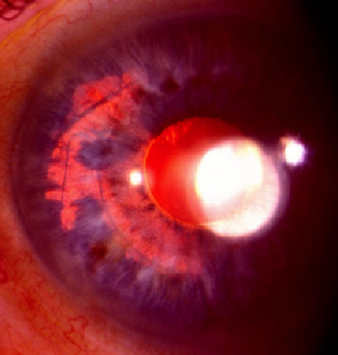
Complications – UGH syndrome
Can be incomplete
Usually secondary to IOL malposition
ANY IOL/iris contact can cause
Uveitis
Glaucoma
Hyphema
CME
More common w/ hydrophobic acrylic IOLs
Management
Atropine/steroids/anti-hypertensives
Reposition or exchange

Slide 24
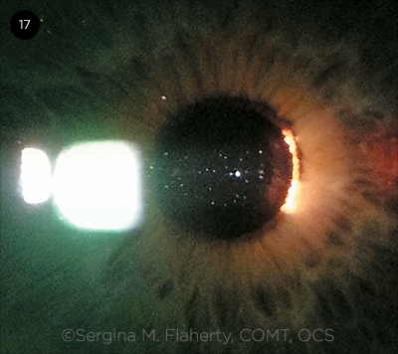
Complications – Persistent Post-Op Iritis
Etiology
Drop non-compliance
Mild IOL malpositioning
Incomplete optic-capsule overlap
Retained lens material
Workup
DILATE!
Attention to optic position
Gonioscopy
UBM if fails taper x 2

Slide 25
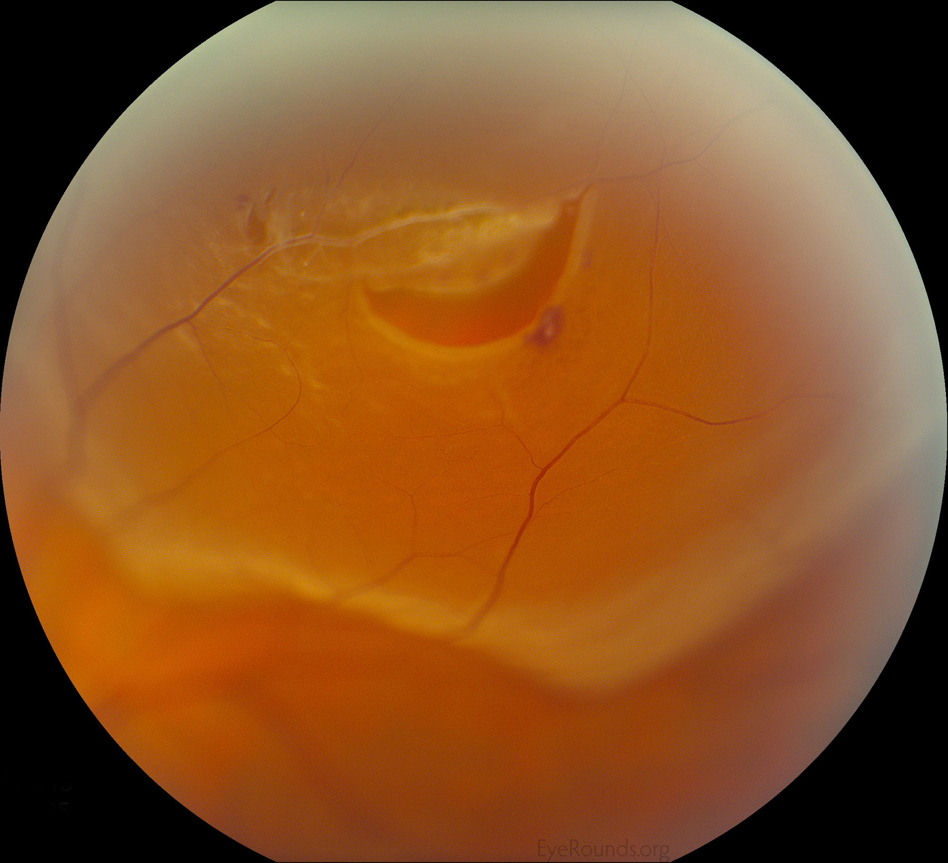
Complications – Retinal Tear
Etiology
PVD
Vitreous presentation
Risk factors
Family history
Tear in contralateral eye
High axial length
Lattice degeneration

Slide 26
Complications – Refractive Surprise
Refraction can settle over a month
Etiology
Measurement error
Calculation error
Transposition
Substitution
Intraoperative error
Wrong IOL implanted
Intracapsular viscoelastic
Myopic shift
Investigation
Refract
Review calcs
Remeasure
Management
Reassure
Glasses/contact
Laser vision correction
IOL exchange

Slide 27
Advice – Complex Cataracts & Complications
Before surgery
Prep
IOL calcs
For contingencies
Visualize your steps
Call your patients if new to you
Sleep
Moderate caffeine
Snack throughout the day
After surgery
Discuss with attending
Discuss complications HONESTLY with patient/family
DO NOT OVERWHELM THEM WITH INFORMATION
REASSURE
Review video
Stand by YOUR patient
If you cut it, you own it

Slide 28
Advice – Complex Cataracts & Complications
With the right tools
With the right help
You can fix a lot of stuff!

