Slide 1
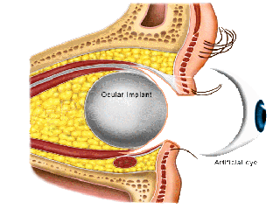
Enucleation & Evisceration
Edward H Bedrossian Jr., MD, FACS, MD

Slide 2
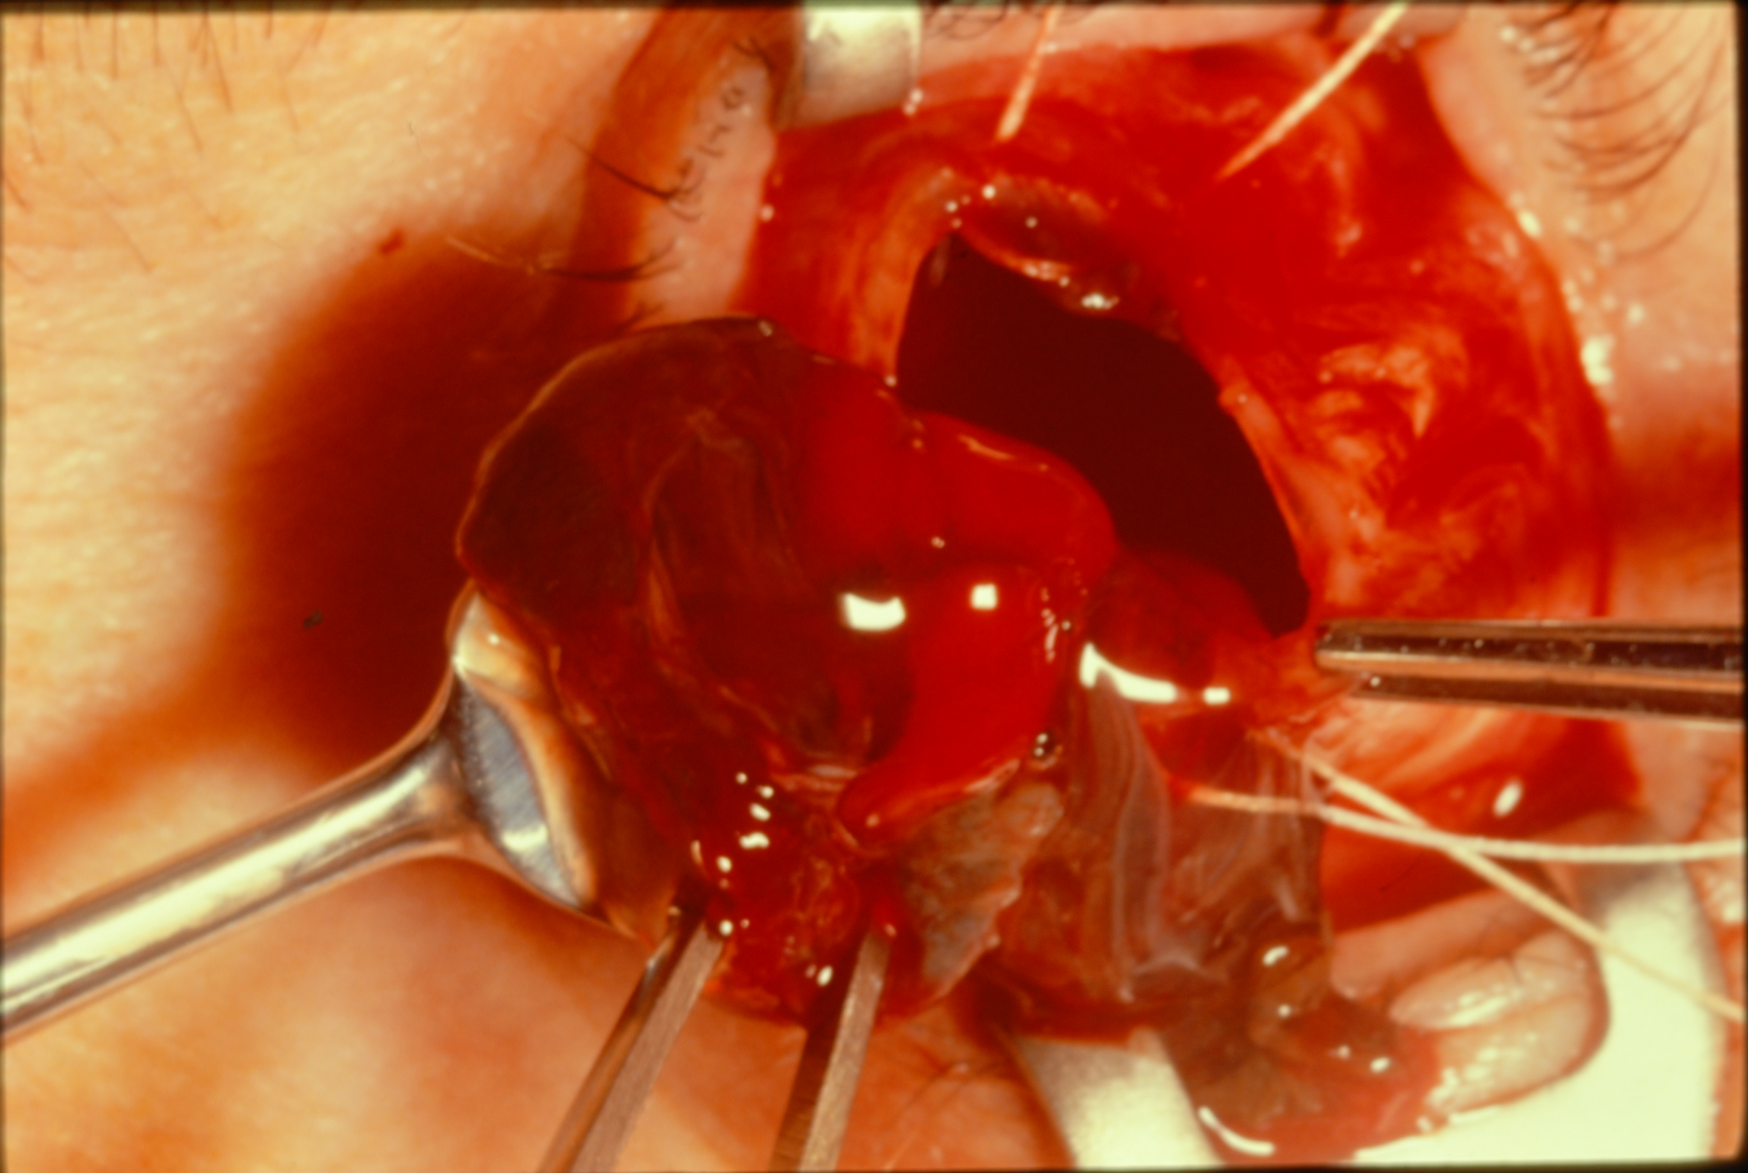
Introduction
Enucleation: removal of entire globe and optic nerve with preservation of periorbital contents
Evisceration: removal of globe contents with preservation of sclera, optic nerve, and extraocular muscles

Slide 3
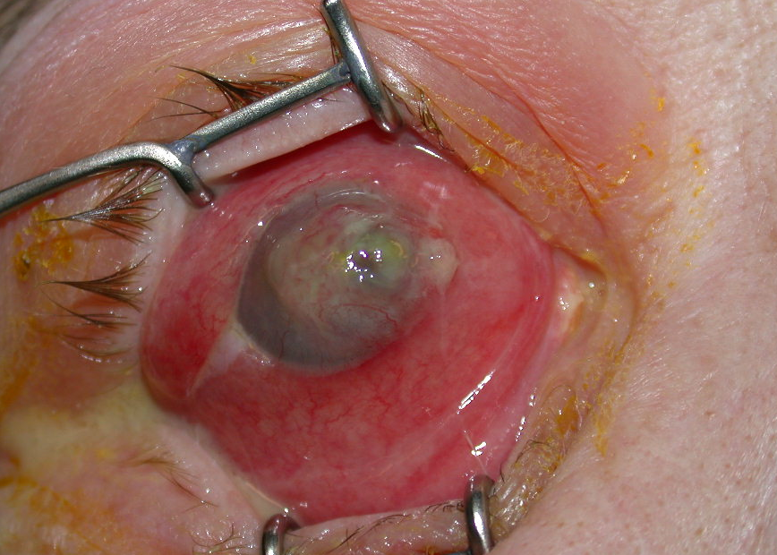
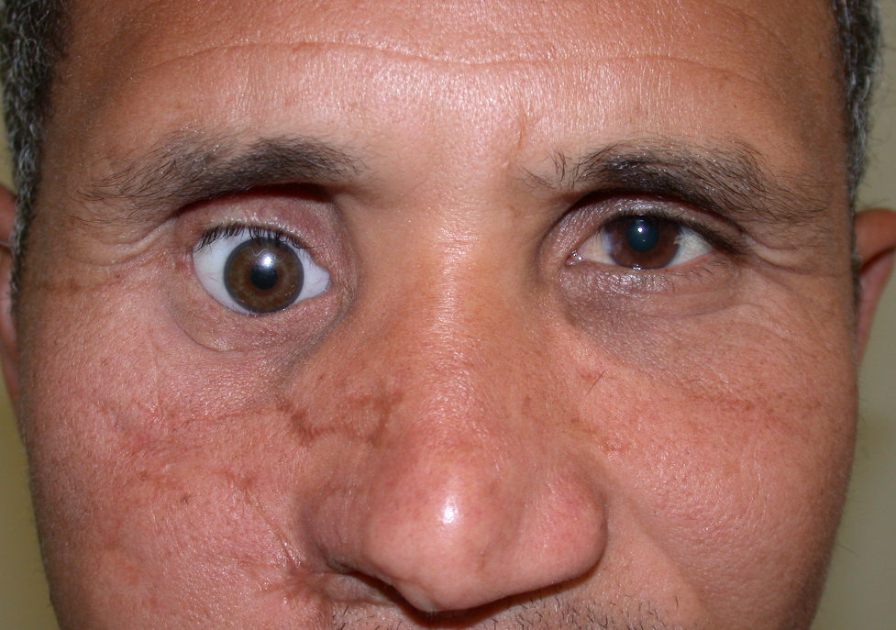
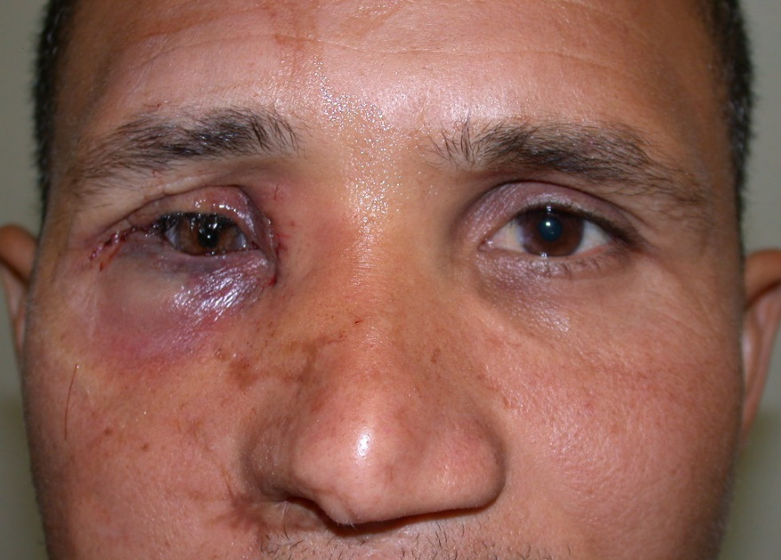
Goals of Enucleation/Evisceration
Restore comfort and cosmesis
Resume social and occupational function

Slide 4
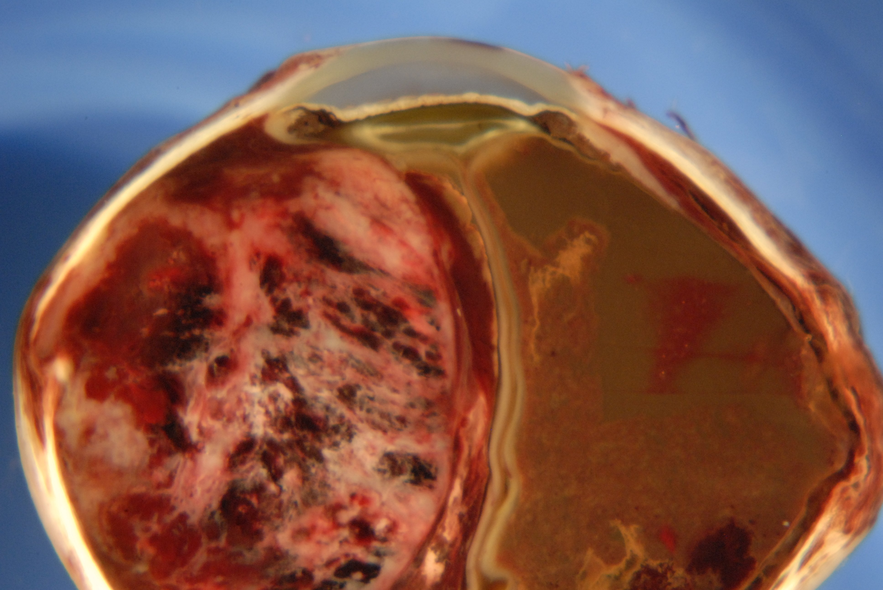
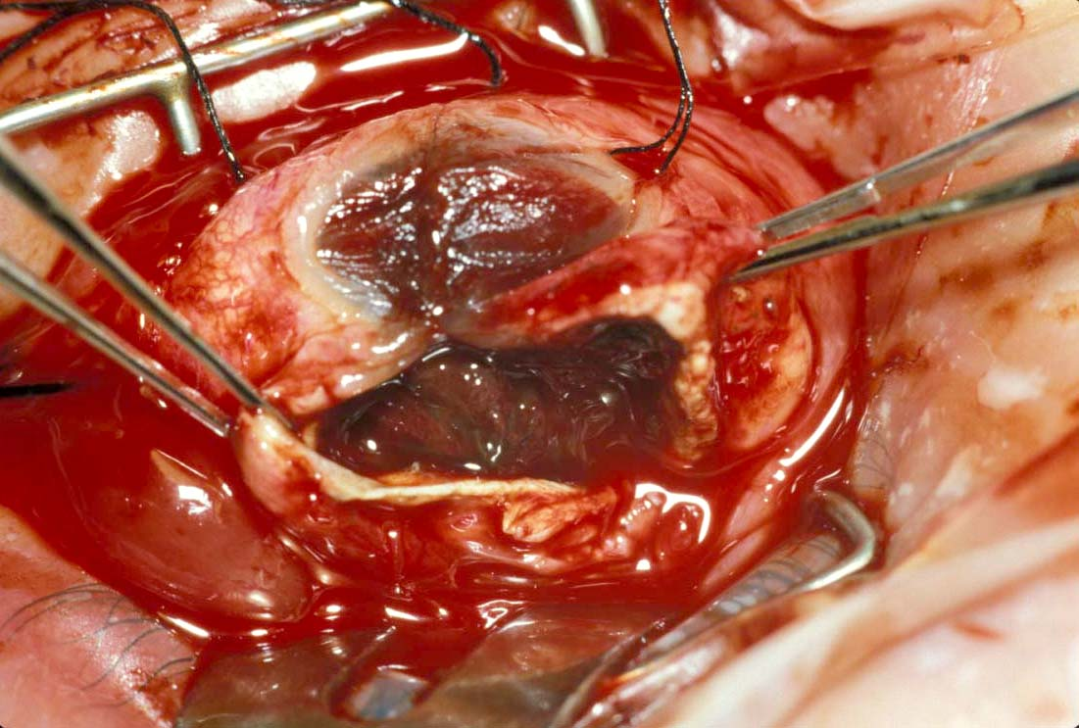
Enucleation: Absolute Indications
Ocular tumors
Ocular trauma beyond repair
Sympathetic Ophthalmia
Blind painful eye of unknown etiology

Slide 5
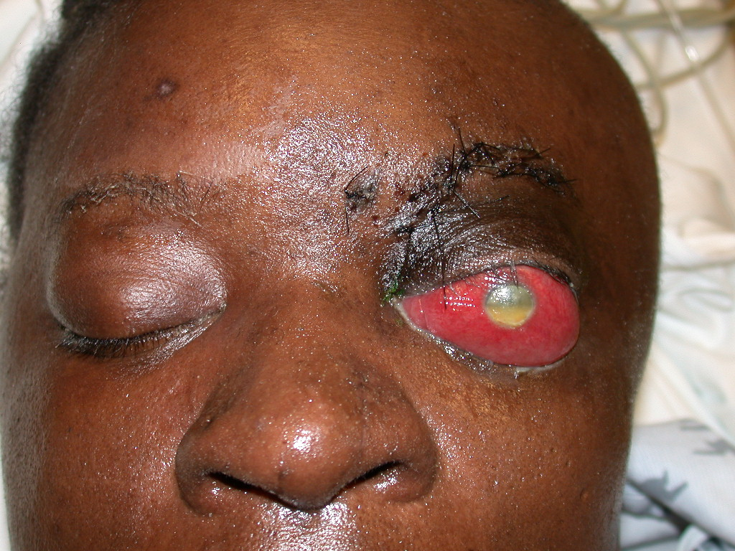
Enucleation: Indications
Endophthalmitis
Blind painful eye of known etiology (e.g. glaucoma)
Phthisis
Congenital cystic eye
Cadaver donation

Slide 6
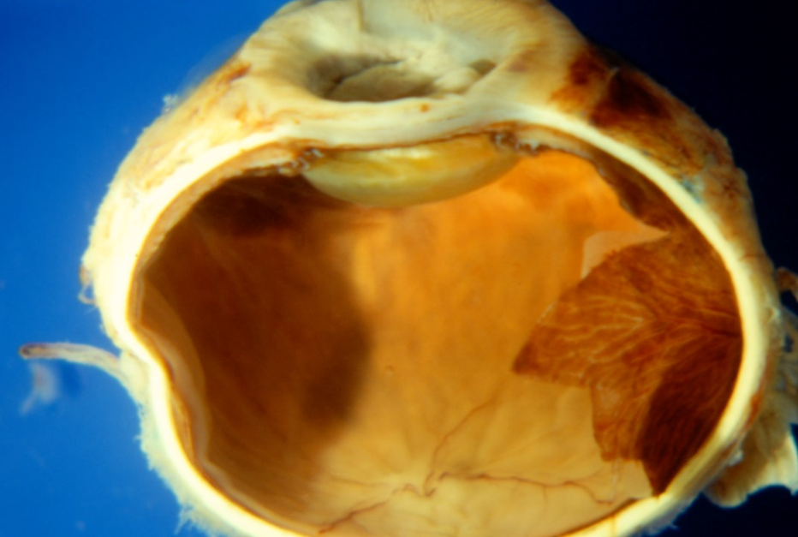
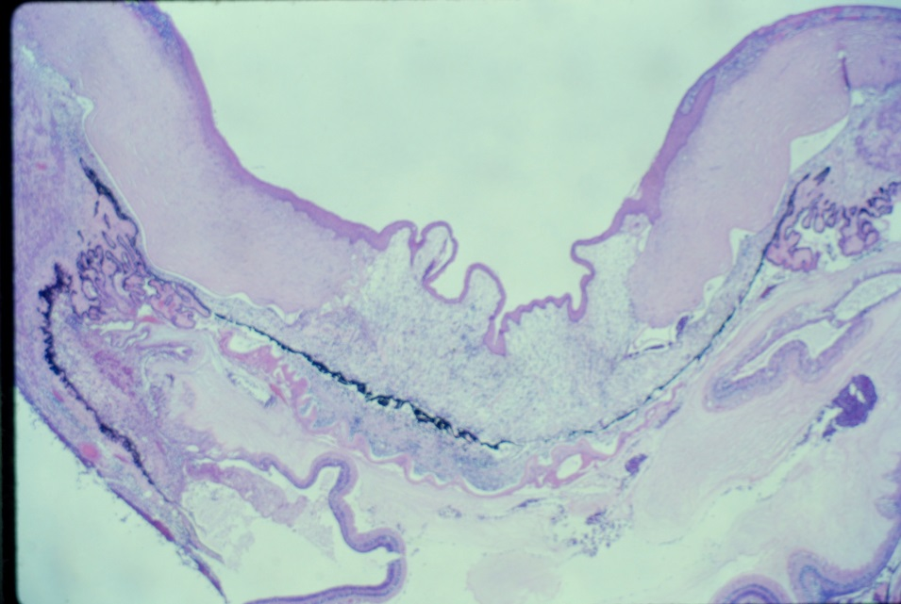
Enucleation: Advantages
Reduced risk of missing occult tumor
Entire globe available for histopathology
Reduced risk of Sympathetic Ophthalmia

Slide 7
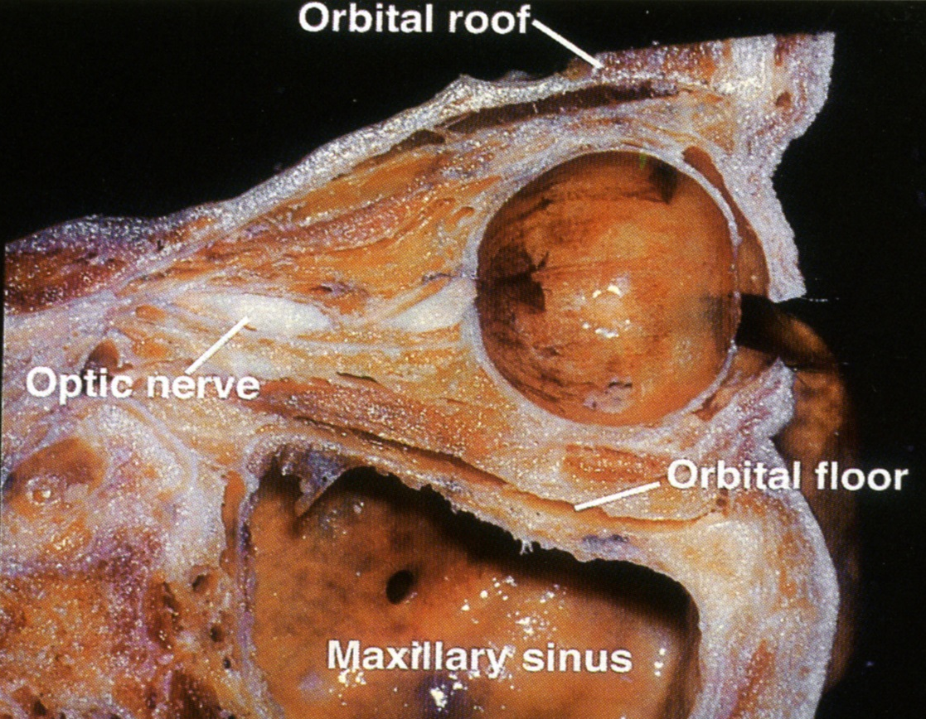
Enucleation: Disadvantages
Changes orbital physiology
Disrupts orbital blood flow
Disturbs orbital fat
Causes orbital volume loss

Slide 8
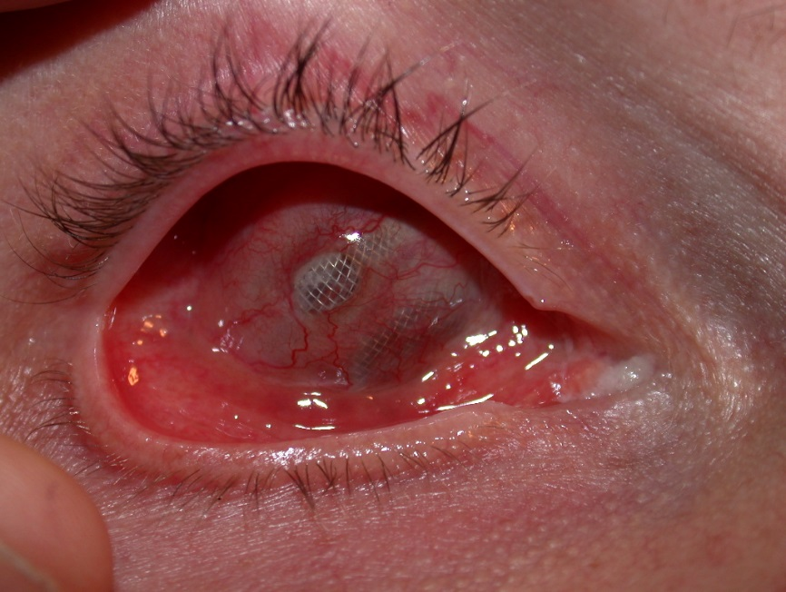
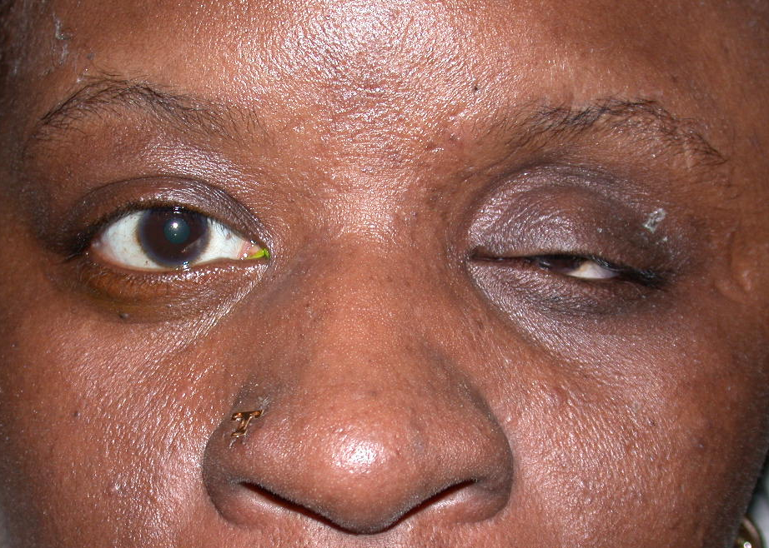
Enucleation: Complications
Hemorrhage
Loss of EOMs
Wound dehiscence
Orbital cellulitis
Implant extrusion
Ptosis, ectropion, entropion
Socket contraction
Orbital volume loss

Slide 9
Evisceration: is sympathetic ophthalmia a concern in the new millennium? Levine MR, Pou CR, Lash RH: The Wendell Hughes Lecture. Ophthal Plastic Reconstr Surg 15(1): 4-8.1999.
Purpose: investigate the relationship between evisceration and sympathetic ophthalmia (SO)
Methods:
Reviewed the data and histologic specimens of 51 patients who underwent evisceration at Mt. Sinai Medical Center and University Hospitals of Cleveland between 1980-1996
Surveyed the American Society of Ophthalmic Plastic and Reconstructive Surgery, the Uveitis Society, and the Eastern Ophthalmic Pathology Society to determine the number of enucleations and eviscerations performed and the incidence of SO after evisceration
Results:
There was no clinical or histopathologic evidence of SO after evisceration
The surveys showed a strong preference for enucleation over evisceration despite no documented evidence of SO after evisceration
Conclusions: Evisceration is a safe and effective procedure with a low risk for SO

Slide 10
Inadvertent evisceration of eyes containing uveal melanoma. Eagle RC, Grossniklaus HE, Syed N, Hogan RN, Lloyd WC, Folberg R. Arch Ophthalmol. 2009 Feb;127(2):141-5.
Objectives: To report an important complication of ocular evisceration therapy for blind, painful eyes and to stress the need for careful preoperative evaluation to exclude occult neoplasms prior to therapy.
Design: Multicenter, retrospective, nonrandomized clinicopathological case series of patients found to have previously unsuspected uveal malignant melanoma during histopathological examination of blind, painful eyes treated by evisceration.
Results: Histopathological examination of evisceration specimens disclosed previously unsuspected uveal melanoma in 7 patients who were treated for blind, painful eyes. Inflammation caused by necrosis of the tumor and other ocular tissues led to misdiagnosis as endophthalmitis, orbital cellulitis, or idiopathic orbital inflammation in several cases. Preoperative imaging was not performed in 3 cases and failed to detect tumors in 4 cases. Failure of necrotic tumors to enhance contributed to misdiagnosis.
Conclusions: The presence of a malignant intraocular neoplasm should be excluded prior to evisceration of any blind eye or blind, painful eye, particularly with opaque media. Necrosis-related inflammation can confound the clinical diagnosis of occult lesions, as can failure of necrotic tumors to enhance on imaging.

Slide 11
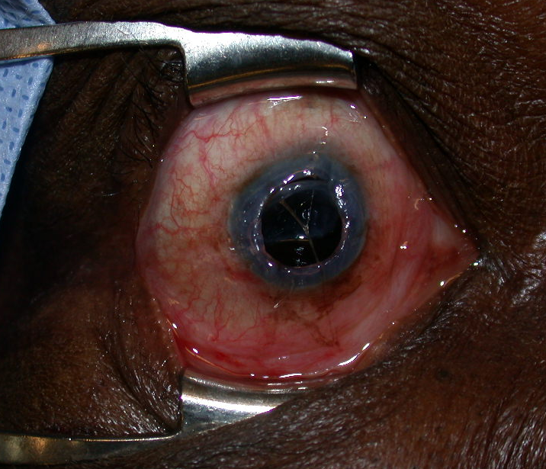
Evisceration: Indications
Endophthalmitis
End-stage glaucoma
Poor surgical candidate
Expulsive choroidal hemorrhage

Slide 12
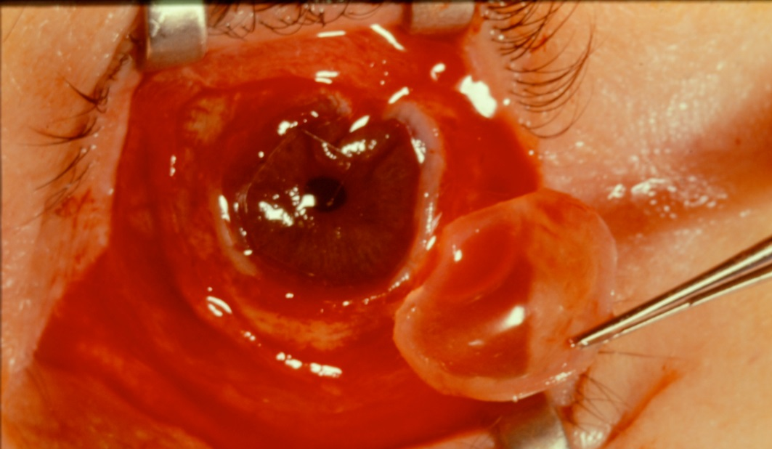
Evisceration: Advantages
Orbital structures left intact
Technically less involved
Shorter surgery time
Minimal chance of spreading infection
Less painful
Better motility

Slide 13
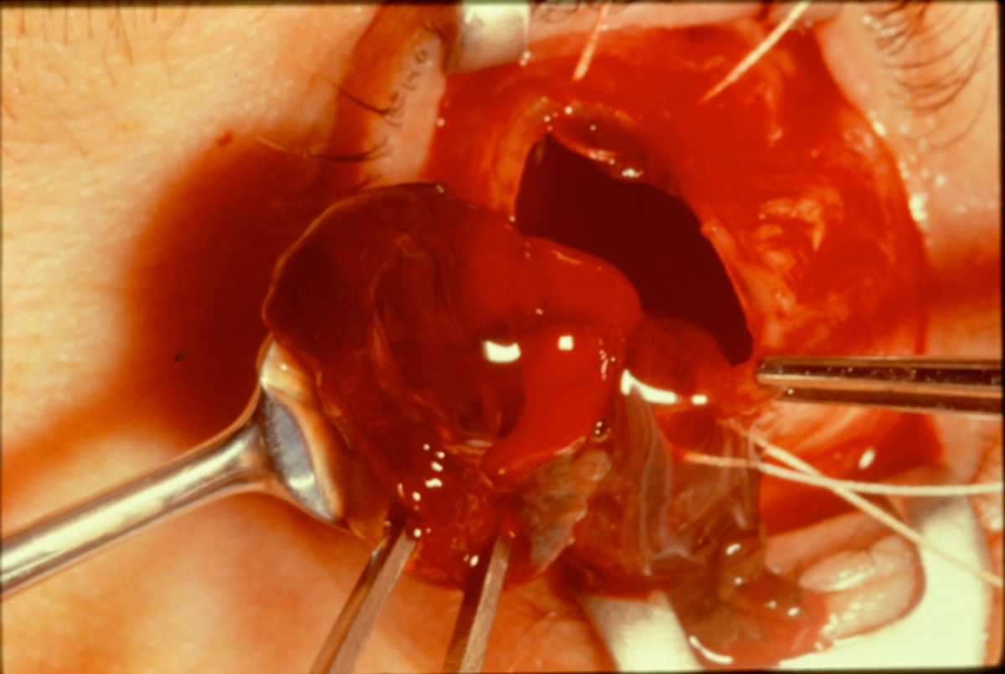
Evisceration: Disadvantages
May miss occult tumor
Sympathetic Ophthalmia

Slide 14
Evisceration: Complications
Orbital edema
Retrobulbar hemorrhage
Implant extrusion
Dissemination of unexpected intraocular neoplasm

Slide 15
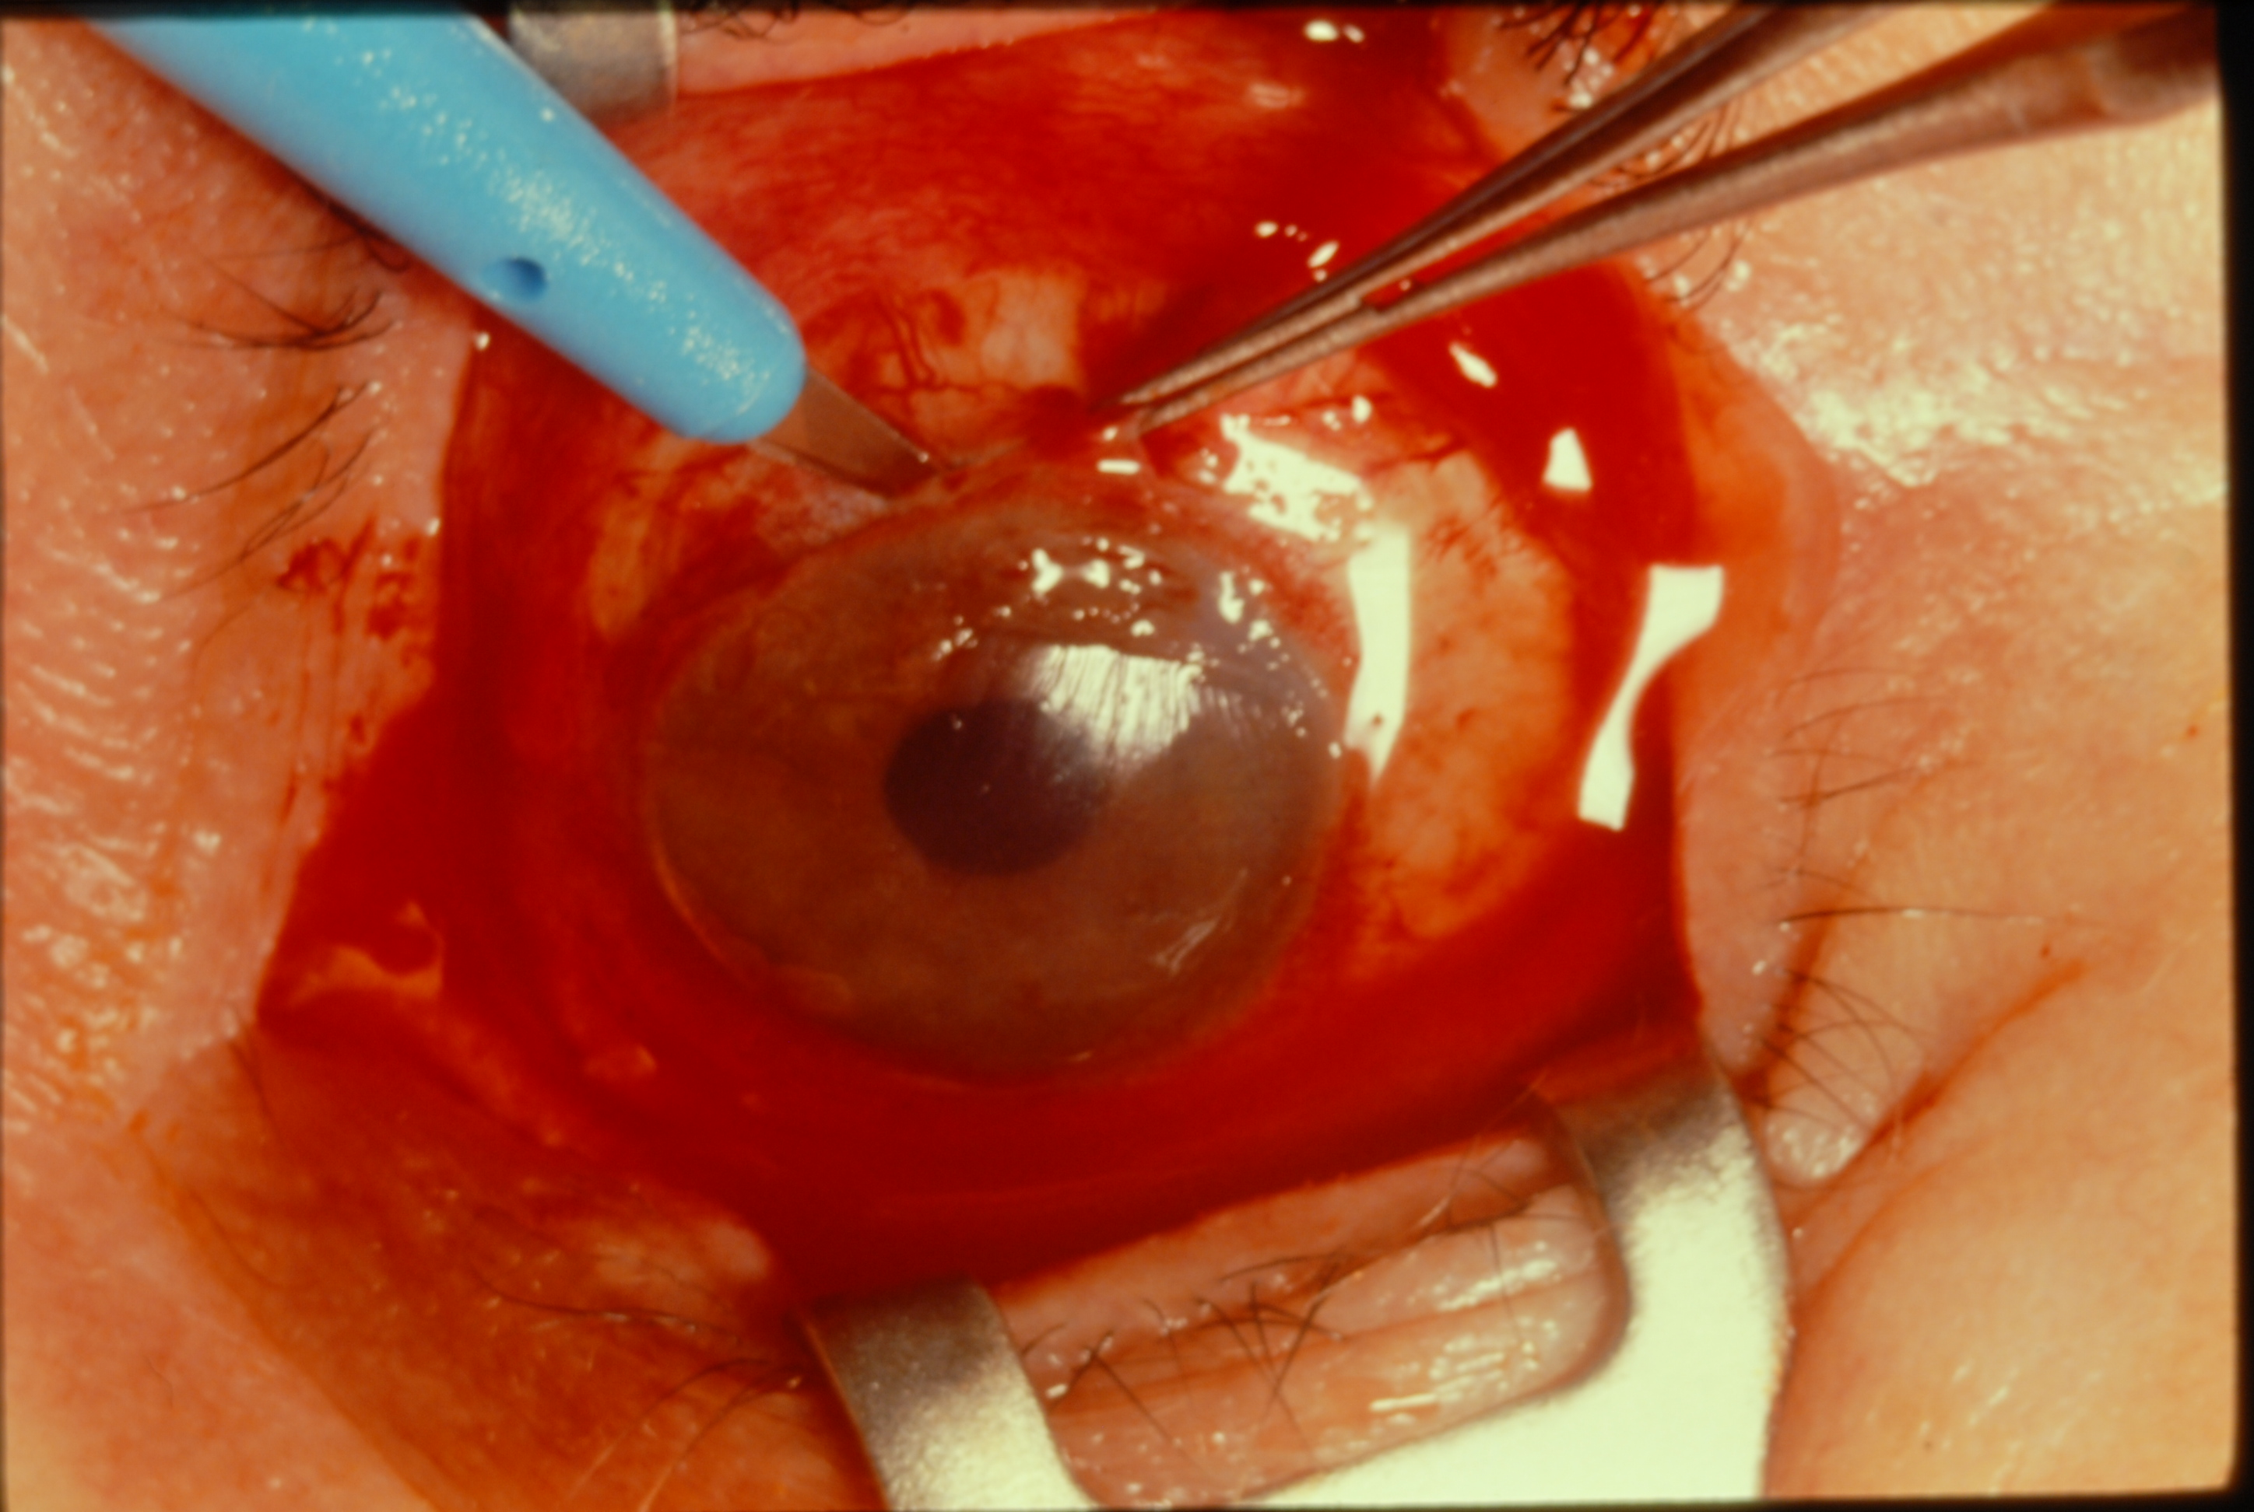
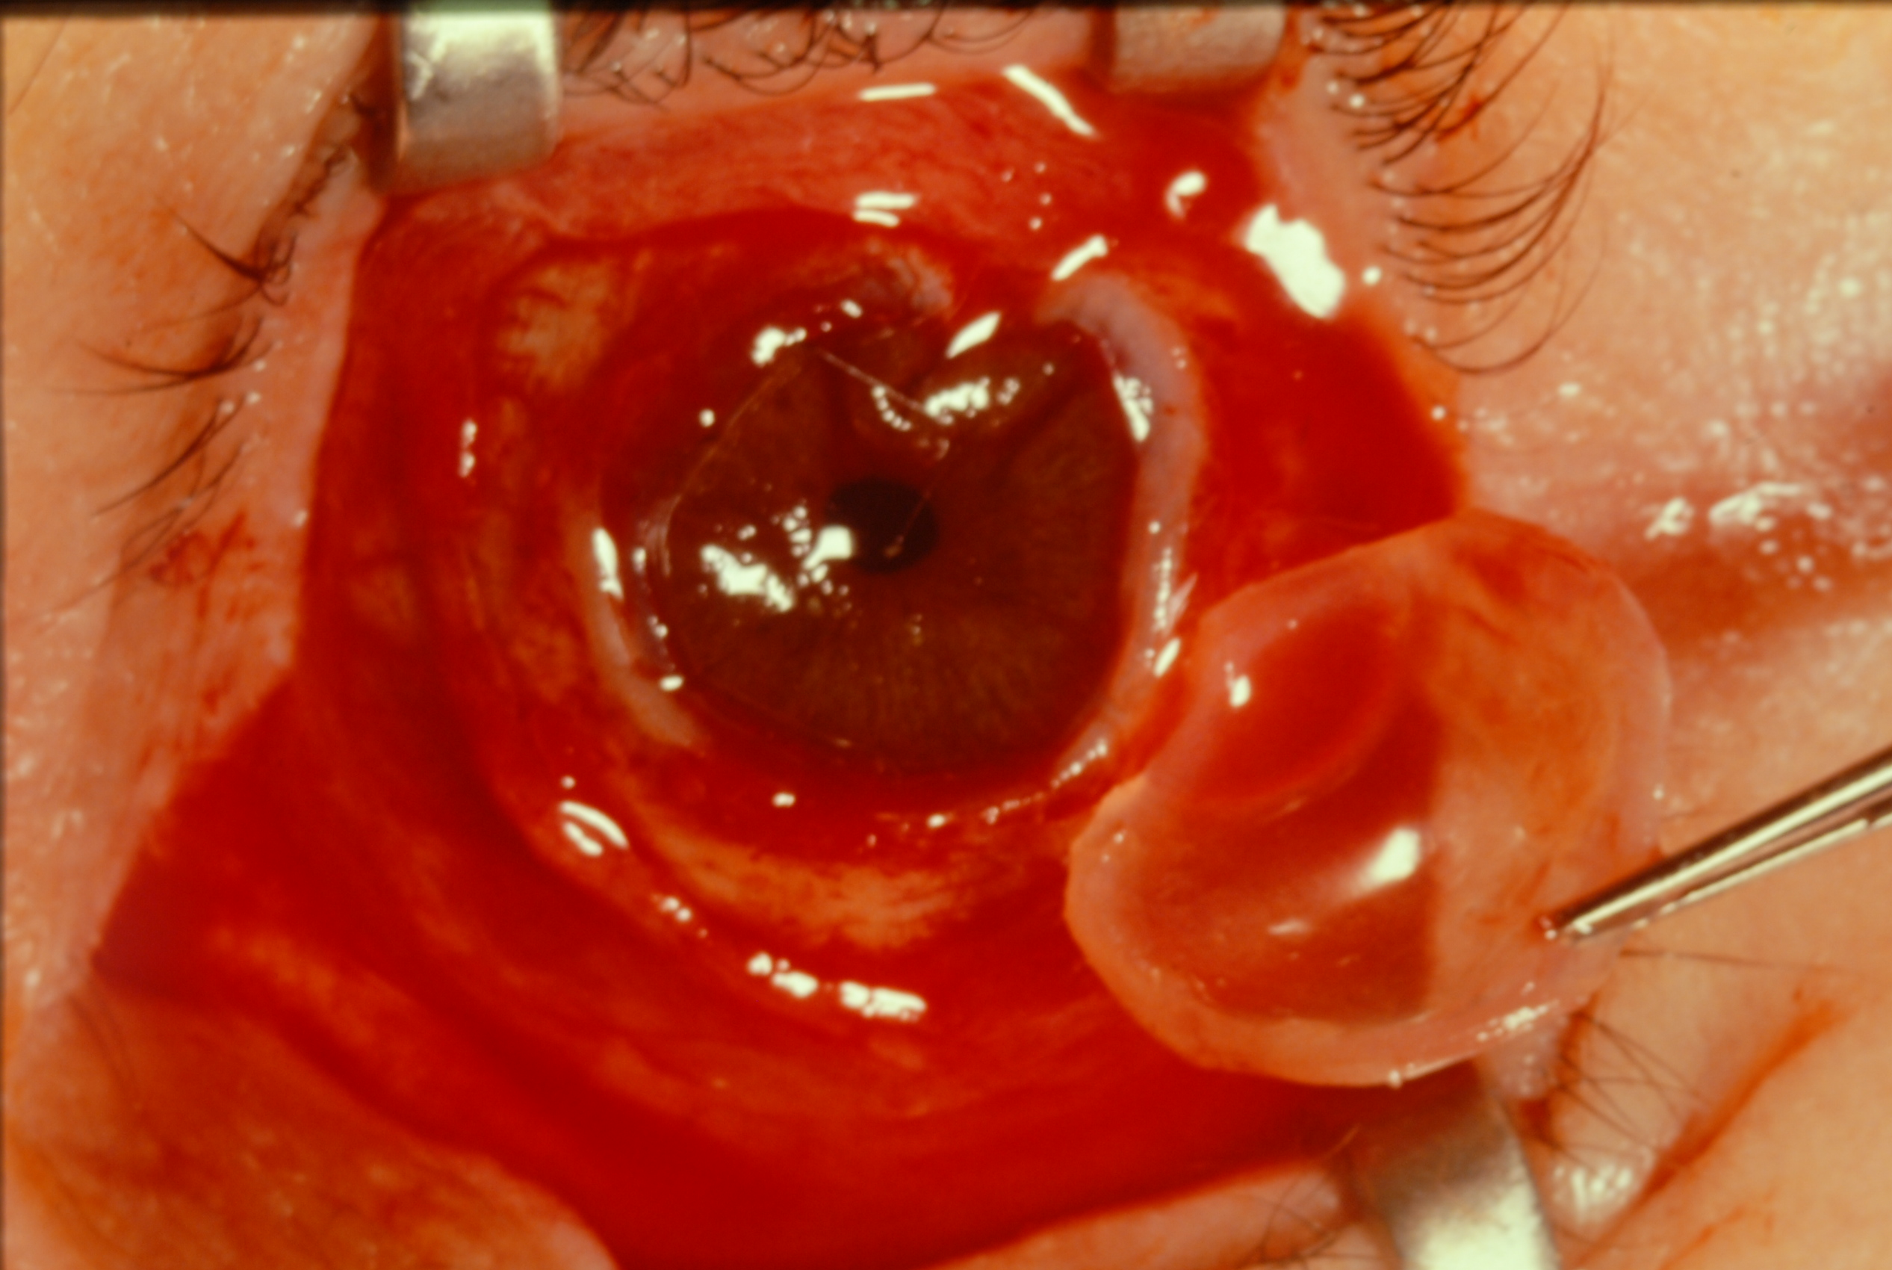
Evisceration: Technique
Peri-bulbar block, prep and drape, then lid speculum
360-degree limbal peritomy
Insert Supersharp blade at limbus, parallel to iris plane
Extend corneoscleral incision 360-degrees
Remove entire cornea

Slide 16
Evisceration: Technique
Lyse attachments of uvea to sclera using an iris spatula
Remove vitreous and uvea using an evisceration spoon
Remove remaining uvea using gauze or cotton-tip applicator (optional: soaked in hydrogen peroxide or similar)

Slide 17
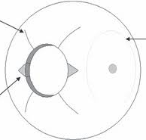
Evisceration: Technique
Remove triangles of sclera at 3:00 and 9:00

Slide 18
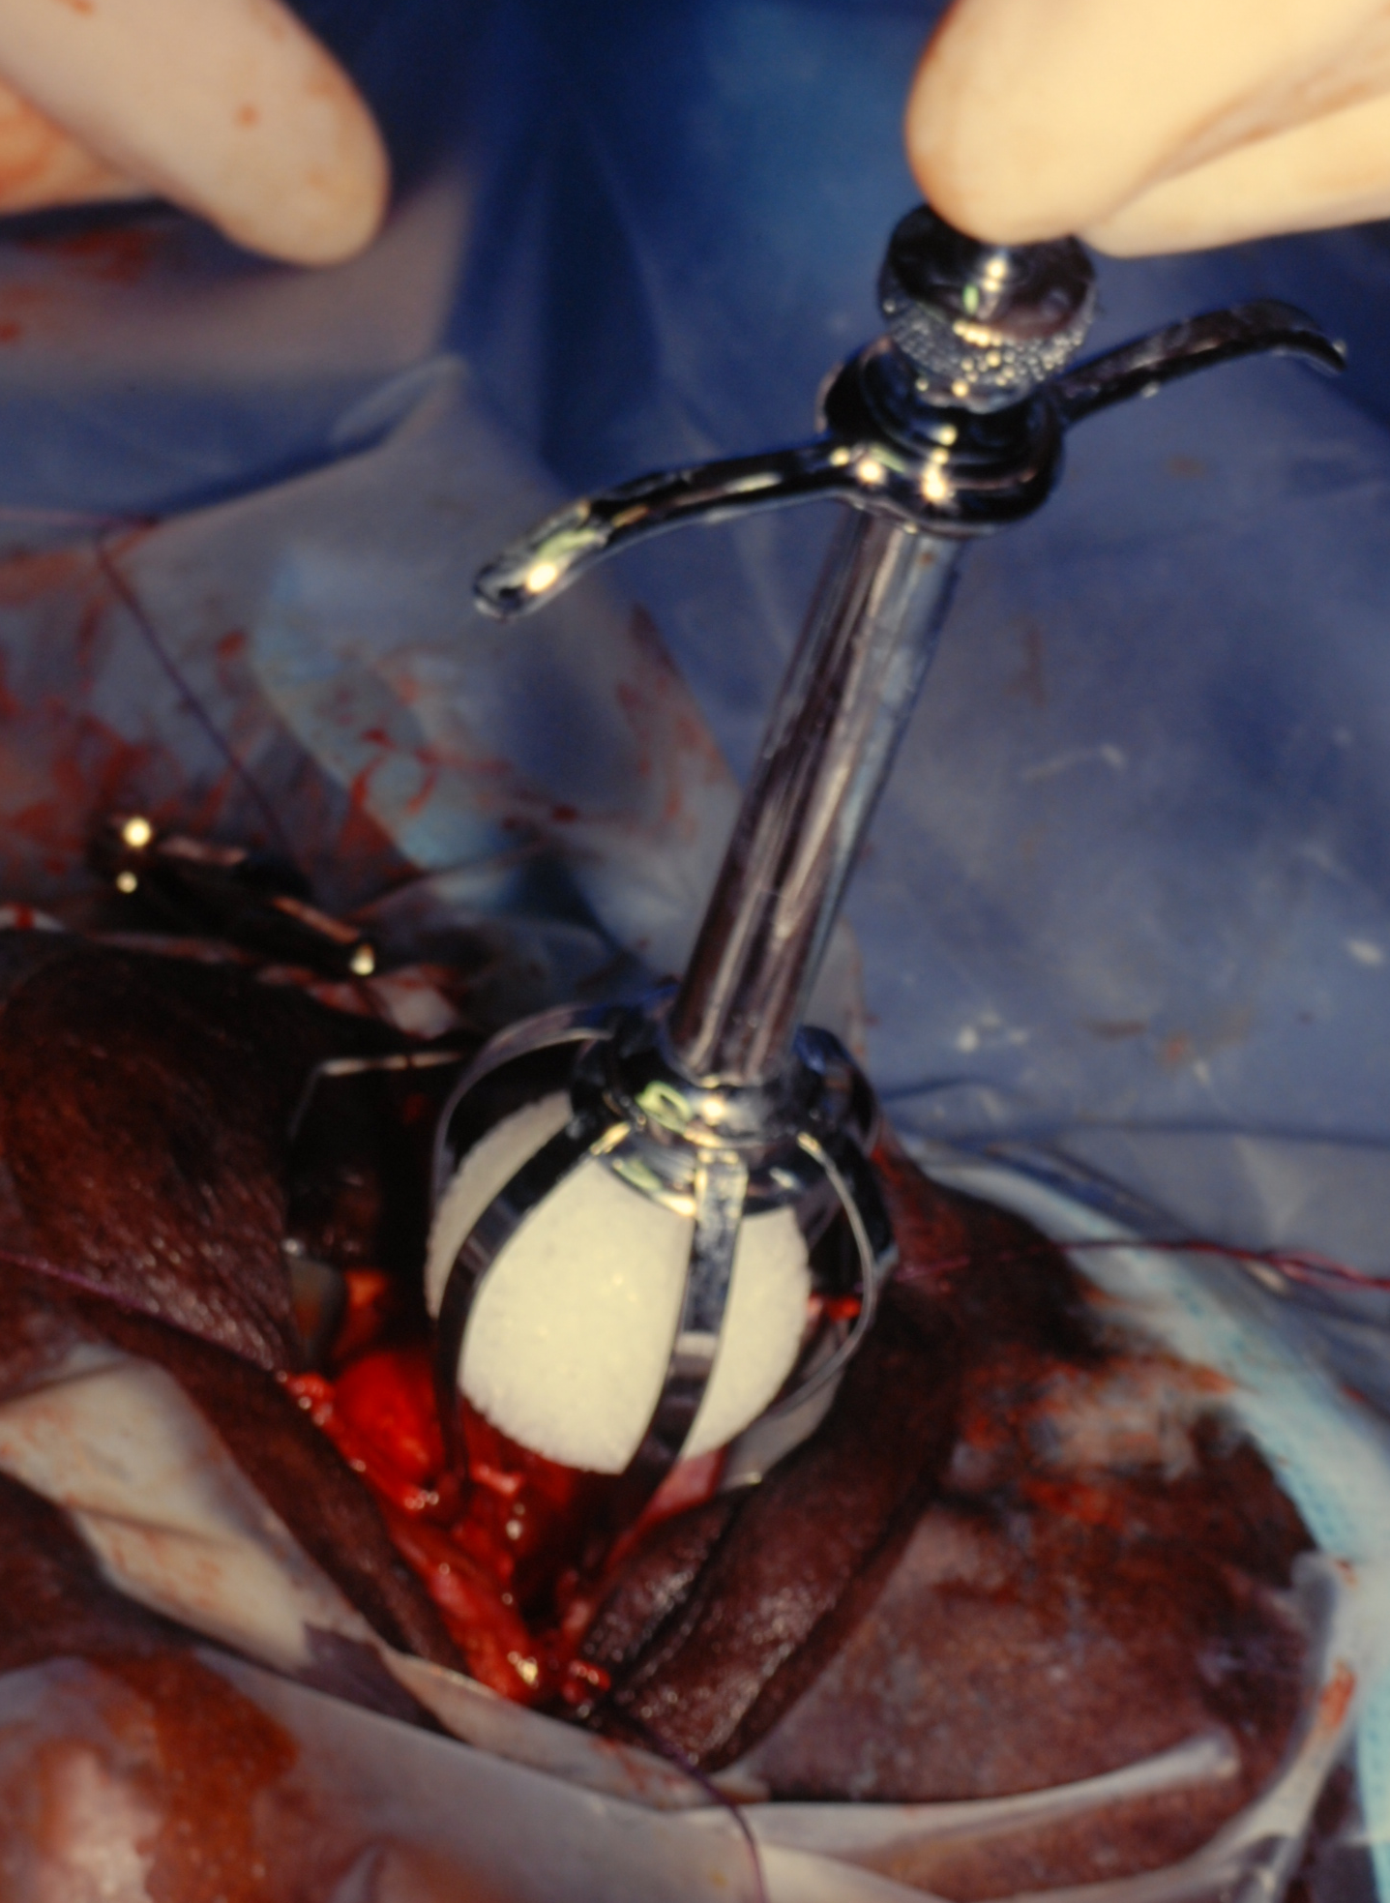
Evisceration: Technique
Insert implant

Slide 19
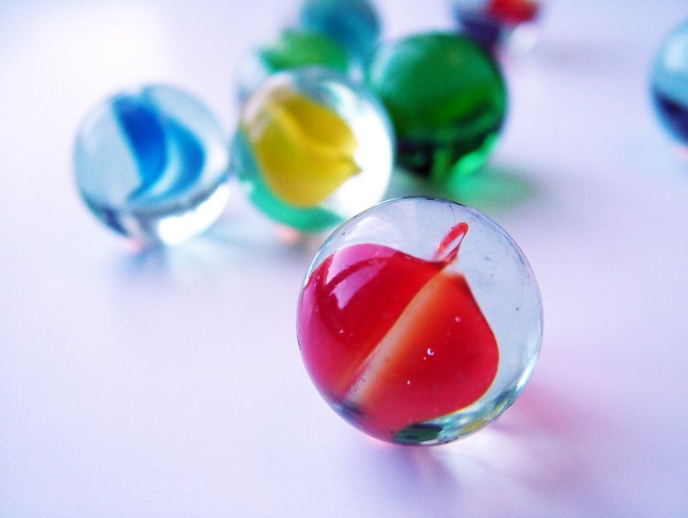
Implants: Non-Integrated
For both enucleations and eviscerations
Acrylic $39
Silicone
PMMA
Glass Marbles $0.25

Slide 20
Implants: Semi-Integrated
For enucleations
Allen
Iowa
Universal

Slide 21
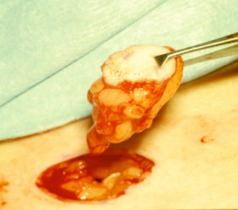
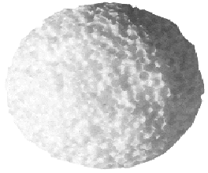
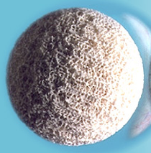
Implants: Integrated
For enucleations for enhanced movement
Autologous dermis-fat graft
Hydroxyapatite (HA, Bio-Eye) $650
Porous Polyethylene (MEDPOR) $450
Bioceramic (synthetic HA)

Slide 22
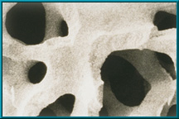
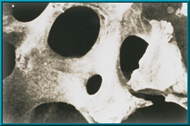
Implants: Integrated
Scanning electron microscope images
coralline hydroxyapatite
human cancellous bone
polyethylene

Slide 23
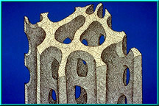
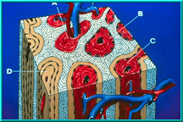
Implants: Integrated
Before blood vessel ingrowth
After blood vessel ingrowth

Slide 24
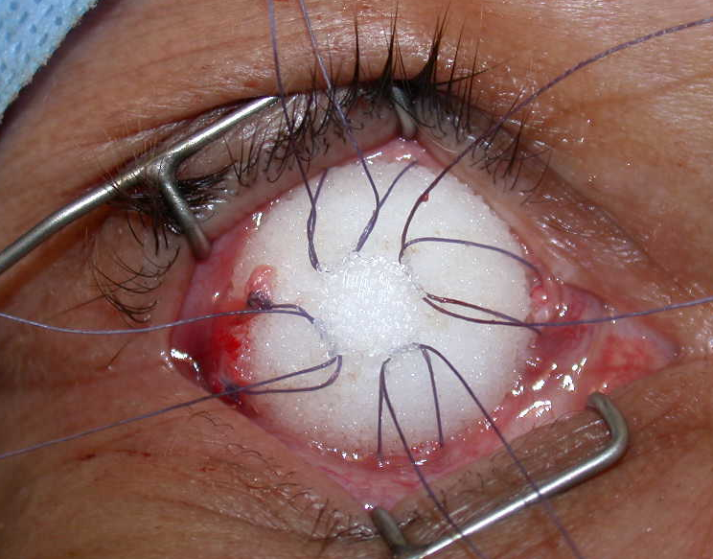
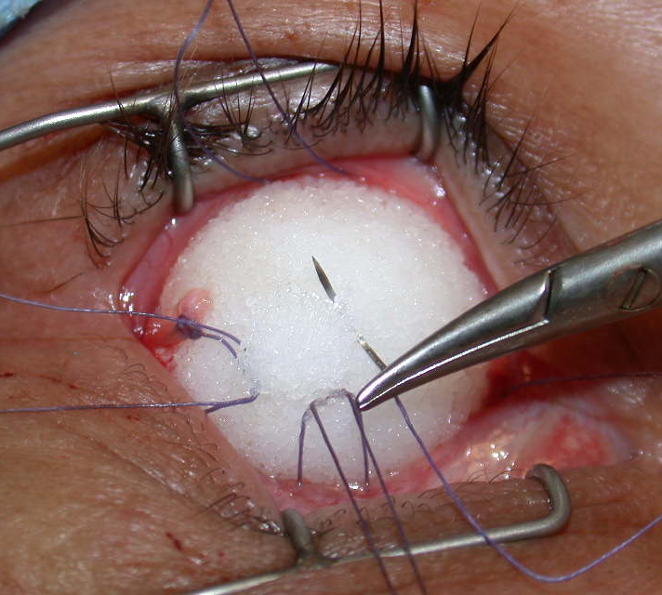
Implants: Integrated

Slide 25
Evisceration: Technique
Close scleral triangles with 5-0 Chromic or Vicryl
Close sclera with 5-0 Chromic or Vicryl
Close Tenon’s with interrupted 5-0 Chromic
Close conj with locked running 6-0 plain gut
16 mm acrylic implant

Slide 26
Evisceration: Technique
Place conformer

Slide 27
Summary
Enucleation: removal of entire globe and optic nerve with preservation of periorbital contents
Indication
Advantages, Disadvantages, Complications
Evisceration: removal of globe contents with preservation of sclera, optic nerve, and extraocular muscles
Indication
Advantages, Disadvantages, Complications

